Slide 1
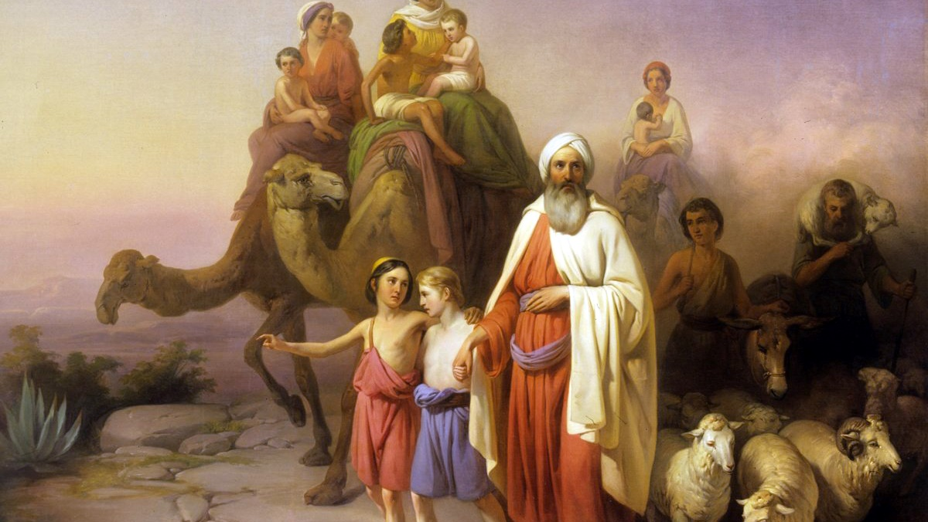
^{Families Forming Disciples}
GOD’S COVENANT WITH ABRAHAM

Slide 2
^{Opening Prayer}
Lord Jesus,
May Your light shine on our way, as once it guided the steps of the Magi: that we too may be led into Your presence and worship You, the Child of Mary, the Word of the Father, the King of nations, the Savior of mankind; to whom be glory forever.
Amen.
Adapted from a prayer by Frank Colquhoun

Slide 3
^{Ice Breaker}
A Great Wind Blows

Slide 4
Let’s dance!
Father Abraham Had Many Sons
https://youtu.be/DPKp4AWmQoI

Slide 5
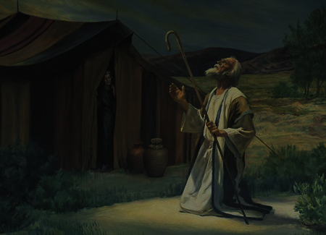
Question
If God asked you to leave everything, trust in Him and go to a foreign land, what would you do?

Slide 6
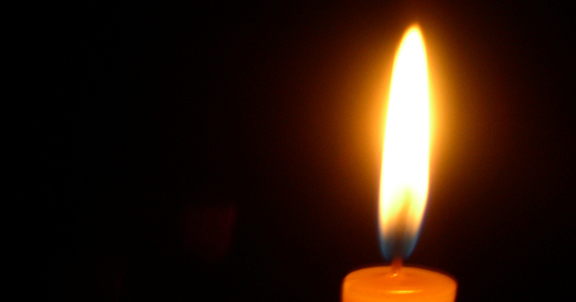
God’s Covenant with Abraham and his descendants
What does it mean for us?
How does God answer our prayers?
How does God invites us to be part of his family?

Slide 7
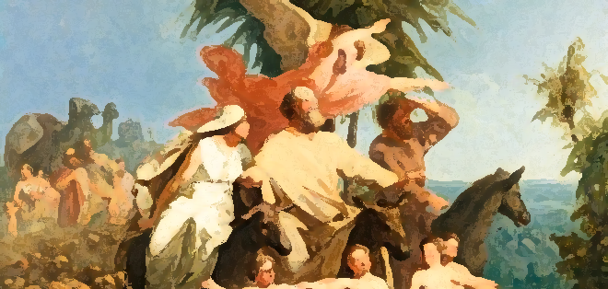
Let’s read the Bible
Let’s read the Bible!
Genesis 12

Slide 8
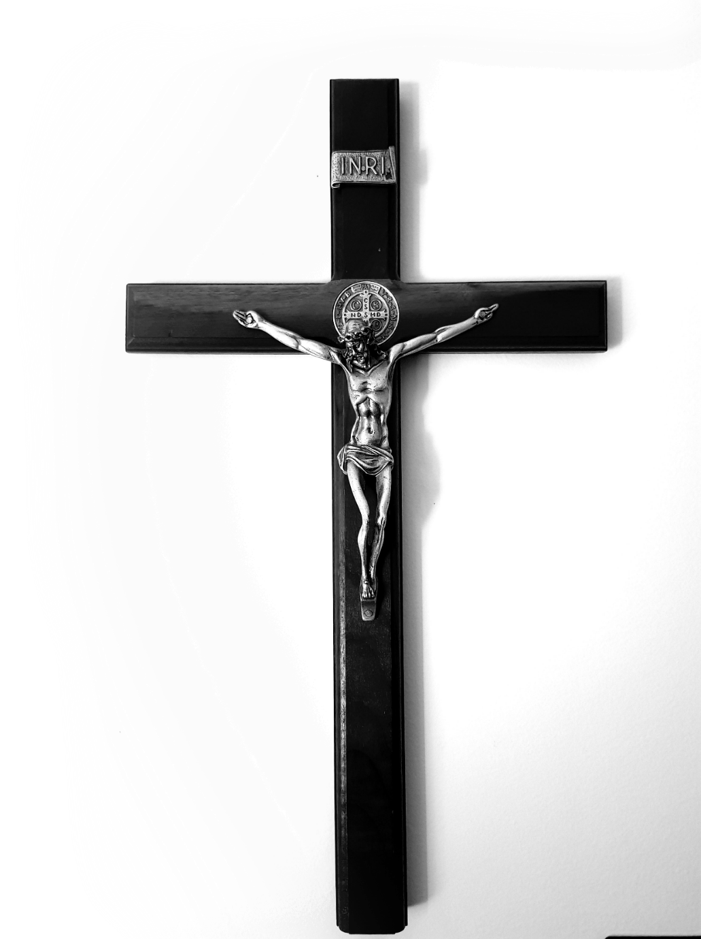
Family Conversation
Has God ever asked you to do something difficult?
What was it?
How did you feel about it?
How did it turn out?
Is there something special for which you are praying?

Slide 9
Let’s read the Bible
Genesis 15

Slide 10
Child of Promise
“Isaac: Child of Promise”
https://youtu.be/PjXpgYq_NiQ

Slide 11
FAMILY ACTIVITY

Slide 12
FAMILY MISSION
1
2
3
1. Introduce Mission Activities
^{2. Explain Activity}
Read the story of the Visit of the Magi Matthew 2:1-12.
Or watch a short video about the Visit of the Magi to the Christ Child. Since we are gathering after the Solemnity of the Epiphany, we will be revisiting what was celebrated!
As a family, you will mark the mantle of your front door (with blessed chalk if possible) and pray the Family Epiphany Blessing. It is very simple to do, and the explanation and the prayer can be found on your Week 2 Handout.
Lastly, you will be encouraged to bless yourselves with holy water in your homes, as a reminder of your baptisms and of Jesus’ baptism in the Jordan, which began His public ministry.
^{3. Family Sharing}
Be prepared to share during week 3 a picture of your door.

Slide 13
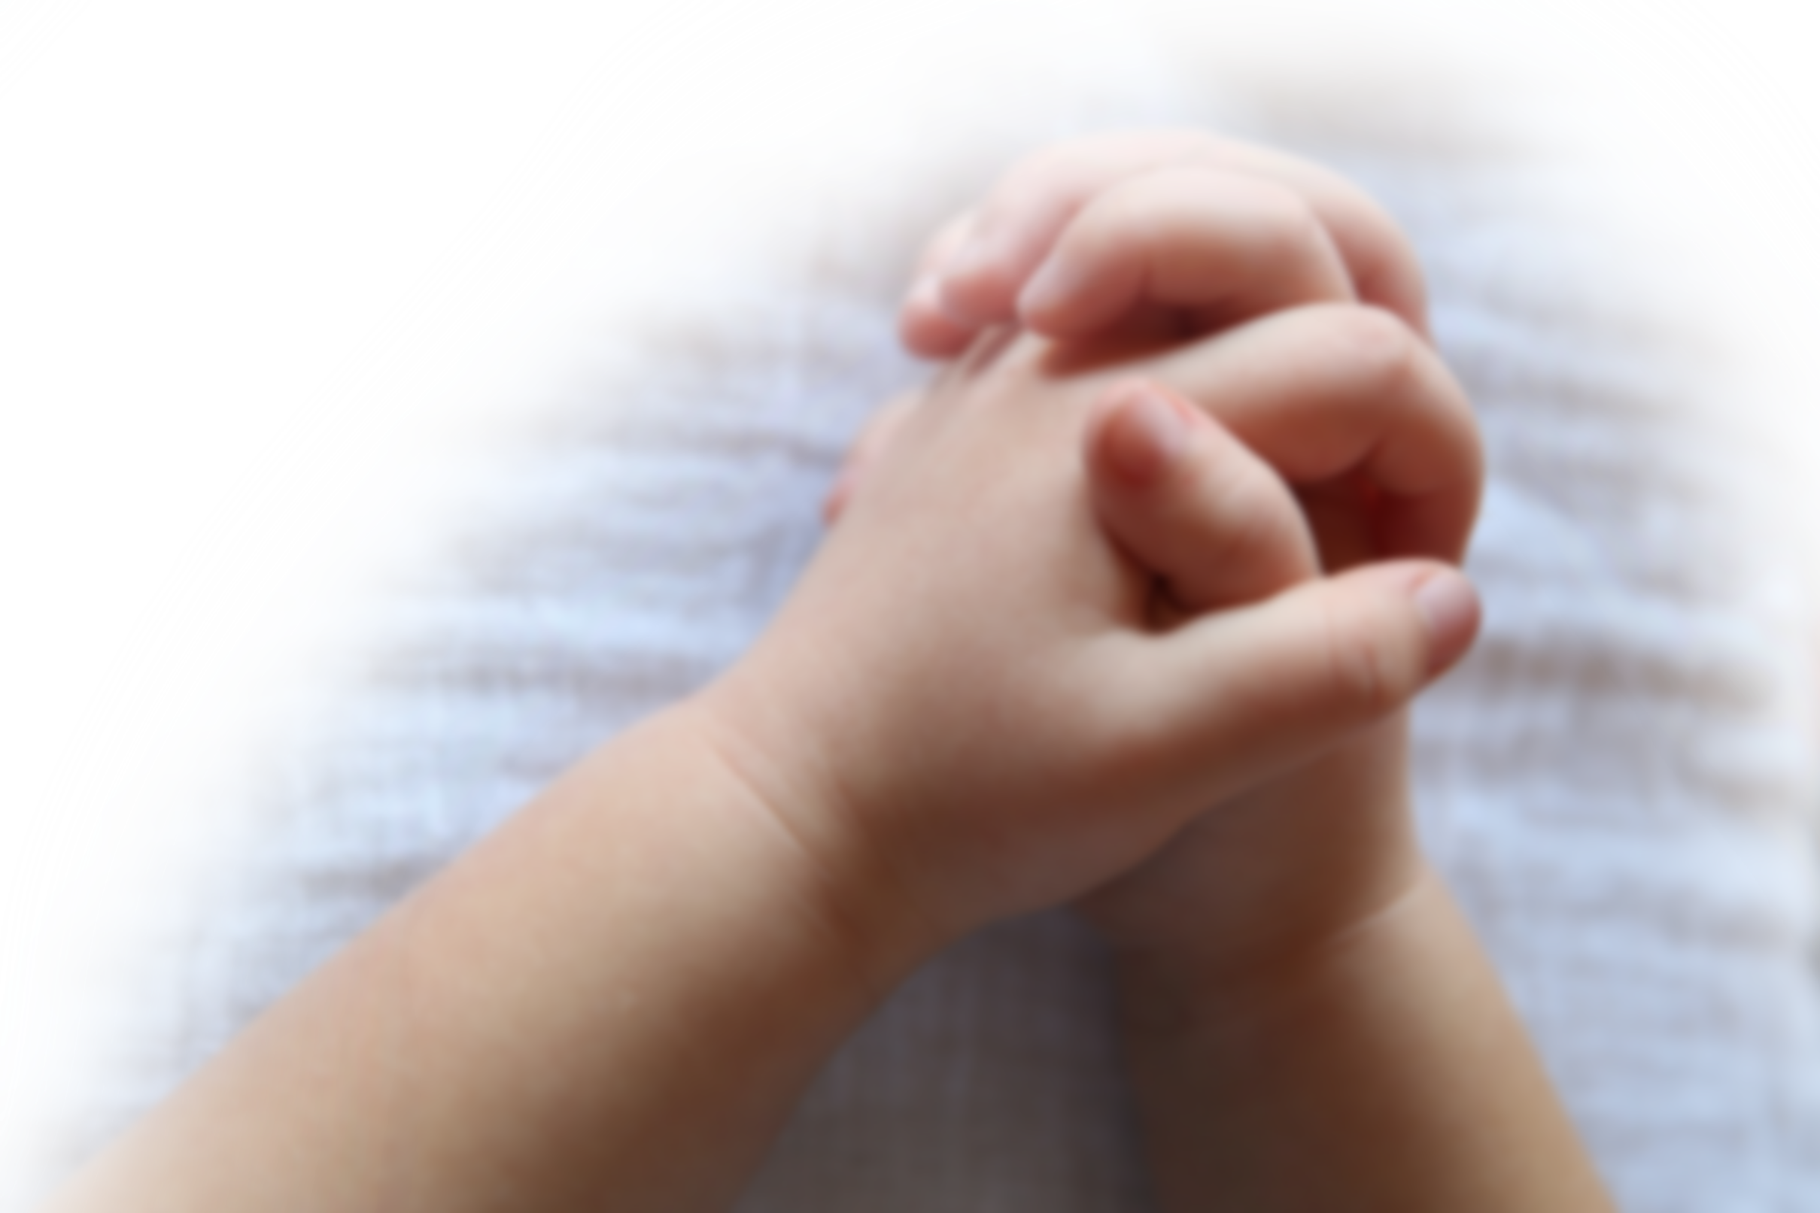
Closing Prayer
Lord Jesus Christ,
We entrust our family to You and ask for Your blessing and protection. We love You Lord Jesus with all our hearts and we ask that You help our family become more like the Holy Family. Help us to be kind, loving, and patient with one another. Give us all the grace we need to become saints and Your faithful disciples.
Amen.

