Slide 1
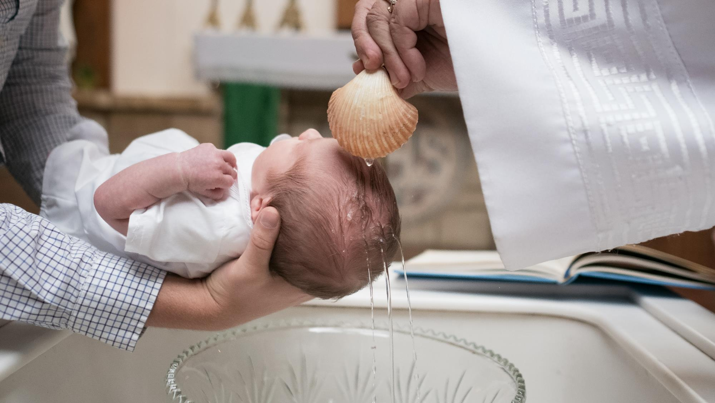
GOD’S SAVING LOVE FOR US:
LITURGY AND THE SEVEN SACRAMENTS
SACRAMENTS OF CHRISTIAN INITIATION: BAPTISM

Slide 2
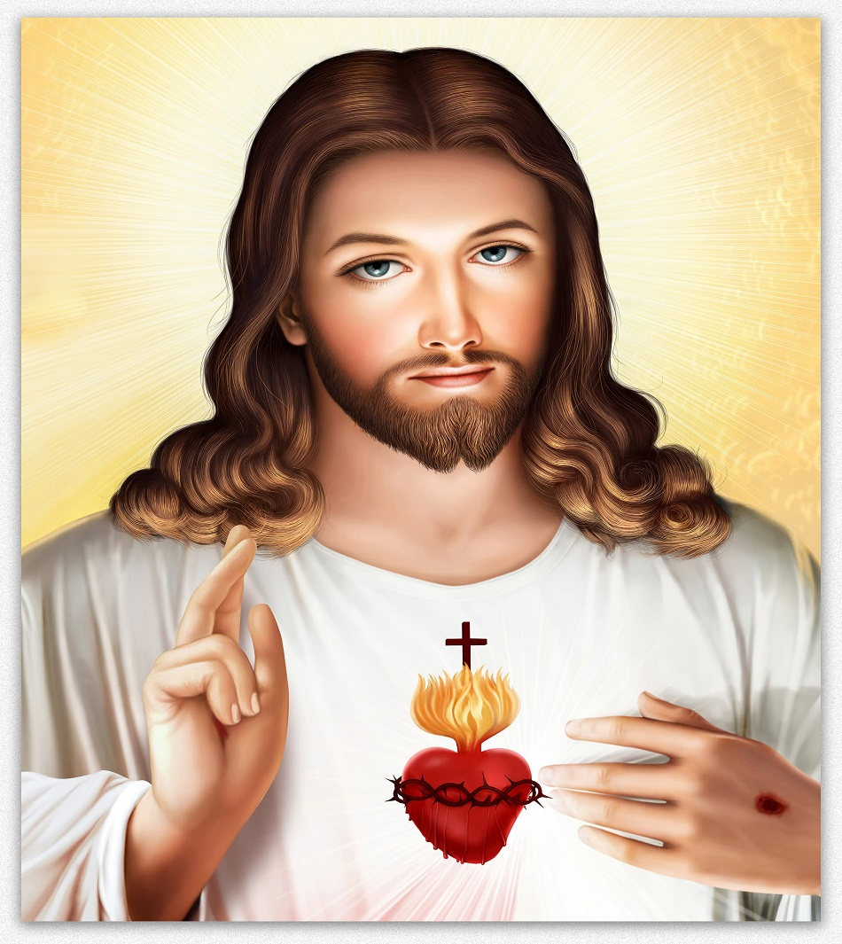
^{Opening Prayer}
Lord Jesus Christ, we entrust our family to You and ask for Your blessing and protection.
We love You Lord Jesus with all our hearts, and we ask that You help our family to become more like the Holy Family.
Help us to be kind, loving, and patient with one another.
Give us all the grace we need to become saints and Your faithful disciples. Amen.

Slide 3
Silent Communication
For Round One, family members are secretly given a number and arrange themselves, WITHOUT SPEAKING or USING THEIR FINGERS to indicate the number, in numerical order by making up their own sign language.
For Round Two, families arrange themselves in order of the calendar month of their birthdays. The family that arranges themselves the fastest wins!
(Larger families may need to break into two groups.)
(adapted from www.signupgenius.com)

Slide 4
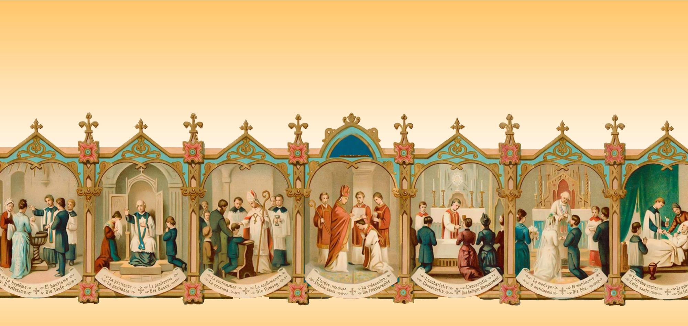
Why do we need sacraments?

Slide 5
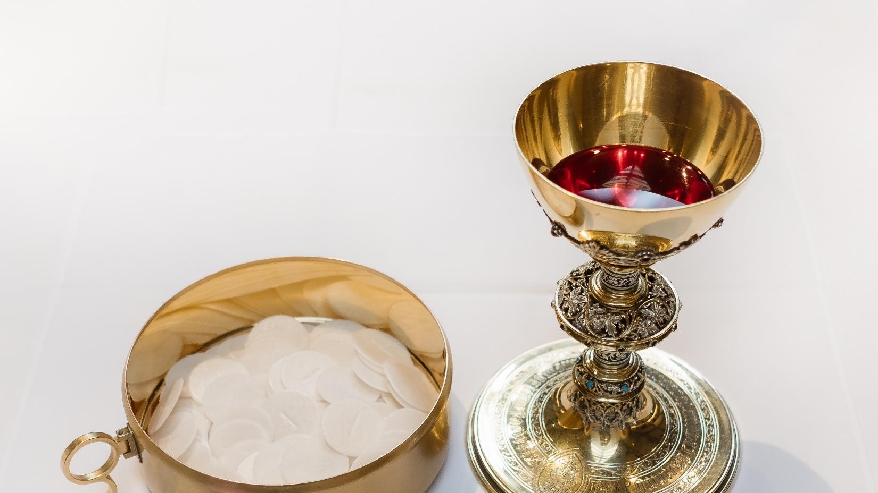
Sacraments give us grace, which is God’s life!
Grace gives us the power to love like God loves!

Slide 6
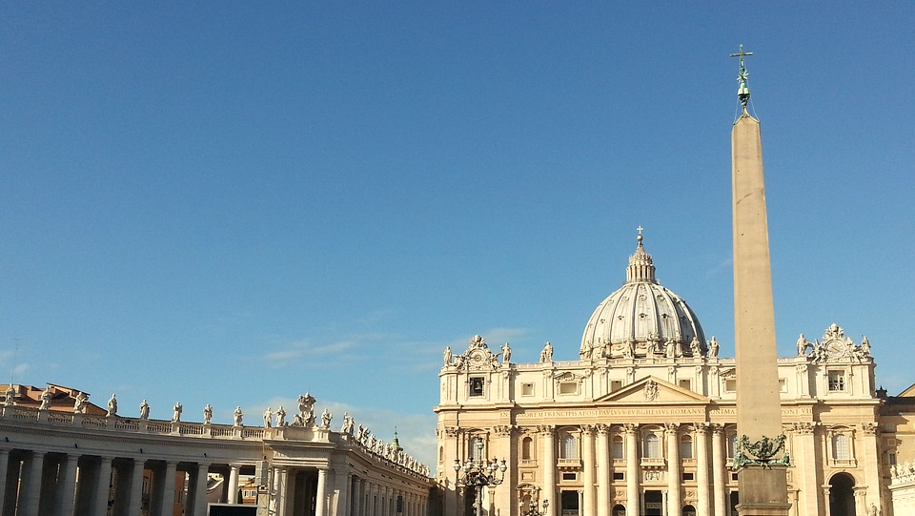
A sacrament is an outward sign instituted by Christ to give grace,
to help us grow in holiness.
They are more than mere signs, however, for through the sacraments the Lord gives His grace—His divine life—to us.
Sacraments are “efficacious signs”, which means signs that give grace.

Slide 7
WATCH
God’s Grace - Fun and Simple Explanation! TheoMatters
https://www.youtube.com/watch?v=9PW3gaImhbg
Bite Size Catholic: What is Grace?
https://www.youtube.com/watch?v=noVGT6MdN7k

Slide 8
But why do we need grace?
The Gospel Project for Kids: Sin Entered the World
^{https://youtu.be/D7LZnMHYrmY}

Slide 9
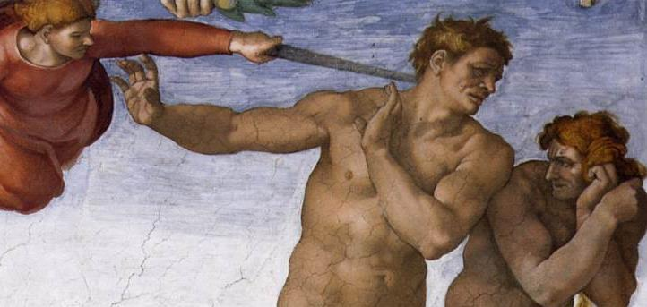
But why do we need grace?
What changed when Adam and Eve sinned?
Ever since our first parents, Adam and Eve, sinned, all people (with the exception of Jesus and Mary) became sinners (Rom 5:12, 19), because we inherited the stain or wound of
Original Sin in our souls.
Sin separated our first parents, their children and all their descendants, including us, from God.

Slide 10
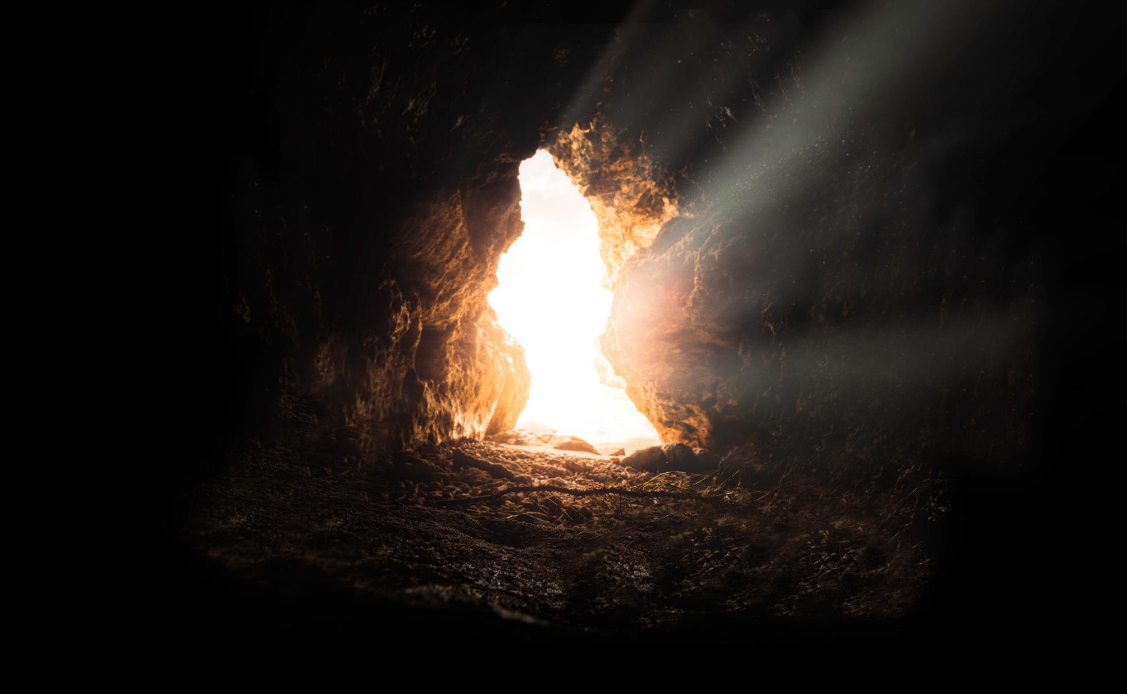
Jesus gave us our Catholic Church and the Seven Sacraments, so that He would remain with us, giving us His mercy and grace through the Holy Spirit to wash us of Original Sin and forgive our personal sins to keep us growing closer and closer to God.
God the Father promised a rescuer would come and save us from our sins and from the consequence of eternal death, and that is exactly what happened. Jesus, the divine Son of God, came, and suffered, died, and rose from the dead for us. He is our rescuer. He opened the gates of Heaven to save us from eternal death and give us the possibility of eternal life with God.

Slide 11
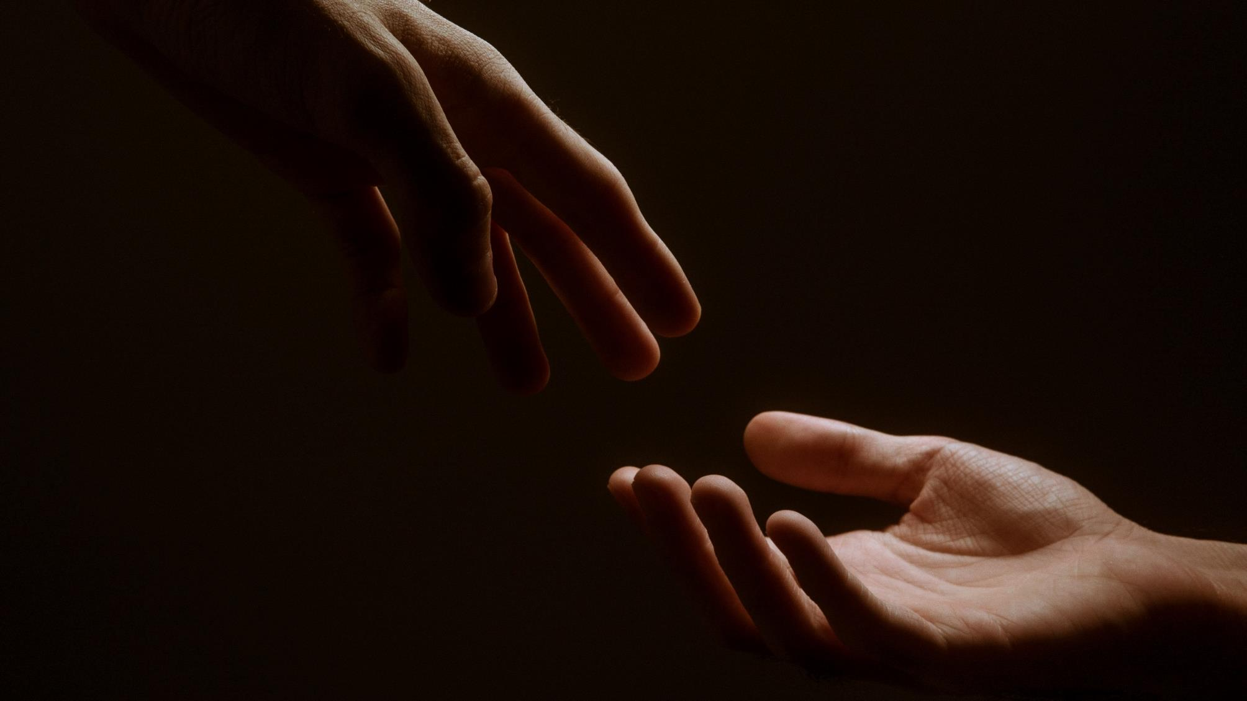
Our Lord Jesus gives us His mercy and grace so that we might follow Him and choose God with our free will.

Slide 12
SACRAMENT FACTS GAME
Families will watch a short video about sacraments.
After the video, each family will write down as many facts as you can about the sacraments of the Catholic Church in two minutes.
3. Families share their answers.
Facts can include:
• How many sacraments are there?
• Name as many sacraments as possible.
• Which sacrament does a person receive first?
• How do sacraments help us?
https://www.youtube.com/watch?v=LatLsVNR0T0

Slide 13
Baptism
Just as every Old Testament covenant had a sign and a promise,
every sacrament does too!
The promise fulfilled in the Sacrament of Baptism is that God washes away the Original Sin that we inherited from Adam and Eve, and through Jesus in the Holy Spirit, we become a part of God’s family as sons and daughters of the Father.
In the story of Noah’s Ark, the flood waters washed away
everything that was sinful.
Which of the Seven Sacraments uses water to wash away sins?

Slide 14
BAPTISM ROLE PLAY ACTIVITY
The sign for the Sacrament of Baptism is the natural water that is poured on the person three times, accompanied by the words of the presider,
“[Name], I baptize you in the name of the Father, and of the Son, and of the Holy Spirit.”

Slide 15
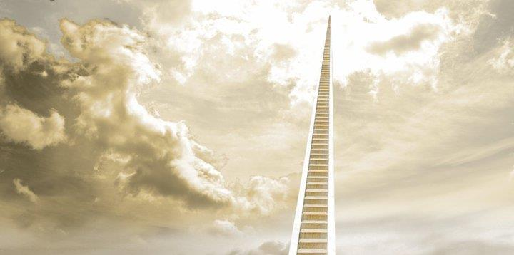
FAMILY CONVERSATION ACTIVITY
“[Sacraments] are like ladders that God gave to Himself by which He climbs down to us.” Dr. Peter Kreeft
What does that quote mean to you?
Each family member draws/colors a picture showing what the quote means to him/her.
Each person explains his/her picture.

Slide 16
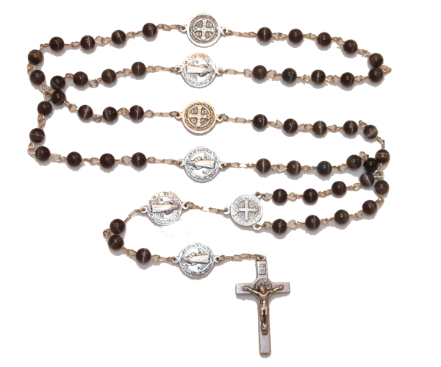
Your FAMILY AT-HOME MISSION is to:
Watch the videos about the Sacrament of Baptism.
Find baptism items or sacramental(s) that were received by each family member at his/her Baptism and bring those items to the Week 3 gathering.
Since this is the month of the Rosary (October), please place your family rosaries on your home altars next to your family bibles.
On November 1st, All Saints Day, we celebrate and show God that we are grateful for the saints who are in Heaven and for all the help they give us. Say a prayer to the saint with whose name you were baptized, asking him/her to pray for you.

Slide 17
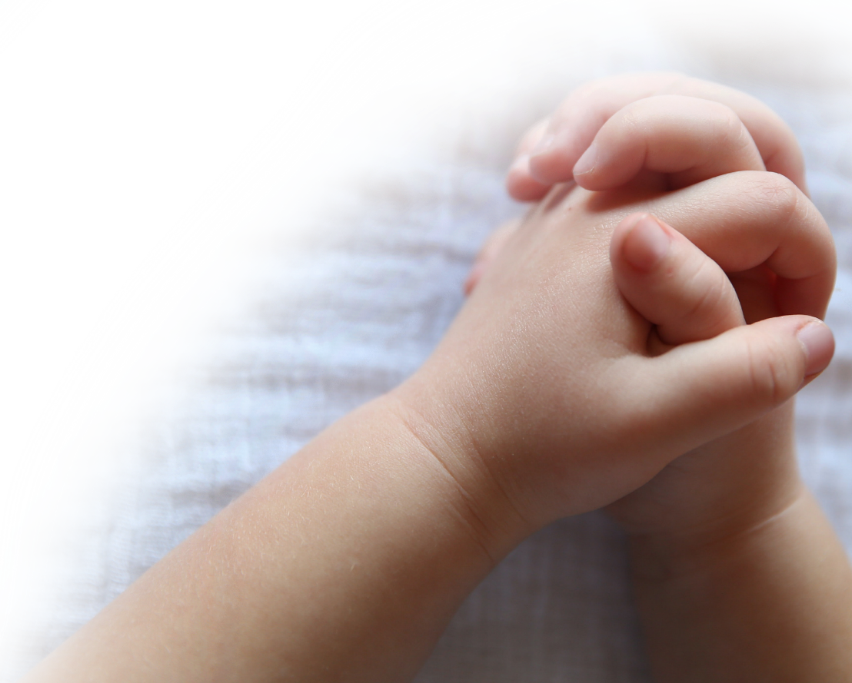
Your FAMILY AT-HOME MISSION continued:
On November 2nd, All Souls Day, we pray for our loved ones who have died as well as for all those who are in Purgatory waiting for us to pray for them, so they too can go to Heaven and finally be with God forever!
Bring a picture of a family member or friend of the family who has died that for whom you want us to pray to the Week 3 gathering. Be ready to share about who the person is, and why he/she is important to your family. Also, was that special person named after a saint? Do you have a favorite saint? Why is that saint your favorite? Are you named after a saint? Who is that saint?
Gather in your prayer space/around your home altar as a family. Take a moment to be silent with God together, and say a prayer for your family member or family friend, and for one another. Then end by praying a decade of the Rosary together while meditating on the First Luminous Mystery, The Baptism of Jesus.

Slide 18
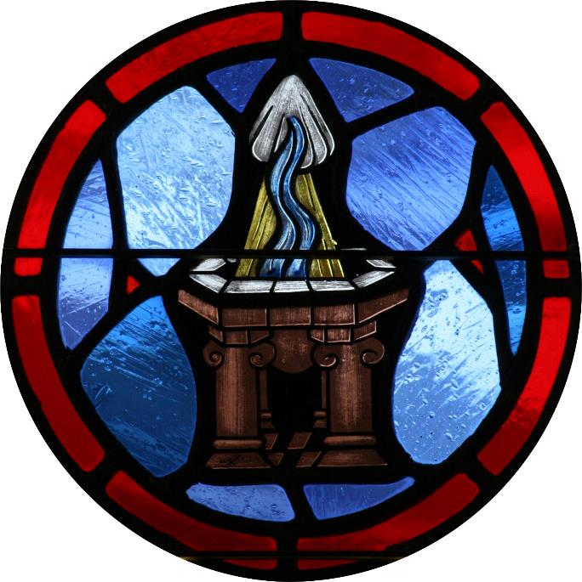
CLOSING PRAYER
Lord, thank You for the precious gift of Baptism, by which You have claimed us as Your own, so that we can publicly declare our love for You and witness to Your love.
Lord, we ask for Your goodness and blessings to be poured out on us, Your faithful servants.
We pray that You would work deeply within our hearts and souls to renew and refresh us each day.
Come guide our footsteps, give us a hope and a vision for the future.
Father, through Your Son Jesus and by the power of the Holy Spirit, cover and protect us now, encircle us with Your promises and fill our hearts with joy. Amen.
Adapted from www.xavier.edu

