Slide 1
GOD’S SAVING LOVE FOR US:
LITURGY AND THE SEVEN SACRAMENTS
SACRAMENTS OF CHRISTIAN INITIATION: EUCHARIST

Slide 2
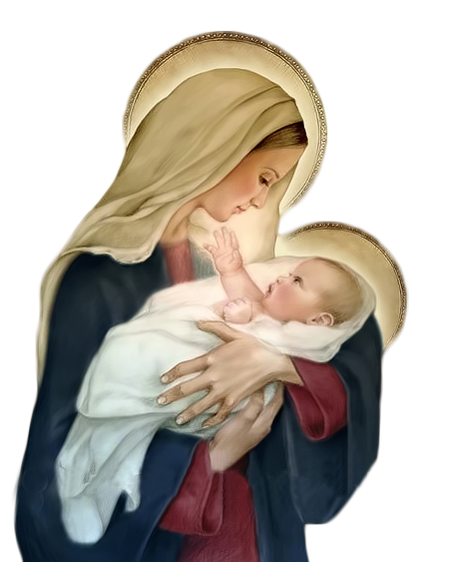
^{Opening Prayer}
Lord Jesus Christ,
We entrust our family to You and ask for Your blessing and protection.
We love You Lord Jesus with all our hearts, and we ask that You help our family become more like the
Holy Family.
Help us to be kind, loving, and patient with one another.
Give us all the grace we need to become saints and Your faithful disciples.
Amen.

Slide 3
^{Ice Breaker}
PENGUINS
Each person receives a sheet of paper (these are the blocks of ice) and spreads them around on the floor of the room.
Everyone get on a block of ice, one per block.
When the music starts (or a whistle is blown), “penguins” jump off their blocks and waddle around like penguins (arms stuck to sides) till the music stops and they must get back on a block of ice.
While music is playing, the leader removes a block of ice.
Participants must not hover around any certain ice block or they are out.
Last penguin standing wins!

Slide 4
God gives us Himself in the Sacrament of the Holy Eucharist
God loves us and knows how much we need Him.
He gives us Himself in the Sacrament of the Holy Eucharist so we are able to see Him, feel Him and receive Him sacramentally and, therefore, tangibly into our bodies and hearts,
to be as close to Him as possible.
In the Eucharist, we are forgiven, loved and made new!
God too desires this intimacy with us!
In the Eucharist, Jesus gives us His whole self—
Body, Blood, Soul, and Divinity.

Slide 5
VIDEO
https://youtu.be/TMSiHGTBdGk

Slide 6
FAMILY CONVERSATION
What do you remember most about your First Holy Communion and
how you felt when
receiving Jesus for the first time?
Why did you feel that way?
Show the sacramentals and photos from your own
Sacrament of First Holy Communion and explain why they are
special to you!

Slide 7
VIDEO
https://youtu.be/NILSVN1hgEM

Slide 8
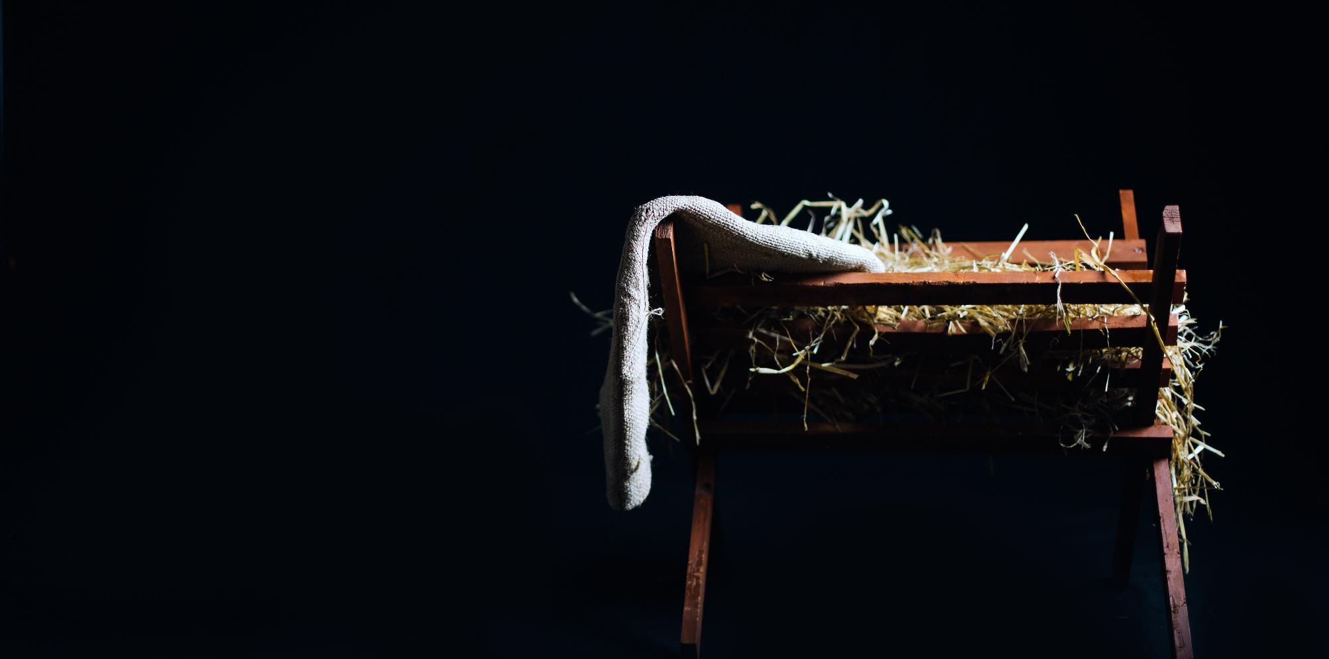
FAMILY CONVERSATION
Share a photo of your family gathered around your home altar or prayer space practicing
your favorite Advent or Christmas tradition.
Explain why it is your favorite tradition, as well as how you will celebrate the Birth of Christ on Christmas Day and during the whole Christmas Season.

Slide 9
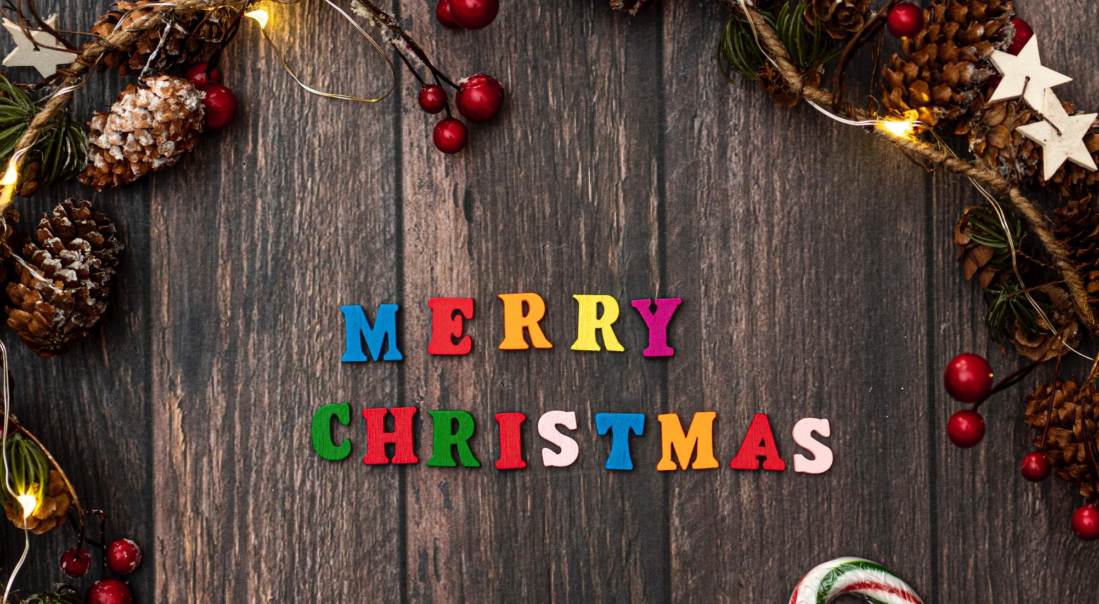
CELEBRATE CHRISTMAS

Slide 10
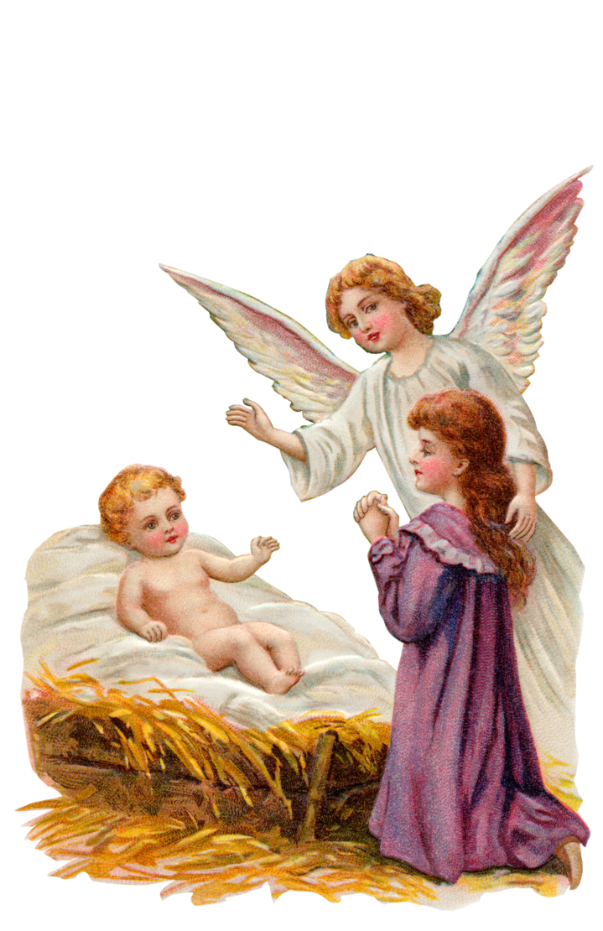
Awaiting Baby Jesus Advent Prayer
My heart is beating, filled with joy, awaiting
Mary’s baby boy.
For with this child, we embrace the birth of God’s most precious grace.
Baby Jesus, soon to come!
For us comes the Promised One.
Baby Jesus, God’s own Son, You will be the Chosen One to lead our flock into salvation.
Our eternal life awaits.
The birth of Jesus brings us nearer Heaven’s holy gates. Sing with joy, and count the days, for soon to come, the Lord we’ll praise.
Rejoice that Jesus will soon arrive, the Messiah and
our faith alive.
Through Christ our Lord. Amen.

