Slide 1
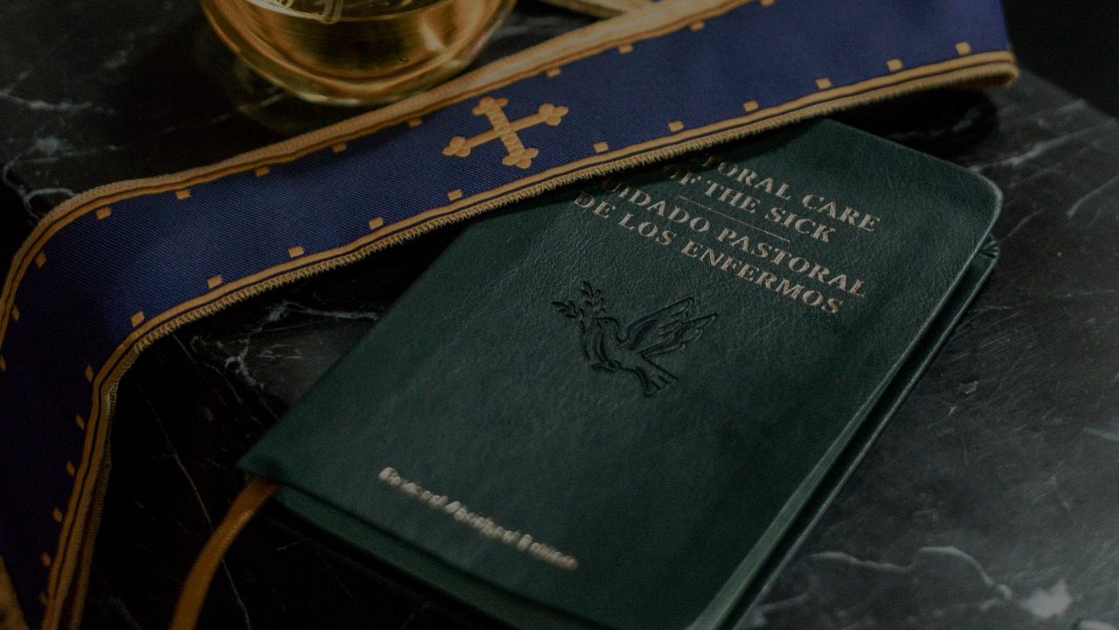
GOD’S SAVING LOVE FOR US:
LITURGY AND THE SEVEN SACRAMENTS
SACRAMENTS OF HEALING: THE ANOINTING OF THE SICK

Slide 2
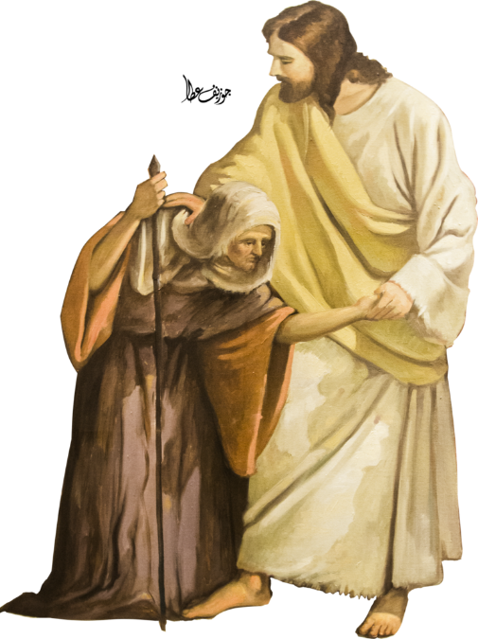
^{Opening Prayer}
Lord Jesus Christ, We entrust our family to You and ask for Your blessing and protection.
We love You Lord Jesus with all our hearts, and we ask that You help our family to become more like the Holy Family.
Help us to be kind, loving, and patient with
one another.
Give us all the grace we need to become saints and Your faithful disciples. Amen.

Slide 3
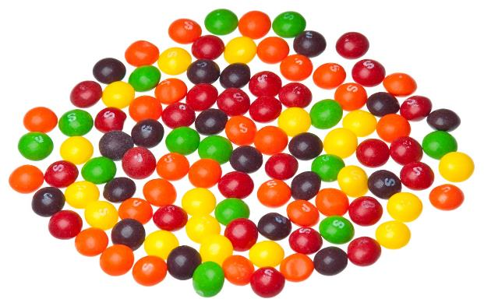
MIX AND MATCH CANDY CHALLENGE
What You Will Need: A bowl of multicolored candy (like M&Ms or skittles) and a poster board list of challenges correlated with each color (see Catechist Guide)
How to Play:
Families sit in a circle, pass the bowl around and have each person pick a handful of candy.
Each person can eat all but one piece.
Then, go around the circle and have everyone perform the challenge associated with the selected color.
Adapted from https://connectusfund.org/icebreaker-games-for-youth-groups

Slide 4
REVIEW
Last month, we learned that there are two Sacraments of Healing. Sin hurts our relationship with God and some sins actually separate us from God’s grace.
God our Father knew that after Jesus’ Death, Resurrection, and Ascension—and even after our own Baptism—we would still sin, but God loves us anyway and wants to be as close as He can be to us.
So, what sacrament did He give to us to bring us closer to Him again?

Slide 5
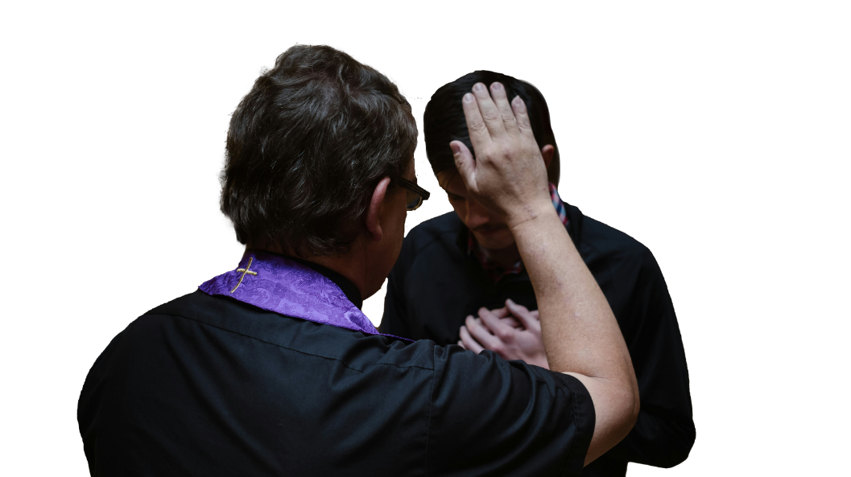
REVIEW
The
Sacrament of Reconciliation.

Slide 6
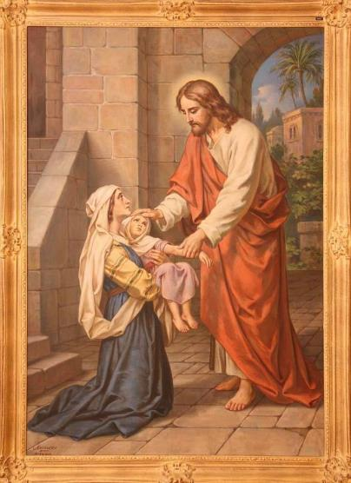
TOPIC
Today we are going to learn about the other Sacrament of Healing. Do you remember what that sacrament is called?
Sacrament of the Anointing of the Sick

Slide 7
LUKE 5:17-26
The Chosen scene: Jesus heals the paralytic video
https://www.youtube.com/watch?v=dlBOmQ1PaMY

Slide 8
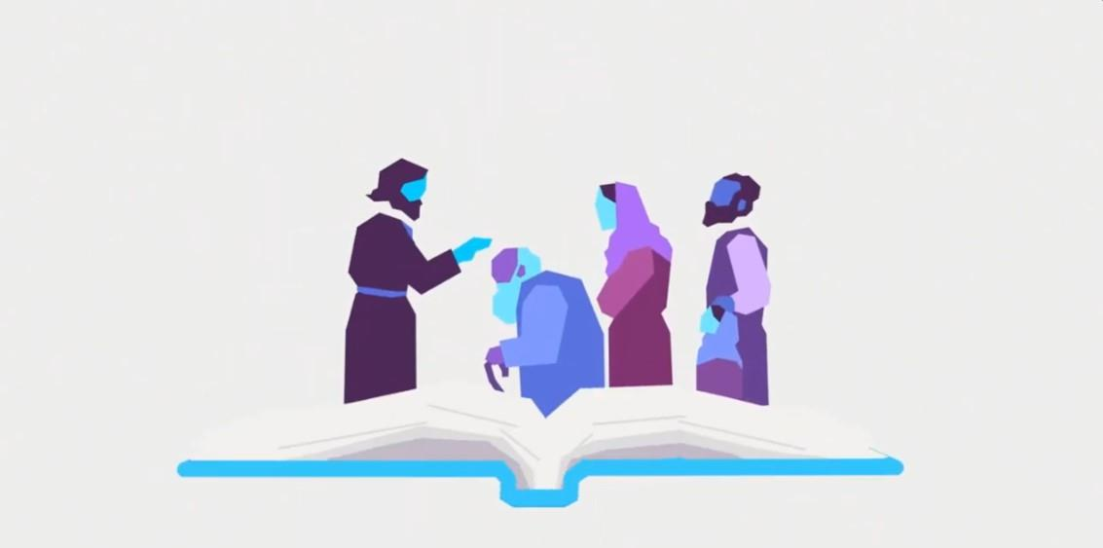
FAMILY CONVERSATION
Families share what stood out to them in the video of Jesus’ healing of the paralytic man and why.
Families name their favorite stories of Jesus healing someone in the Bible .
Families find their stories in their bibles and share them with one another, explaining why the story is their favorite.

Slide 9
WHAT IS THE ANOINTING OF THE SICK?
What are some of the signs of the Sacrament of the Anointing of the Sick that were mentioned in the video?

Slide 10
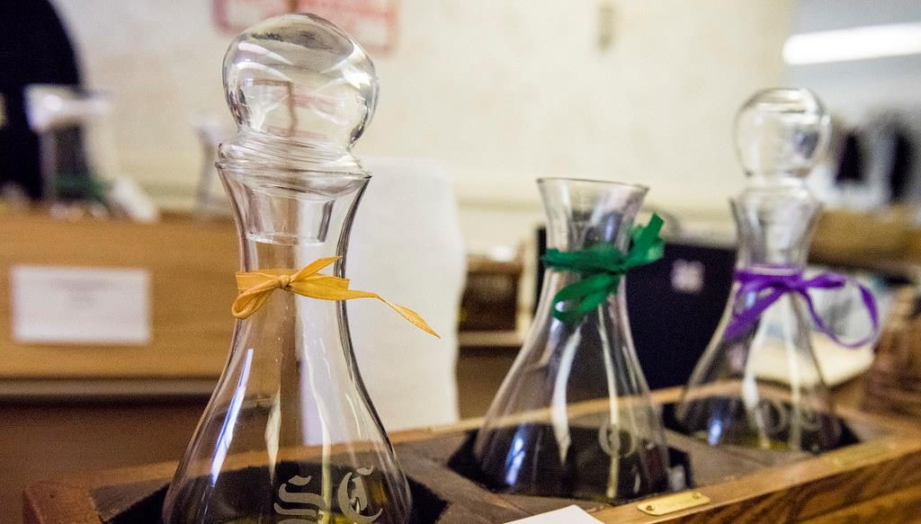
Blessed or consecrated oil, the Sign of the Cross, and the laying on of hands (accompanied by the prayer of faith)

Slide 11
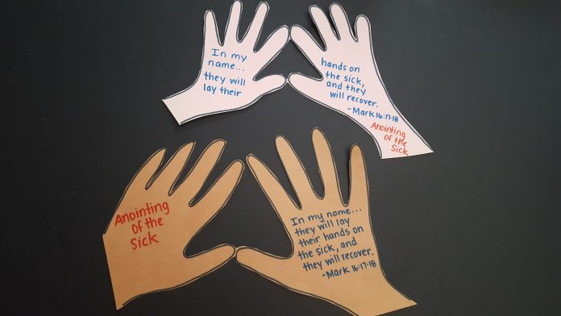
FAMILY ACTIVITY – LAYING ON OF HANDS

Slide 12
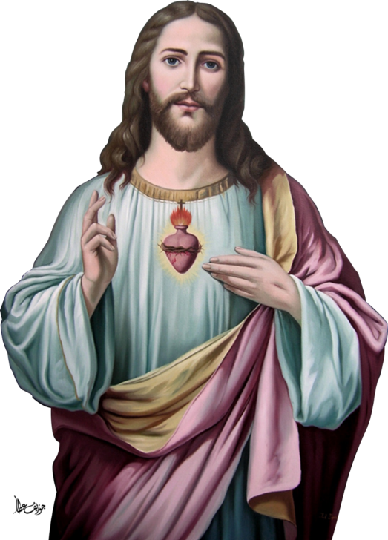
FAMILY AT-HOME MISSION
Watch the videos about the Sacrament of the Anointing of the Sick.
As a family, make a list of people who need prayers for healing, both spiritual and physical.
Gather as a family around your home altar and place your healing hands craft upon it.
Pray for those who are sick around your home altar

Slide 13
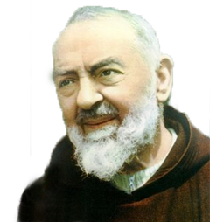
HEALING PRAYER
Attributed to Padre Pio
Heavenly Father,
I thank You for loving me. I thank You for sending Your Son, Our Lord Jesus Christ, to the world to save and to set me free. I trust in Your power and grace that sustain and restore me.
Loving Father, touch me now with Your healing hands, for I believe that Your will is for me to be well in mind, body, soul and spirit. Cover me with the most Precious Blood of Your Son, our Lord, Jesus Christ from the top of my head to the soles of my feet. Cast out anything that should not be in me. Saturate my entire being with Your presence, love, joy and peace and draw me ever closer to You every moment of my life.
And Father, fill me with your Holy Spirit and empower me to do Your works so that my life will bring glory and honor to Your holy name. I ask this in the name of our Lord Jesus Christ.
Amen.
Adapted from Pembroke Diocese.

