Slide 1
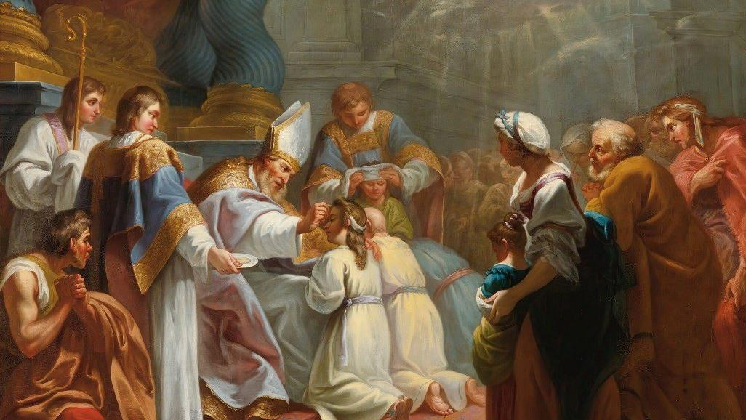
GOD’S SAVING LOVE FOR US:
LITURGY AND THE SEVEN SACRAMENTS
SACRAMENTS OF CHRISTIAN INITIATION: CONFIRMATION

Slide 2
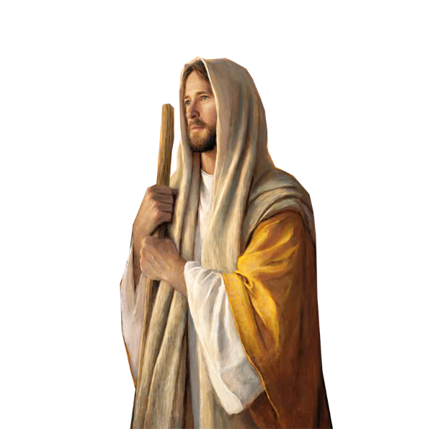
^{Opening Prayer}
Lord Jesus Christ, we entrust our family to You and ask for Your blessing and protection.
We love You Lord Jesus with all our hearts, and we ask that You help our family to become more like the Holy Family.
Help us to be kind, loving, and patient with one another.
Give us all the grace we need to become saints and Your faithful disciples. Amen.

Slide 3
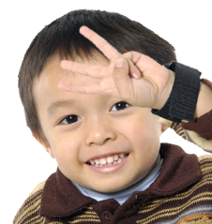
WHAT’S ON YOUR 4HEAD?
1. Have a parent come up front to be the “caller.” The “caller” turns around so he/she can’t see the people.
2. Everyone else stands up and picks a number between 1 and 5, and then puts that number of fingers up to his/her forehead and holds it there. Count “1-2-3, hold.” (Family members should now have their numbers set on their foreheads.)
3. The “caller” (who is facing the opposite direction and can’t see the crowd) calls out a number between 1 and 5. Anyone holding up the number that was called out must sit down.
4. Remaining players are allowed to pick another number (or keep the same one) and the game continues. If a player’s number is called out, he/she is out of the game.

Slide 4
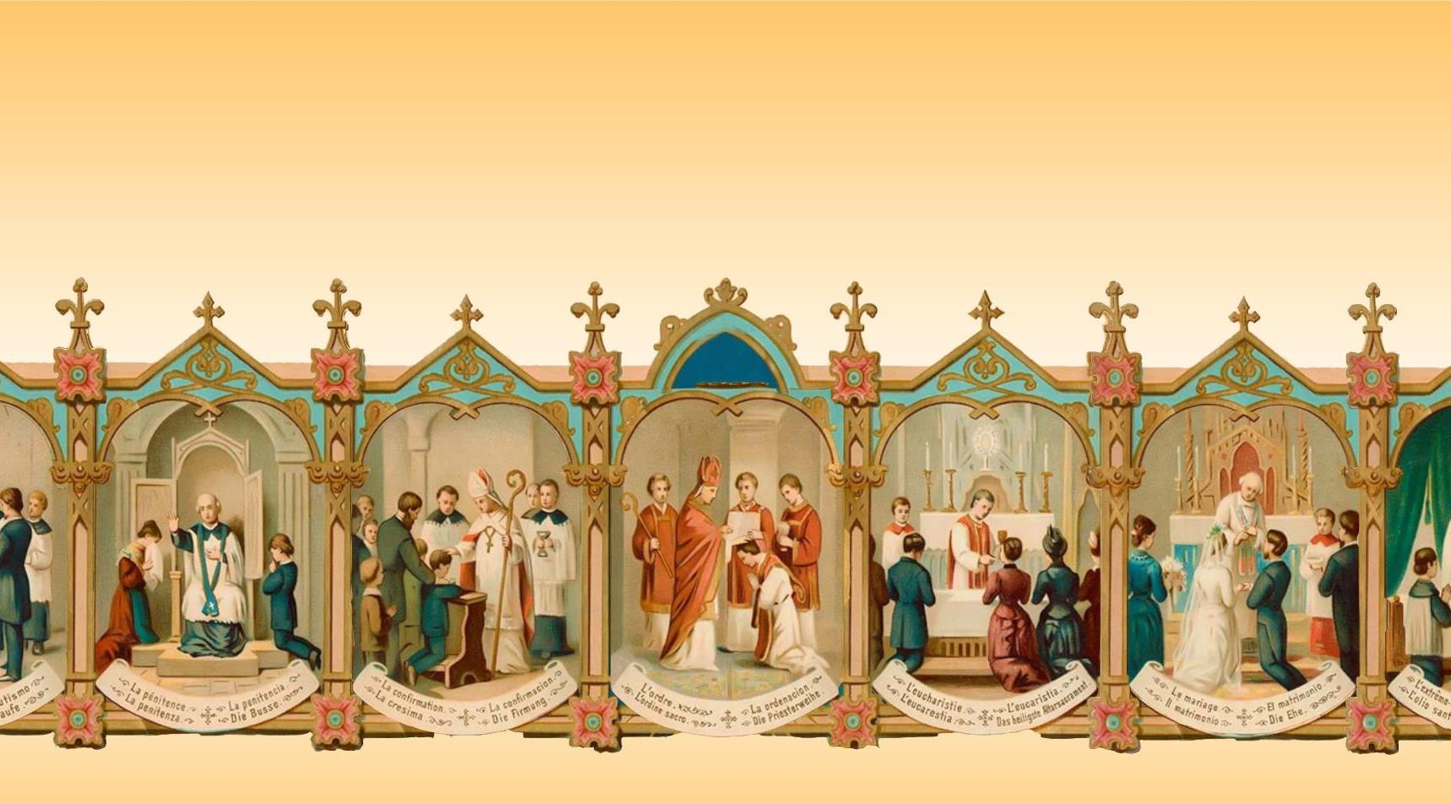
Which Sacrament of Christian Initiation did we learn about the last time we were together?

Slide 5
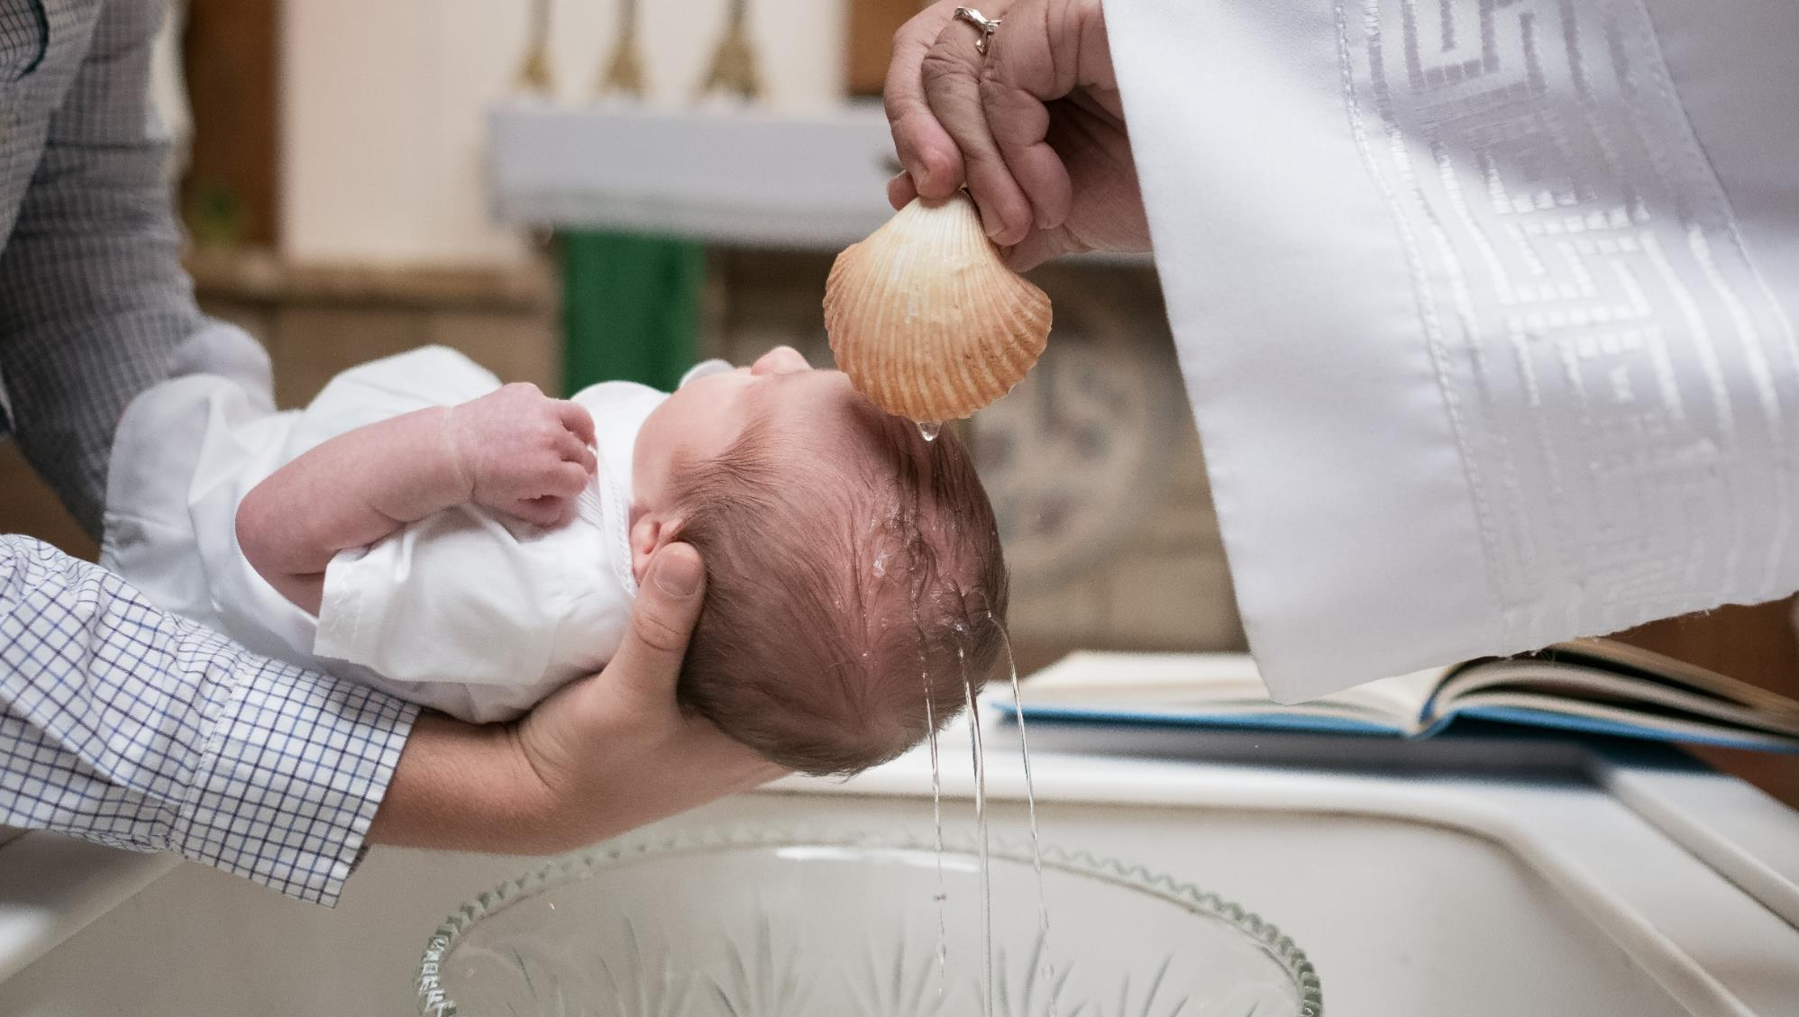
BAPTISM!

Slide 6
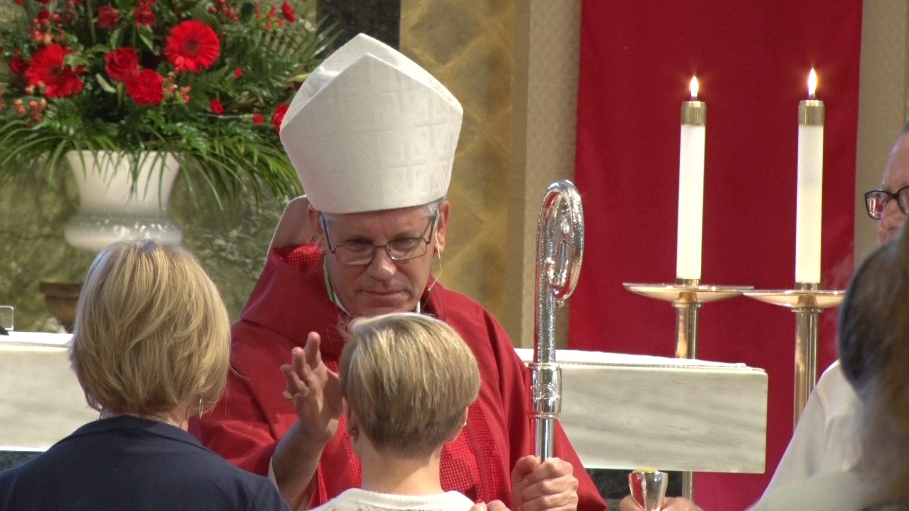
Confirmation is the Sacrament of Christian Initiation that completes baptismal grace. A person is sealed with the Holy Spirit and strengthened by grace and spiritual gifts to spread and defend the faith and to live as a true disciple of Jesus.

Slide 7
WATCH
Confirmation | Catholic Central
^{https://youtu.be/1v-FLo7bcTE?}

Slide 8
Right before Jesus ascended into Heaven, He promised that all his disciples would receive the power of the Holy Spirit.
What do we call the event that was the first time Jesus’ disciples received the power of the Holy Spirit?
Hint: It is the Third Glorious Mystery

Slide 9
WATCH
Pentecost
^{https://youtu.be/jNiApXVR9go?}
Acts of the Apostles: What is Pentecost? | What’s in the Bible?
^{https://youtu.be/xtokHQOmFu0?}

Slide 10
But why do we need grace?
Acts 2
When the disciples received the Holy Spirit they went from hiding in fear to boldly proclaiming to everyone how much Jesus loves them!
So what did Jesus tell us about the Holy Spirit?

Slide 11
WATCH
Brother Francis “What did Jesus tell us about the Holy Spirit?”
^{https://youtu.be/cy-itFb-Kmo?}
What Does the Holy Spirit Do: Elementary Lesson (Stop at 5:08 min)
^{https://youtu.be/OMPoPNWyBdo?}

Slide 12
Filled with the Holy Spirit Simulation

Slide 13
FAMILY CONVERSATION
When and where
in your own lives have you seen the
Holy Spirit at work
in big ways
and/or
in small ways?

Slide 14
Your FAMILY AT-HOME MISSION is to:
Watch the videos about the Sacrament of Confirmation and Pentecost.
Find Confirmation items or sacramental(s) that family members received when they were confirmed. These could be a prayer book, rosary, or crucifix/cross, stole, photos, or a picture of the saint whose name you chose for your Confirmation.
Bring those items to the Week 3 gathering.
Place your Paper Pentecost Candle on your home altar next to your family bible, and pray a decade of the Rosary together meditating on the
Third Glorious Mystery, The Descent of the Holy Spirit.

Slide 15
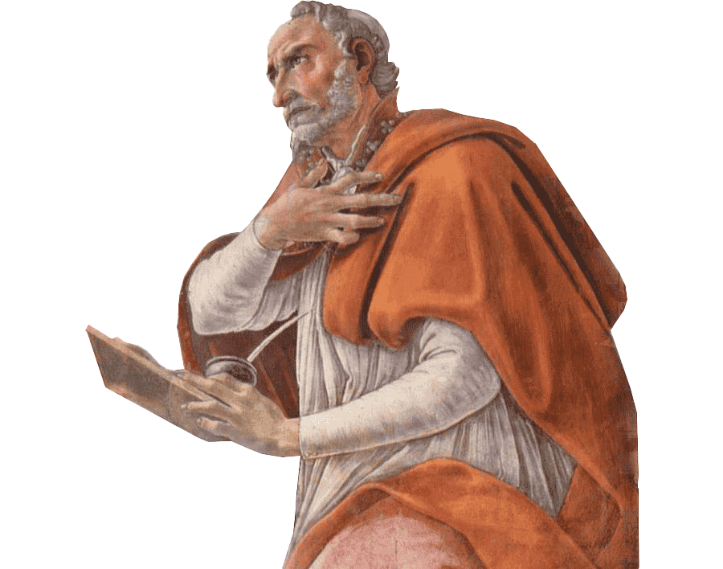
CLOSING PRAYER
Breathe into me, Holy Spirit,
that my thoughts may all be holy.
Move in me, Holy Spirit,
that my work, too, may be holy.
Attract my heart, Holy Spirit,
that I may love only what is holy.
Strengthen me, Holy Spirit,
that I may defend all that is holy.
Protect me, Holy Spirit,
that I may always be holy.
-St. Augustine

