Slide 1
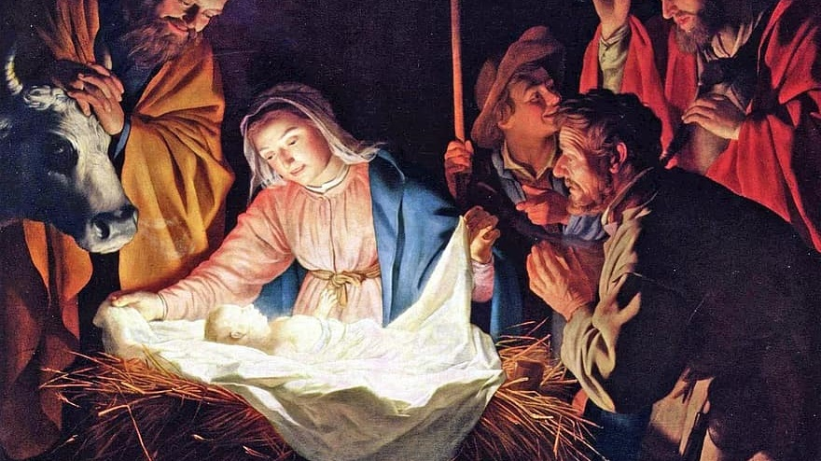
THE LIFE OF CHRIST: THE JOYFUL MYSTERIES
THE VISITATION AND THE NATIVITY

Slide 2
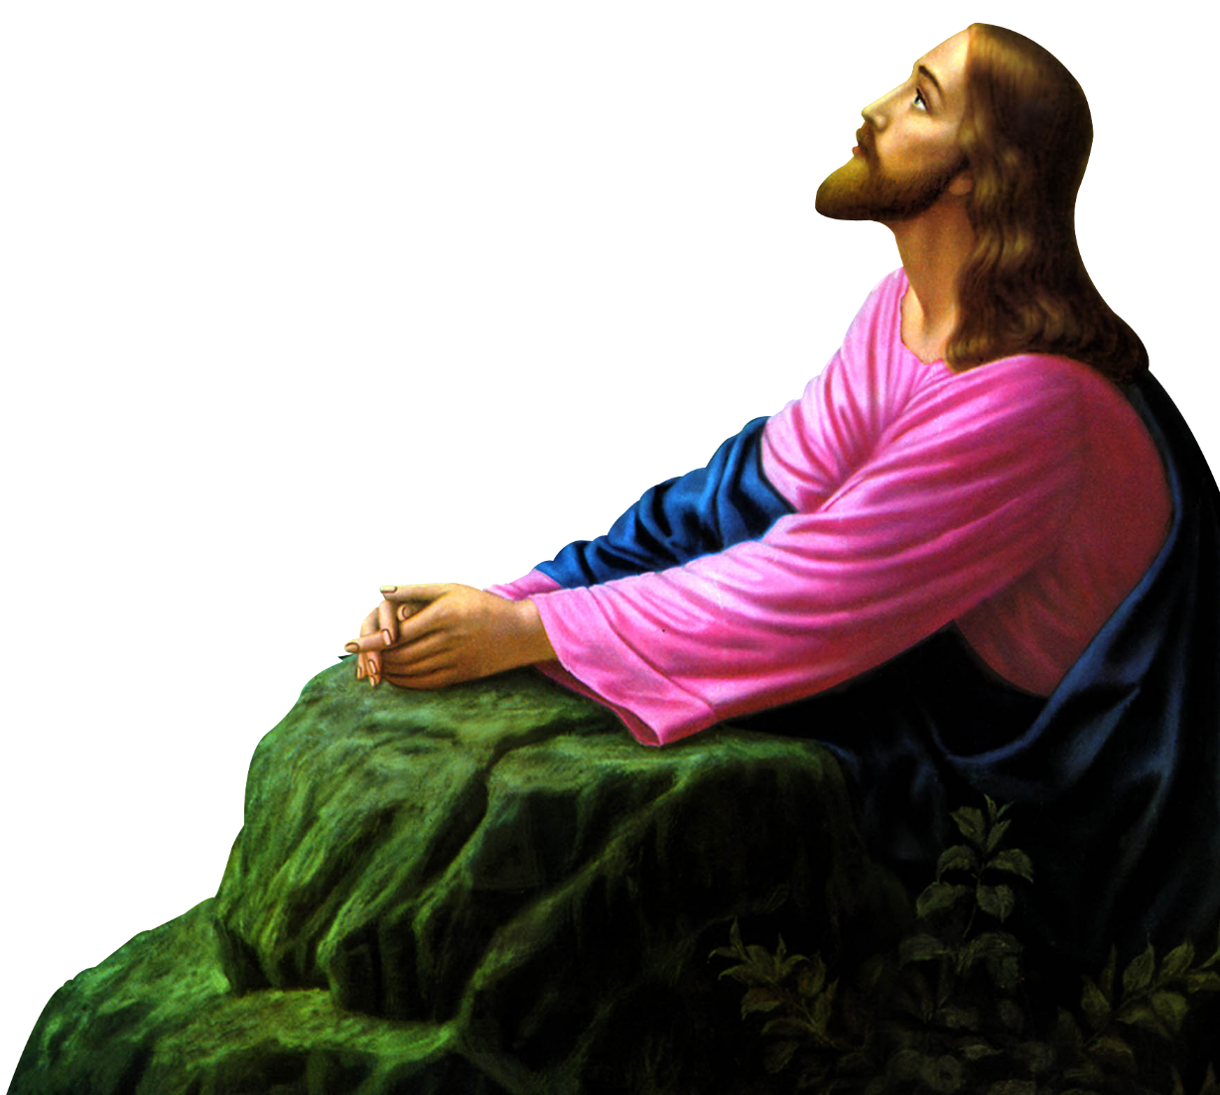
^{Opening Prayer}
Lord Jesus Christ, we entrust our family to You and ask for Your blessing and protection. We love You Lord Jesus with all our hearts and we ask that You help our family become more like the Holy Family. Help us to be kind, loving, and patient with one another. Give us all the grace we need to become saints and Your faithful disciples.
Amen.

Slide 3
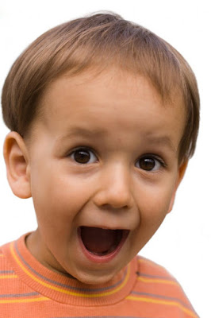
^{Ice Breaker}
FIND 10 THINGS IN COMMON
Find 10 things that all of you share in common in two minutes (besides the obvious, e.g., that they are human). At the end of the two minutes we will share your answers with the larger group.
Adapted from https://www.tinypulse.com/

Slide 4
REVIEW MAIN CONCEPT
The last time we were together we reflected on the First Joyful Mystery, the Annunciation. Today we will reflect on the Second and Third Joyful Mysteries, the Visitation and the Nativity or Birth of Jesus.

Slide 5
FAMILY SHARING
After watching the At-Home videos, (link below) answer the following questions:
What is the Gospel? What did you learn about the four Gospel writers?
The Four Gospels | Jesus is the Good News! | What's in the Bible? | DVD 10
https://www.youtube.com/watch?v=SBQiinMzR_0

Slide 6
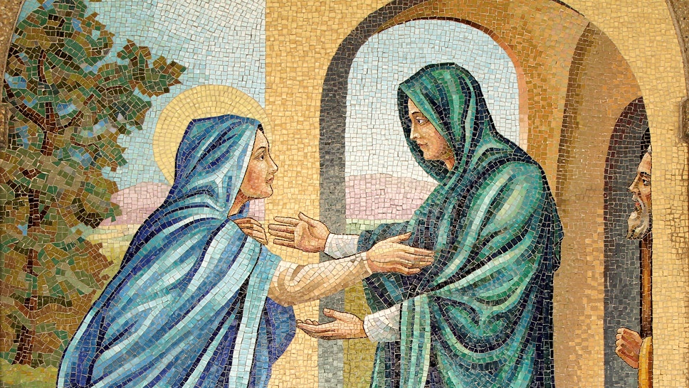
THE VISITATION OF MARY TO ELIZABETH

Slide 7
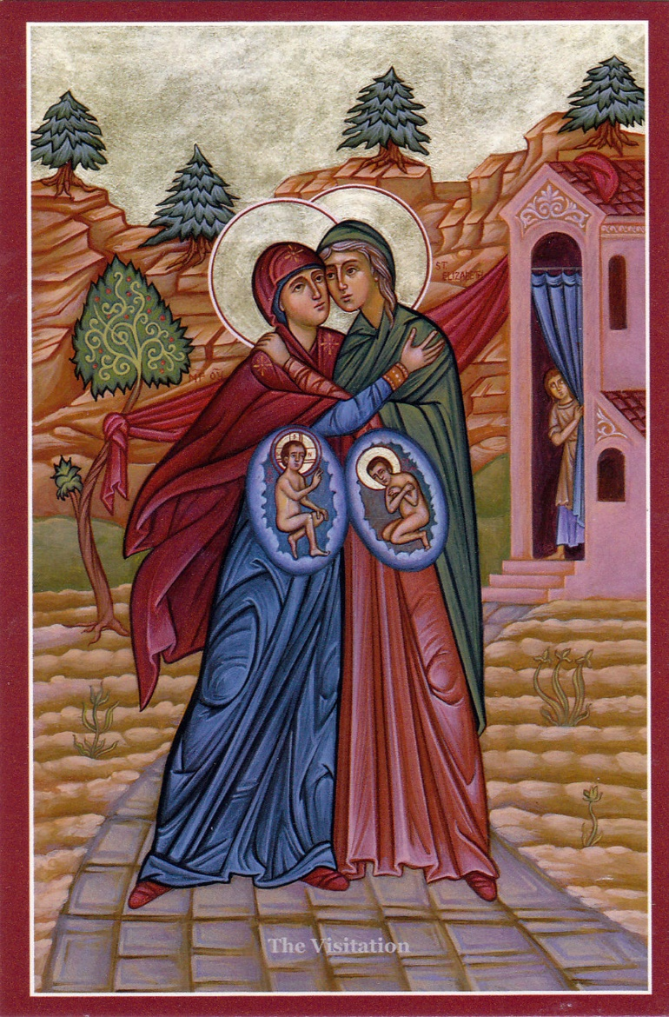
FAMILY CONVERSATION
Question:
What special graces can be seen at this moment of the Visitation?

Slide 8
VIDEO
The Nativity Video https://youtu.be/X7LU6mFLsO4

Slide 9
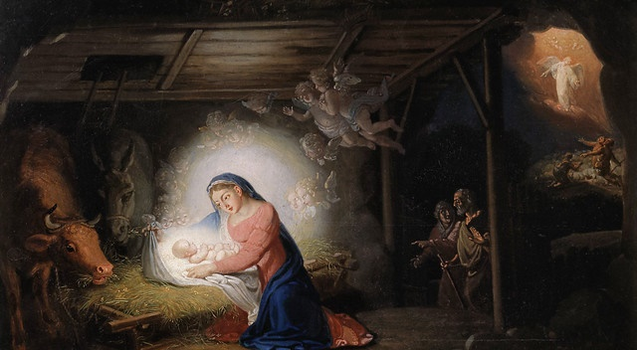
FAMILY CONVERSATION
Question:
What part of the story of the Mystery of the Nativity of Our Lord Jesus Christ is your favorite and why?

Slide 10
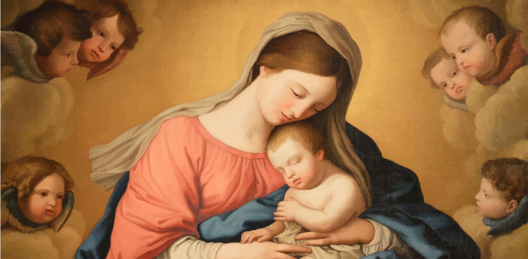
CLOSING PRAYER

