Slide 1
SACRAMENTS AT THE SERVICE OF COMMUNION AND MISSION: HOLY ORDERS

Slide 2
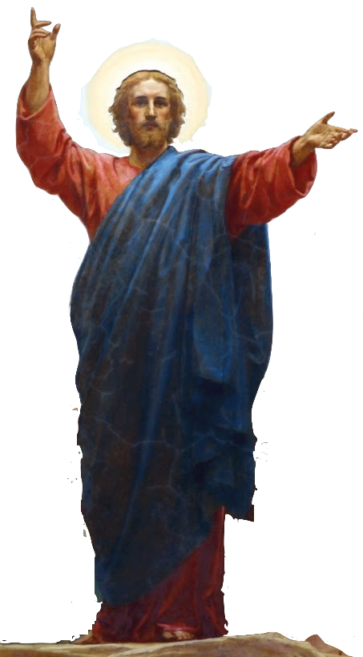
^{Opening Prayer}
Lord Jesus Christ, We entrust our family to You and ask for Your blessing and protection.
We love You Lord Jesus with all our hearts, and we ask that You help our family to become more like the Holy Family.
Help us to be kind, loving, and patient with
one another.
Give us all the grace we need to become saints and Your faithful disciples. Amen.
This Photo by Unknown Author is licensed under CC BY-NC

Slide 3
I AM BLESSED!
How to Play:
Ask a volunteer to name a reason why he or she is blessed.
Continue around the small family group or around the large group if there is time.
The only guideline is that each person should try to think of a new and different blessing.
(Adapted from disciple.org)
BLESSINGS

Slide 4
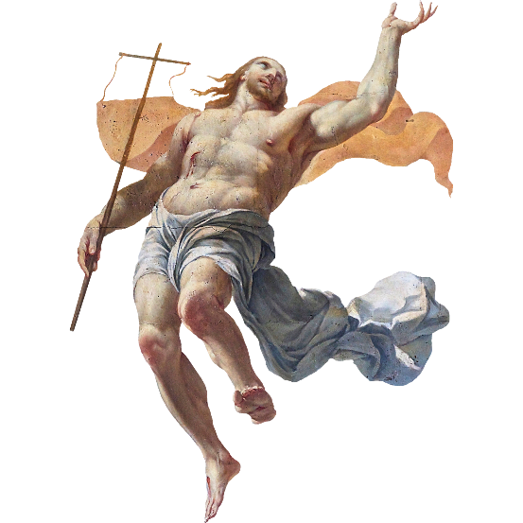
REVIEW
What are your family’s plans
for celebrating the
Easter Season?
This Photo by Unknown Author is licensed under CC BY-NC

Slide 5
MAIN CONCEPT
The Sacraments of Service and Mission
are the Sacraments of
Holy Orders and Matrimony (Marriage)..
Marriage too is a vocation, or a
calling from God!

Slide 6
MARRIAGE
https://www.youtube.com/watch?v=yjwPsZaK4Do

Slide 7
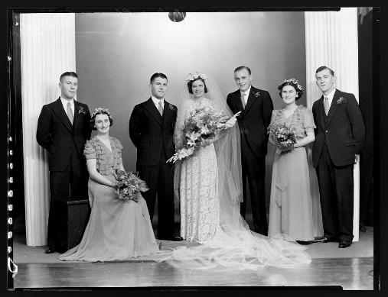
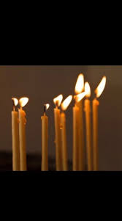
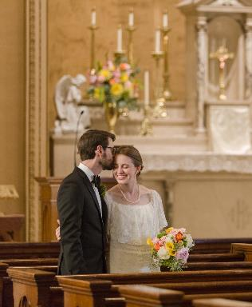
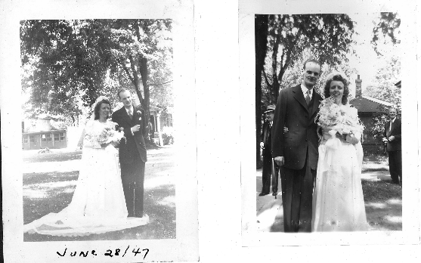
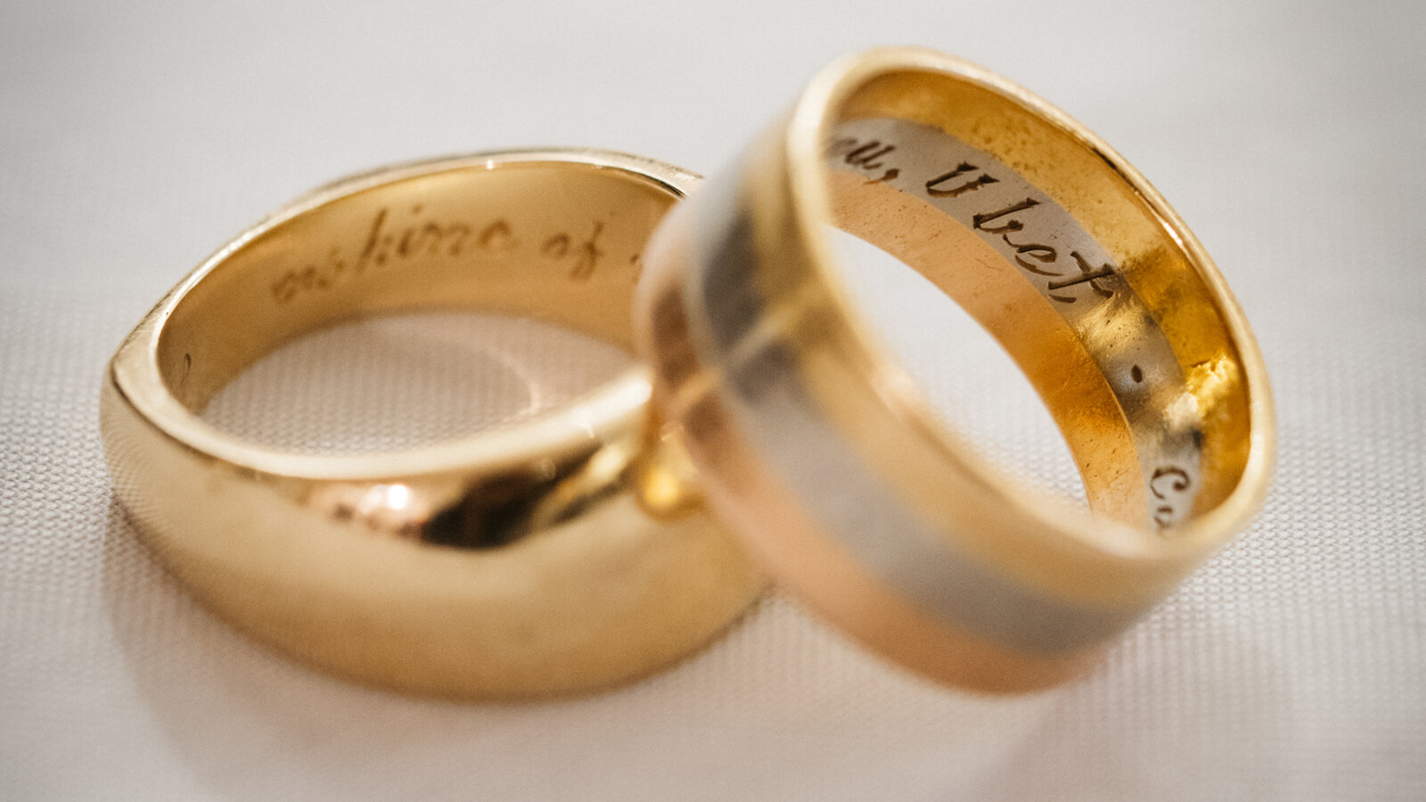
FAMILY SHARING
Families take turns showing their Sacrament of Marriage sacramentals,
favorite keepsakes,
or photos from their own
wedding, or of a couple who are a witnesses to the holiness of marriage,
and explain why it is special to them.

Slide 8
LECTIO DIVINA:

Slide 9
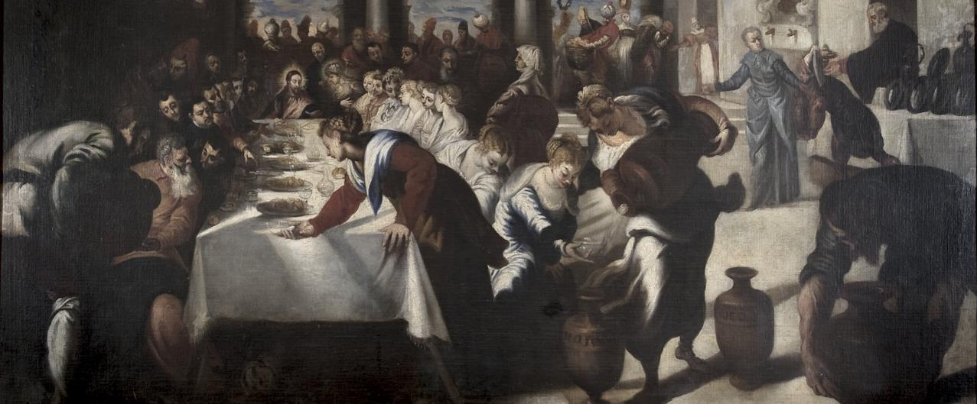
Wedding at Cana
(Family members to find a comfortable place to sit together as a small group.)
It was not an accident that it was at the Wedding at Cana that Jesus did His first public miracle. The Trinity is the giver of grace for every Christian marriage, and this grace comes through Christ’s Cross, “the source of all Christian life” (CCC, no. 1615). The Lord knows how much we all need Him, and He wants to be sought, invited and a part of all of our relationships, so He can give us His grace and His love, which in turn strengthens us to love one another better!

Slide 10
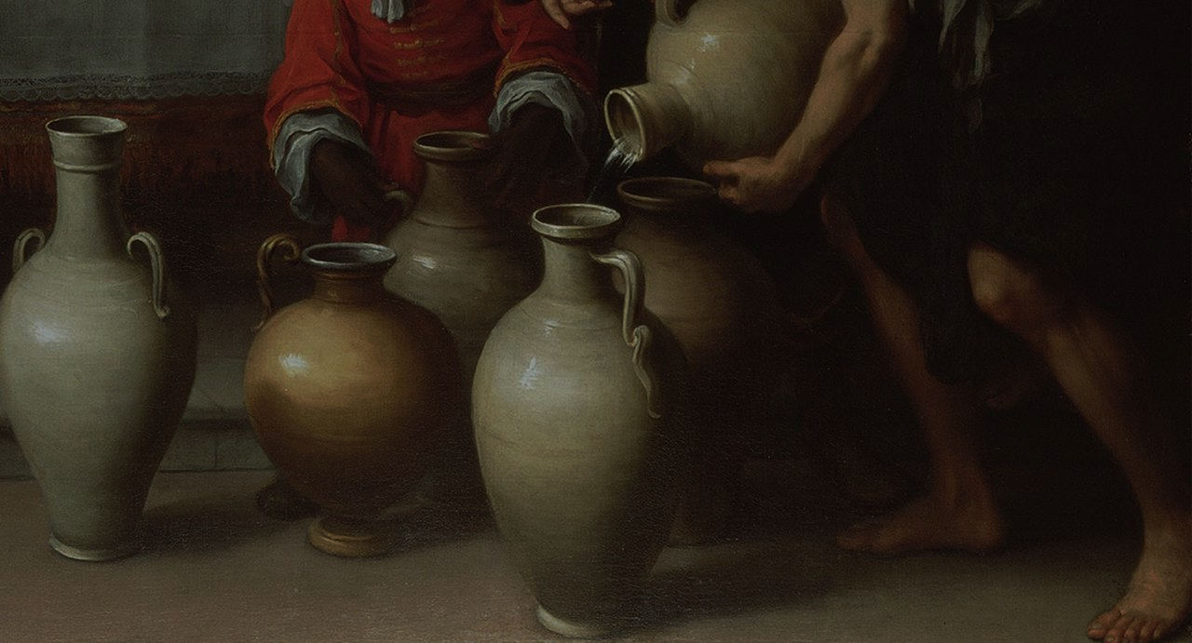
SACRAMENT OF MARRIAGE
The excerpts below are adapted from God’s Help for Our Marriages: Transforming Water to Wine
“We may never know [for sure] why John included this story (in his Gospel), but it’s a good thing he did. For centuries, people have turned to it for encouragement and inspiration, especially when it comes to the Sacrament of Marriage. For this miracle tells us that when we invite Jesus into our marriage, just as Jesus was invited to the wedding at Cana, He takes what is already good—the “water” of our love for each other and our desire to treat each other well—and transforms it into the choice “wine” of his own divine grace and power.”

Slide 11
SACRAMENT OF MARRIAGE
So why does it seem like the grace is not working in some marriages and families that have been wounded by divorce?
“Like all the other sacraments, the Sacrament of Marriage has power only to the degree that married couples embrace and try to live out the grace available to them through the sacrament.
It’s a grace that is released as the couple welcomes Jesus into their marriage in ways both big and small, in their overall philosophy of marriage and in the specific ways
they make Jesus a part of their relationship.”

Slide 12
SACRAMENT OF MARRIAGE
“Every marriage will eventually face some kind of tension that may push the couple to fight, to isolate themselves from each other, or to fall into selfishness or resentment.
When these situations arise, those couples who have been taking hold of the grace of the sacrament stand a much better chance of weathering the storm together. Their love for each other will supersede the tension. They will be more able to forgive. They will hold each other in respect and honor, and their marriage will even be strengthened.”

Slide 13
SACRAMENT OF MARRIAGE
“A Sacramental Seal
Just as Jesus came to the wedding at Cana, he comes to every wedding where he is invited. And he remains for the whole marriage when a couple continues to welcome him into their home.
He takes their natural human love, which is good, and transforms it into supernatural, divinely graced love. He makes sure that their love, which on its own has the potential to run dry, remains vibrant and life-giving. Through the sacrament, He offers his seal on their marriage so that they can learn how to love each other with the same love that He has for his church. And that love, like the choice wine at Cana, is the best there is!”

Slide 14
CLOSING PRAYER
Dear Father,
You live in eternity with the Son and the Holy Spirit in oneness of life and communion of love; grant that all married couples will be mindful of the covenant of love they entered into with You through the Sacrament of Marriage.
Send Your Holy Spirit to heal the wounds that have driven families apart.
Pour your grace of reconciliation to mend broken hearts and restore love.
Give us renewed understanding and compassion for one another.
Glory be… Amen.

