Slide 1
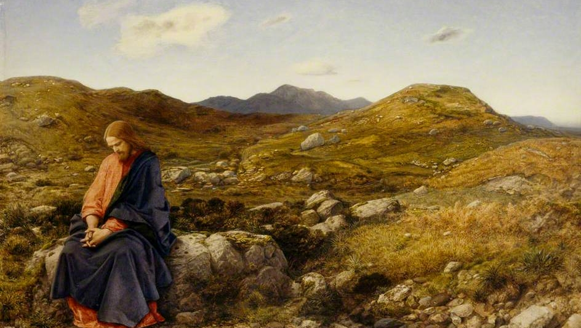
FAMILIES FORMING DISCIPLES
^{Lesson 6 – Week 3}

Slide 2
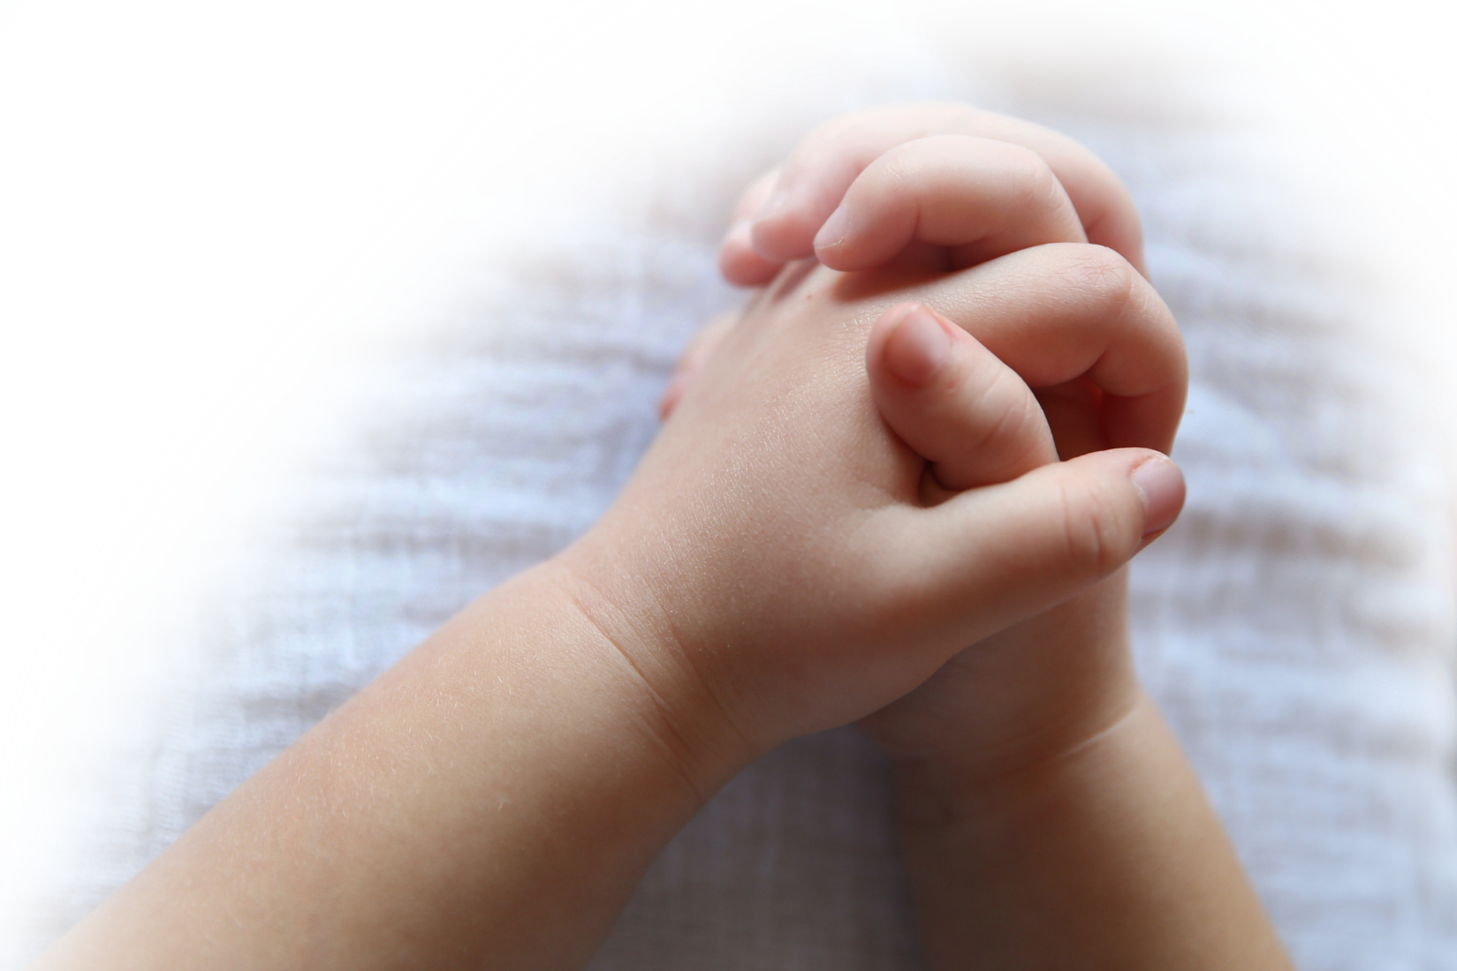
^{Opening Prayer}
Come, O Spirit of Fortitude, and strengthen all parents and encourage them in their vocation of service to their families and to each other. Strengthen especially those who are single, separated, or divorced, to have courage and remain in your care as they too serve their families. Lead them all to a future filled with hope. Our Father…
(adapted from Catholics For Family Peace)

Slide 3
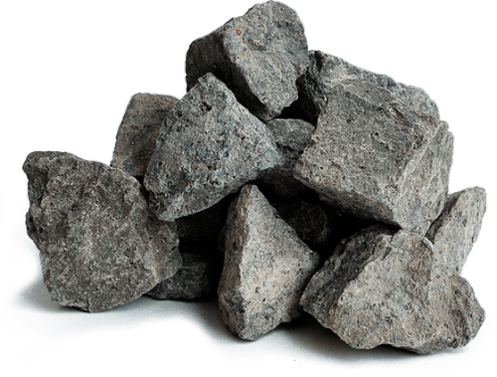
Materials
^{Bibles}
^{Rocks & Sharpie markers}

Slide 4
Ice Breaker
Who is the most generous person that you know? Why?
Who is the funniest person that you know?
^{Why?}

Slide 5
Family Sharing
Please share your Senior Sharing experience.
Who did you interview?
What did he/she say?
How did you feel about your experience?

Slide 6
Review Main Concept
Preparing for Lent
Jesus in the desert

Slide 7
Family Sharing
Please share your own Family Lenten Plan.
How does it relate to the three Lenten Pillars of Prayer, Fasting and Almsgiving?

Slide 8
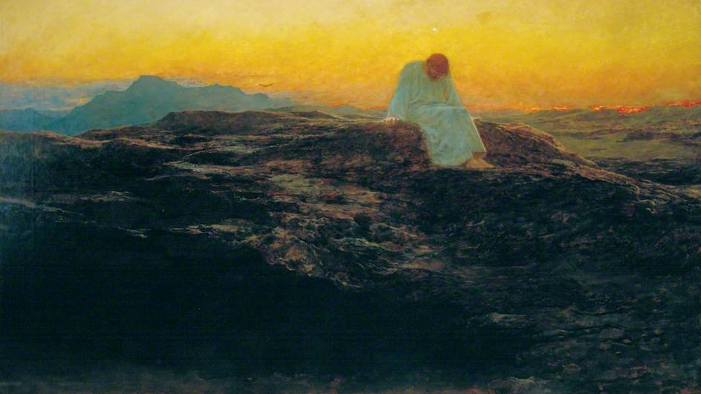
Luke 4:1-13

Slide 9
Family Sharing
Share Guidelines:
a. Respectfully listening to each family member as he/she is sharing their reflection is very important.
b. Avoid interrupting or even correcting what another is saying (we’re looking to listen, not critique).
c. When each family member has had an opportunity to share his/her reflections, signal by raising your hand.
d. Please continue to sit quietly while we wait for the other families to finish.

Slide 10
Lenten Rocks

Slide 11
Prayer
Families should be gathered around their home altars.
^{God, heavenly Father,}
Look upon all the families gathered here and hear our prayers during this holy Season of Lent.
By the good works You inspire in us, help us to follow Jesus’ example to discipline ourselves through fasting and almsgiving and to be renewed in spirit through prayer. We unite all our Lenten sacrifices and our
difficulties to You because we love You and we know that You love us. We are Your children and You rejoice when we give our hearts to You! We ask all this in the name of Your Son, Jesus Christ. Amen.

Slide 12
Next Meeting

