Slide 1
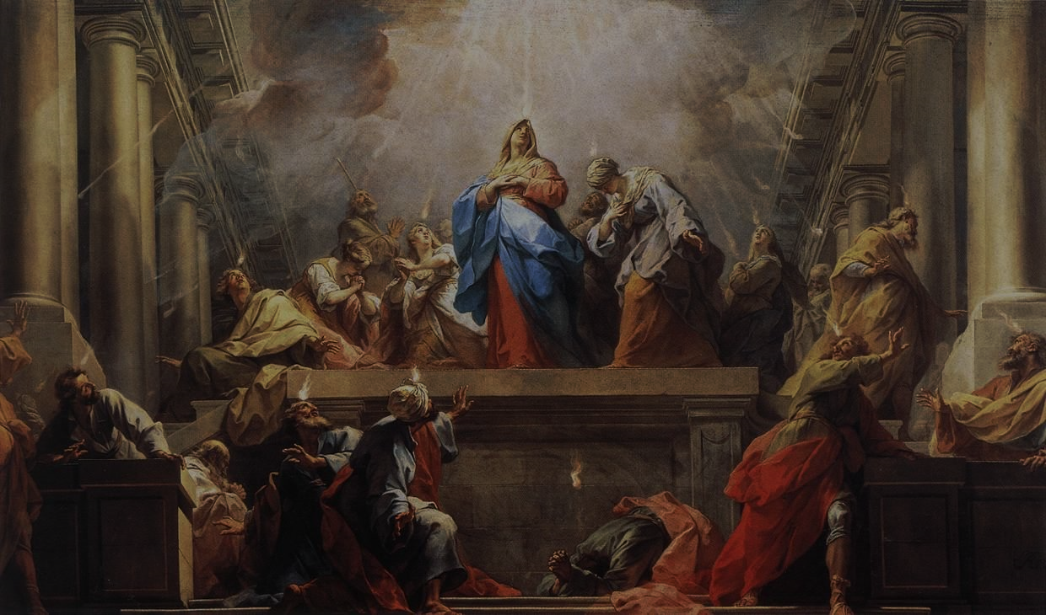
FAMILIES FORMING DISCIPLES
^{Lesson 9 – Week 1}

Slide 2
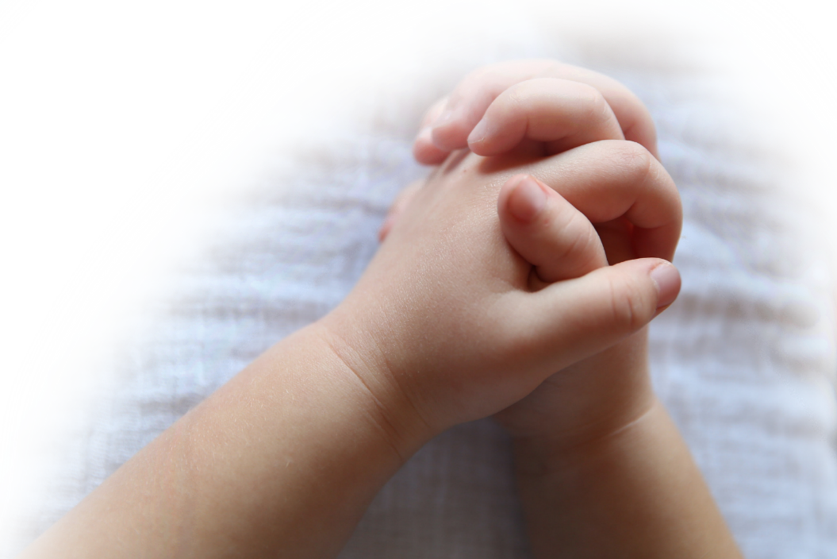
^{Opening Prayer}
^{Prayer to the Holy Spirit}
Come, Holy Spirit, fill the hearts of Your faithful.
And kindle in them the fire of Your love.
Send forth Your Spirit and they shall be created.
And You will renew the face of the earth.
^{Lord,}
by the light of the Holy Spirit
You have taught the hearts of Your faithful.
^{In the same Spirit}
help us to relish what is right
and always rejoice in Your consolation.
We ask this through Christ our Lord.
^{Amen.}

Slide 3
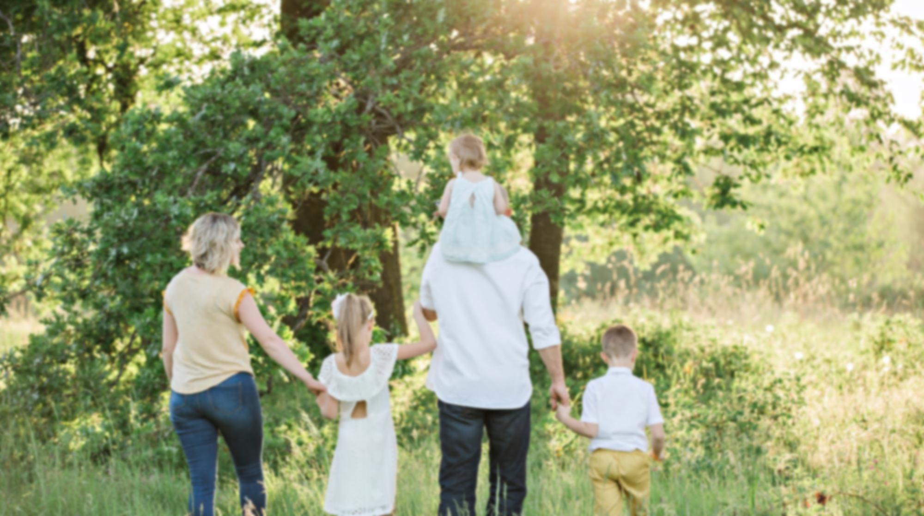
Goals
Families will reflect on the Ascension of Jesus, the mission He gave to the Church, as well as their own family’s mission
Families will reflect on the coming or Descent of the Holy Spirit at Pentecost
Families will reflect on their Living-the-Easter-Season Family Plan

Slide 4
Ice Breaker
^{Questions:}
What is your most favorite thing about Spring? What is your least favorite thing about Spring?

Slide 5
We learned many different prayers including the Rosary and the Chaplet of Divine Mercy this year. Of all the different prayers said throughout this year, which is your favorite and why?

Slide 6
Topics
Today we prayed the powerful Prayer to the Holy Spirit together because we are going to reflect on what the Second and Third Glorious Mysteries of the Rosary, Jesus’ Ascension and the Descent of the Holy Spirit at Pentecost, really mean.

Slide 7
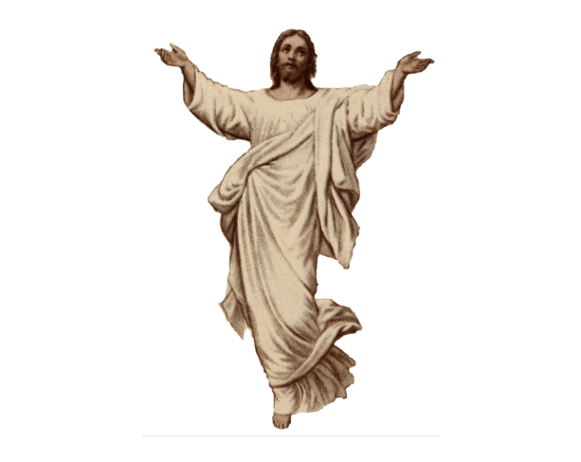
Content
Let’s read together Luke 24:50-53, on the Ascension.

Slide 8
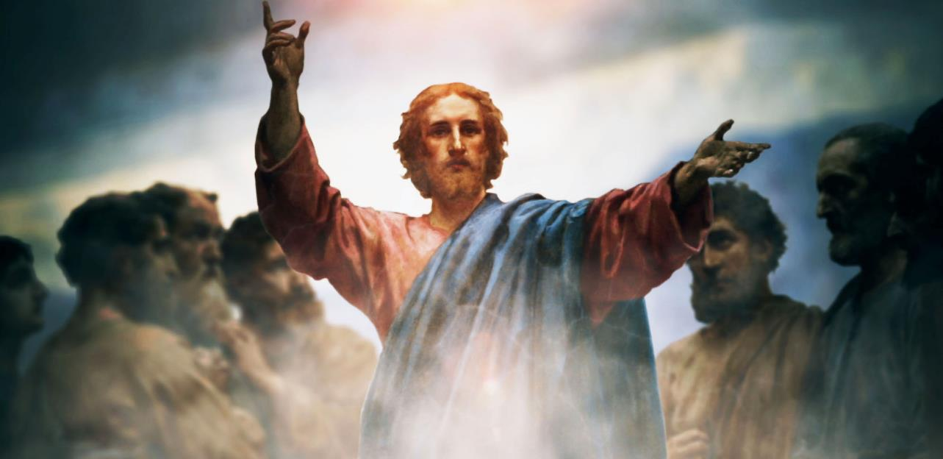
Content
Matthew 28:18-20, The Great Commission, which is Jesus’ final instructions to His disciples right before He ascended into Heaven.

Slide 9
Content
Catholic Kids Media What is the Ascension?! Solemnity of the Ascension, cycle A
https://youtu.be/1SpNKkeOAGY

Slide 10
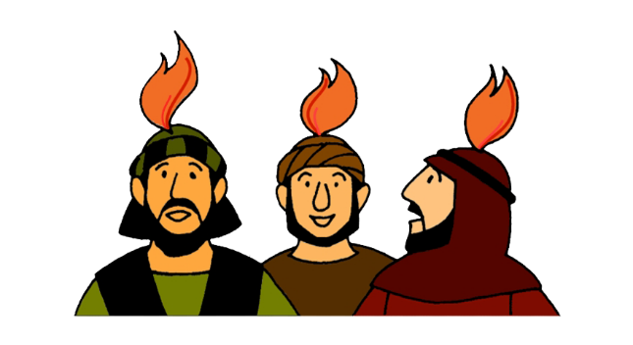
Content
We are the Church, the Body of Christ, so each one of us and each family here has a mission to be Jesus’ witnesses.
How are you a witness for Jesus?
How is your family a witness for Jesus?

Slide 11
Mission
Have a Family Movie Night and together watch the videos on Pentecost.
Together pray for the release and outpouring of the fullness of the Holy Spirit in the life of your family

Slide 12
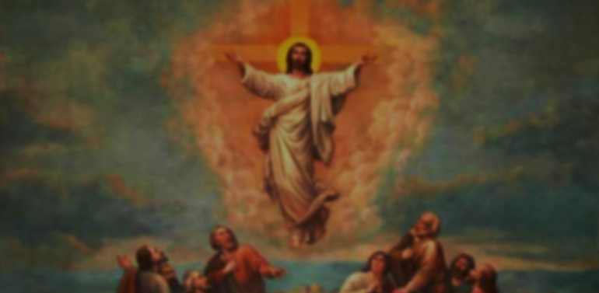
Close in Prayer
Gather around your prayer space/home altar and use the Rosary for Children pamphlets/booklets to pray one decade of the Rosary together in which we will meditate on the Second Glorious Mystery of Jesus’ Ascension into Heaven.

