Slide 1
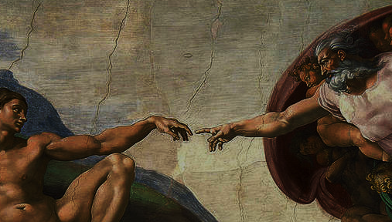
^{Families Forming Disciples}
Creation

Slide 2
^{Opening Prayer}
Lord Jesus Christ,
We entrust our family to you and ask for
your blessing and protection. We love
you Lord Jesus with all our hearts and we
ask that you help our family become more
like the Holy Family. Help us to be kind,
loving, and patient with one another. Give
us all the grace we need to become saints
and your faithful disciples.
Amen.

Slide 3
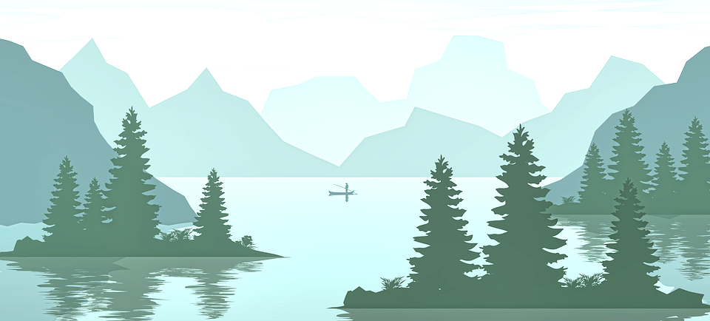
^{Ice Breaker}
Which of God’s creations do you enjoy the most?
Do you prefer the beach or the mountains? What kinds of natural settings or activities do you like, fishing, camping, picnicking, boating, bird watching, etc.?

Slide 4
Concept Review
Today we will talk about how God made a covenant with Adam,
Adam was the High Priest of the Garden of Eden,
and that Jesus is our High Priest.

Slide 5
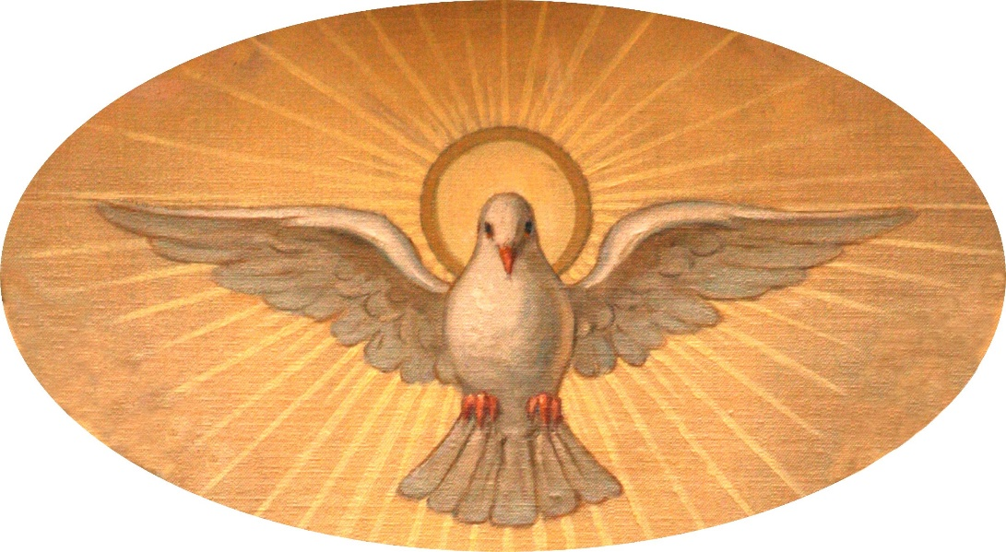
Read: Genesis 2
What do you think the term breath of life means?

Slide 6
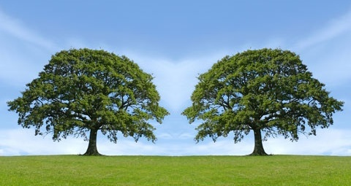
Trees in the Garden of Eden

Slide 7
Adam and Eve
https://youtu.be/6pBF3BHVuQI

Slide 8
Families share their experiences
Whom are you responsible for and
how do you care for them?

Slide 9
^{Liturgical Calendar}
On November 1st, All Saints Day, we celebrate and show God that we are grateful for the saints who are in Heaven and for all the help they give us.
On November 2nd, All Souls Day, we pray for our loved ones who have died as well as for all those who are in Purgatory waiting for us to pray for them, so they too can go to Heaven and finally be with God forever!

Slide 10
Family Sharing
Show a photo/picture and tell about your loved one(s) that you will be praying for during All Souls Day which is celebrated on November 2nd.

Slide 11
^{Close in Prayer}
Since October is the month of the Holy Rosary, we will use the Rosary for Children pamphlets/booklets to pray one decade of the rosary together for your loved ones who have died and for one another.

Slide 12
Reminder of next meeting and prayer

