Slide 1
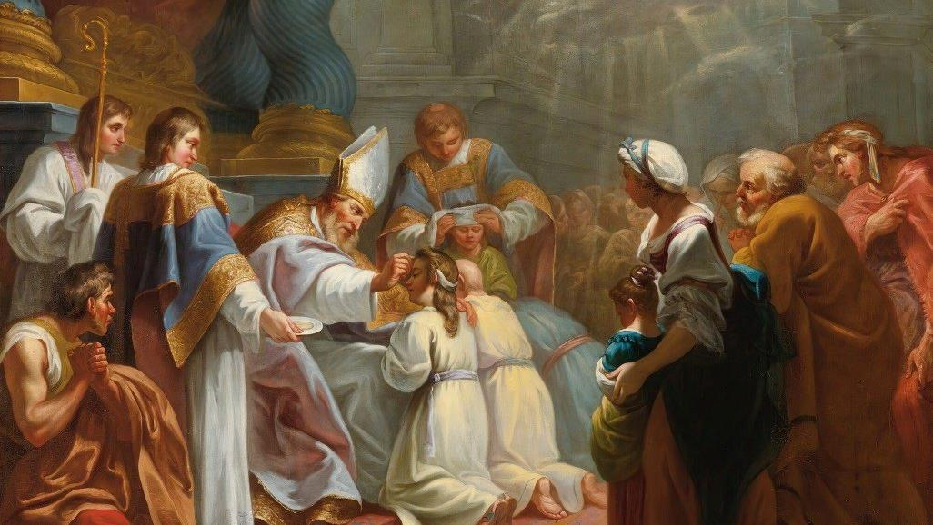
GOD’S SAVING LOVE FOR US:
LITURGY AND THE SEVEN SACRAMENTS
SACRAMENTS OF CHRISTIAN INITIATION: CONFIRMATION

Slide 2
^{Opening Prayer}
Lord Jesus Christ,
We entrust our family to You and ask for Your blessing and protection.
We love You Lord Jesus with all our hearts, and we ask that You help our family become more like the
Holy Family.
Help us to be kind, loving, and patient with one another.
Give us all the grace we need to become saints and Your faithful disciples.
Amen.

Slide 3
^{Ice Breaker}
Art Collector
Everyone a piece of paper and a pencil.
In 5 minutes, each person draws a picture that conveys who he or she is without writing any words or numbers.
At the end of five minutes, the pictures are collected. The leader shows the pictures to the group one at a time and everyone guesses who drew it.
The person who guesses the most correctly gets to be the “Master Art Collector!”

Slide 4
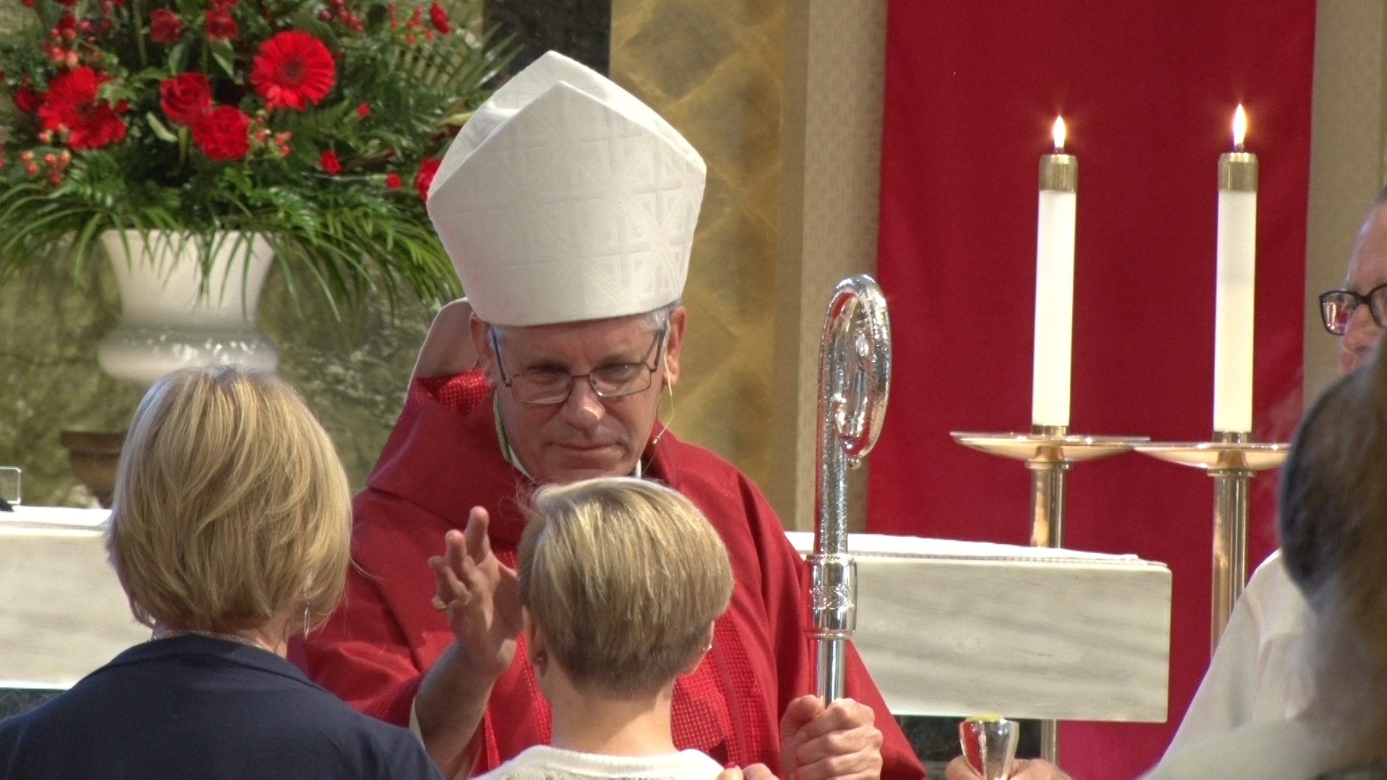
Confirmation is the Sacrament of Christian Initiation that completes baptismal grace. A person is sealed with the Holy Spirit and strengthened by grace and spiritual gifts to spread and defend the faith and to live as a true disciple of Jesus.

Slide 5
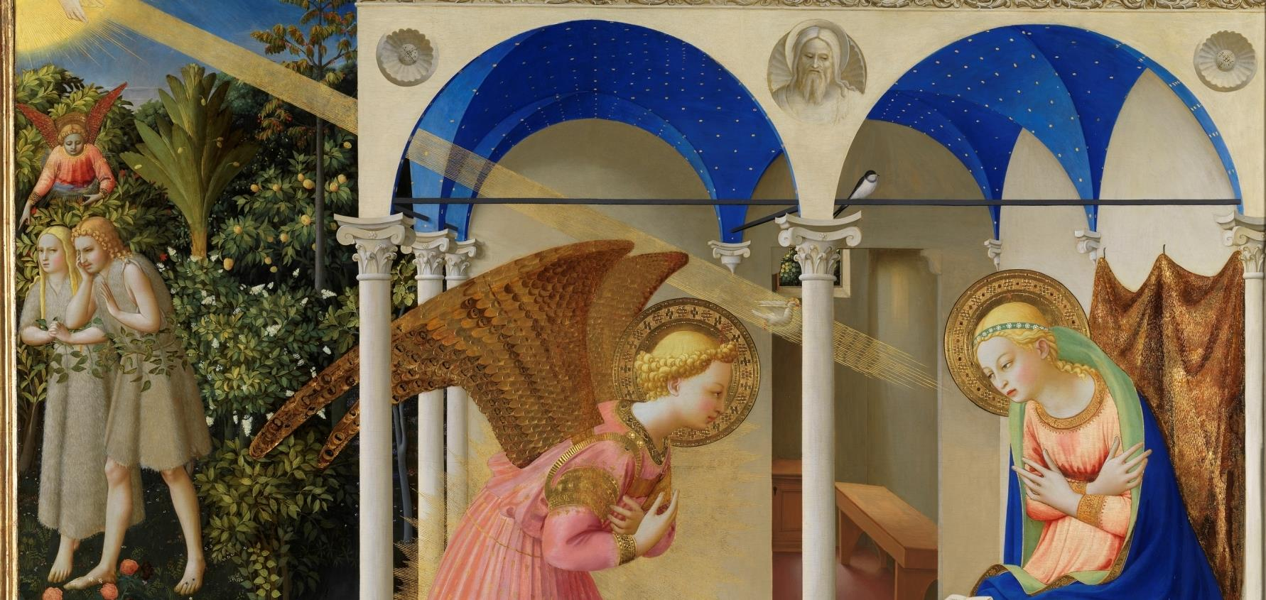
FAMILY BIBLE ACTIVITY
And the angel said to her in reply, “The holy Spirit will come upon you, and the power of the Most High will overshadow you. Therefore, the child to be born will be called holy, the Son of God.” Luke 1:35
Jesus was conceived by the Holy Spirit
Luke 1:26, The Announcement of the Birth of Jesus.

Slide 6
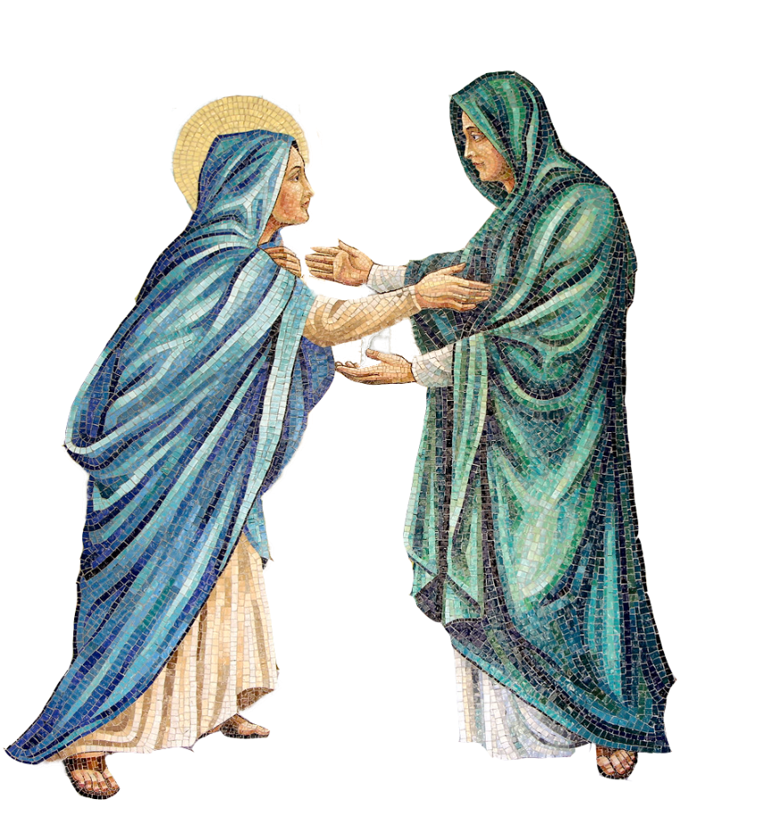
THE VISITATION
Luke 1:39
That Mary travelled to visit her cousin Elizabeth.
We call this event the Second Joyful Mystery,
The Visitation.

Slide 7
Jesus’ entire life and mission was carried out in the
power of the Holy Spirit!
In Luke 1:41-45, who was filled with the Holy Spirit? What did they say about Jesus.
In Luke 1:67-80, who was filled with the Holy Spirit and prophesized about Jesus and John the Baptist?
In Luke 2:25-32, the Third Joyful Mystery, the Presentation of Our Lord, who was filled with the Holy Spirit and prophesized about Jesus and Mary?
In Luke 3:15-16, who prophesized about Jesus baptizing us with the Holy Spirit and fire?
In Luke 3:21-22, the First Luminous Mystery, the Baptism of Jesus, how was the Holy Spirit seen by the people who were there?
In Luke 4:1-2, the Temptation of Jesus, right after His Baptism, who was it that led Jesus into the desert for 40 days?

Slide 8
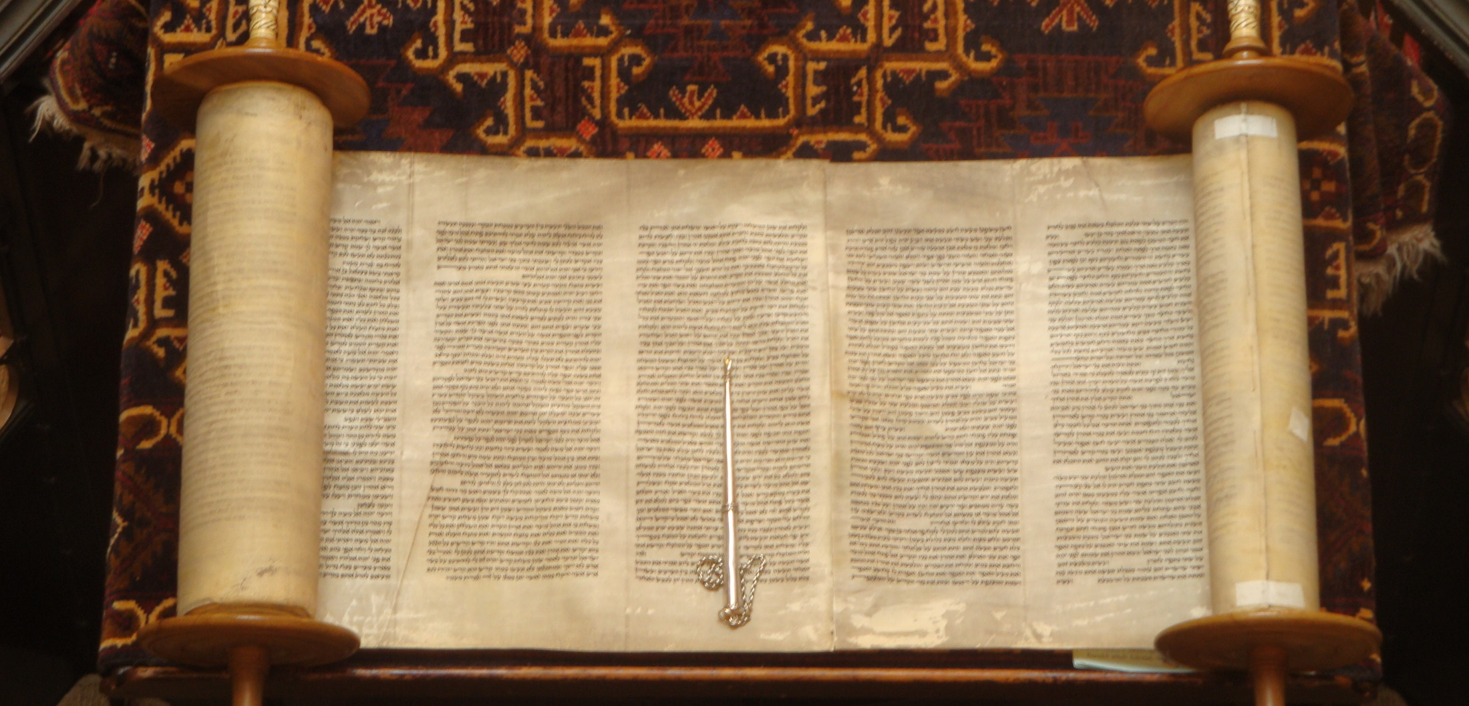
Luke 4:14-21

Slide 9
WATCH
The Holy Spirit | Catholic Central video
^{https://youtu.be/iUFdHxBXM44?}

Slide 10
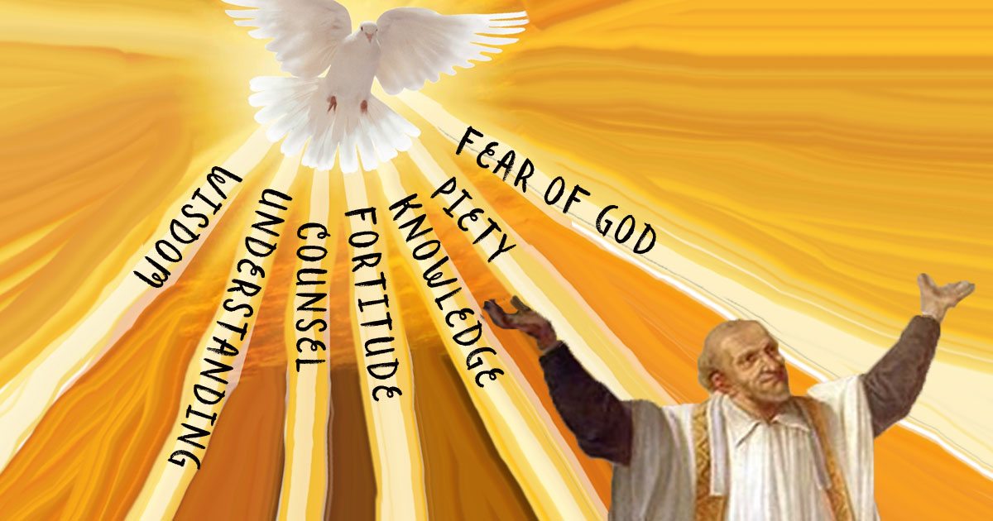
CONFIRMATION
The Gifts of the Holy Spirit are given to us so that we can lead happy, spiritually healthy and holy lives!
As a family share about moments in your lives, or even in your
day-to-day experiences,
when you have needed, or will need, each Gift of the Holy Spirit.

Slide 11
WATCH
Sacraments 101: Confirmation (why we’re confirmed) Busted Halo
https://www.youtube.com/watch?v=Qt32SyDWuW8

Slide 12
FAMILY ACTIVITY
Family members show and share about the sacramentals and photos
from their own Sacrament of Confirmation.
Families answer (some or all of) the following questions:
1. How old were you when you were confirmed?
2. What saint’s name did you choose and why?
3. Who was your Confirmation Sponsor?
4. Why did you want to be confirmed?
5. How do you think you are answering God’s call to live out your mission?
6. What do you hope for your children when they are confirmed and answer God’s call to share in Jesus’ mission in the world?

Slide 13
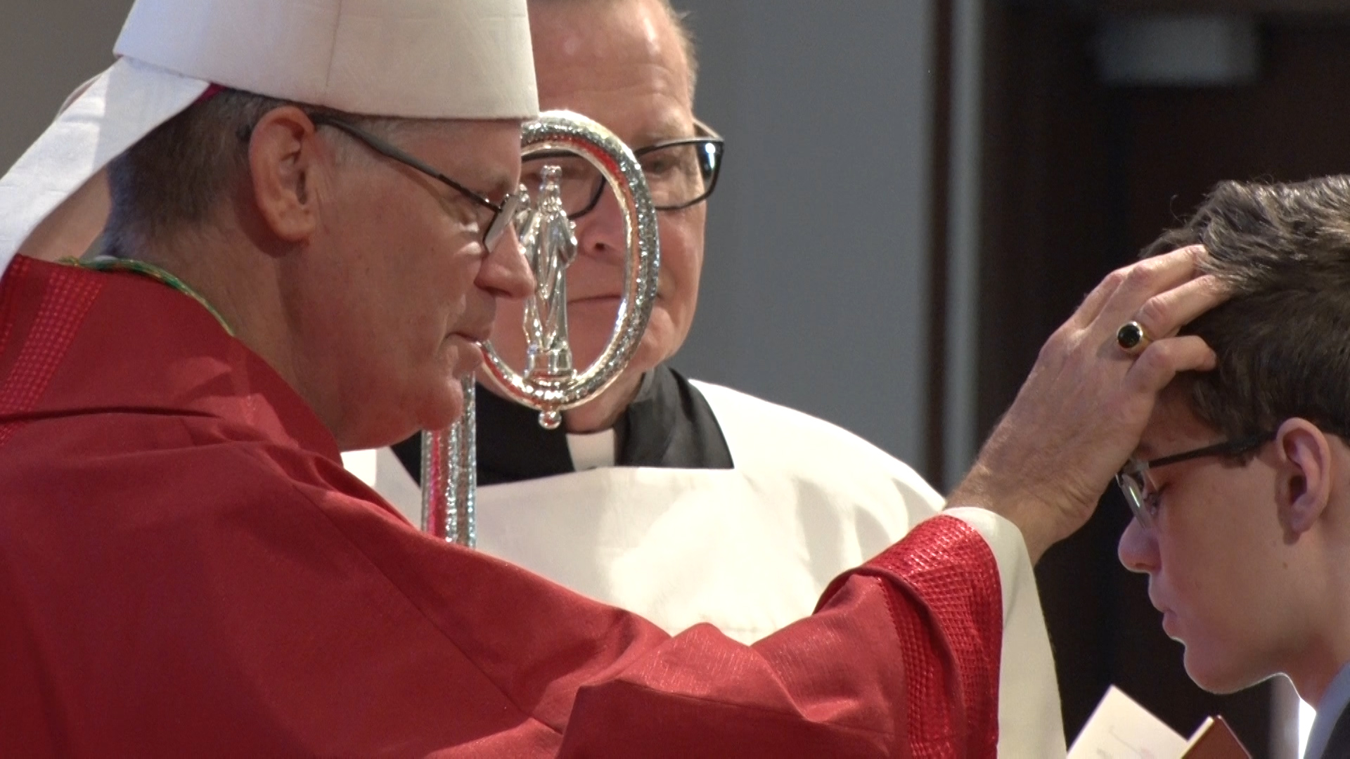
If you have not yet received the Sacrament of Confirmation,
ask your parish leader for information on how you can prepare for the sacrament!

Slide 14
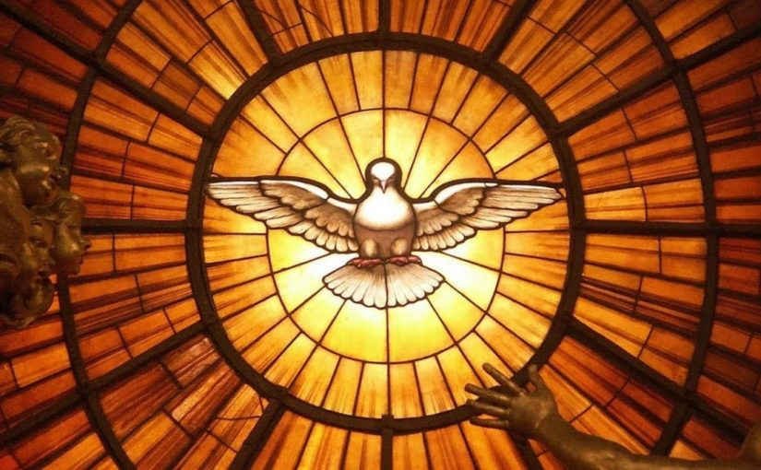
CLOSING PRAYER
Come, Holy Spirit, fill the hearts of your faithful and kindle in them the fire of your love. Send forth your Spirit and they shall be created, and you shall renew the face of the earth.
Let us pray.
O God, who have taught the hearts of the faithful by the light of the Holy Spirit, grant that in the same Spirit we may be truly wise and ever rejoice in his consolation.
Through Christ our Lord. Amen.

