Slide 1
GOD’S SAVING LOVE FOR US:
LITURGY AND THE SEVEN SACRAMENTS
SACRAMENTS OF CHRISTIAN INITIATION: EUCHARIST

Slide 2
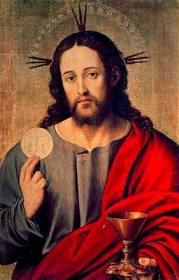
^{Opening Prayer}
Lord Jesus Christ, we entrust our family to You and ask for Your blessing and protection.
We love You Lord Jesus with all our hearts, and we ask that You help our family to become more like the Holy Family.
Help us to be kind, loving, and patient with one another.
Give us all the grace we need to become saints and Your faithful disciples. Amen.

Slide 3
WHAT’S NEXT?
Families sit in a circle.
The first person starts with any word they wish, like “blue.”
The next person repeats the first word then adds another word which links to the first, like “berry.”
The next person repeats the previous word, and adds another word link like “pie.”
To keep this moving, only allow a few seconds for each new word association.
Adapted from www.signupgenius.com.

Slide 4
The Passover Story for Seder Video
https://youtu.be/UFU5NrPgutA?feature=shared

Slide 5
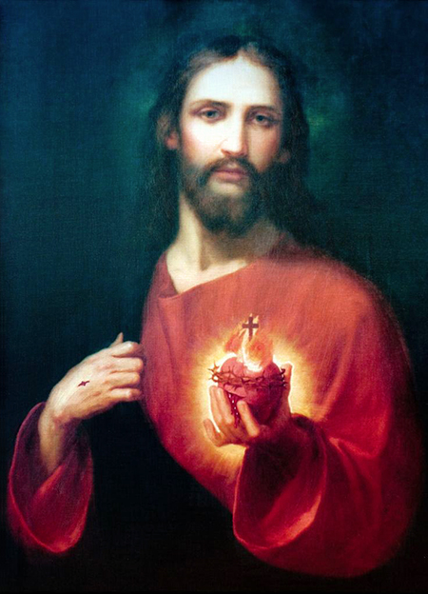
TOPIC
We are going to review what we have learned from the
Old and New Testaments of the Bible about the Eucharist.
Sacred Scripture teaches us about God’s plan to give us the
Heart of His Son, Jesus,
in the
Sacrament of Holy Communion.

Slide 6
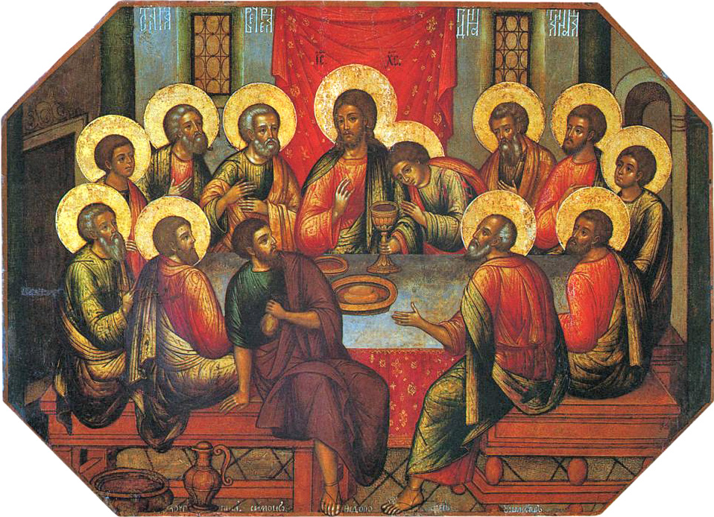
Luke 22:17-20

Slide 7
THE LAST SUPPER
https://youtu.be/c8bkJ-4NMbU?

Slide 8
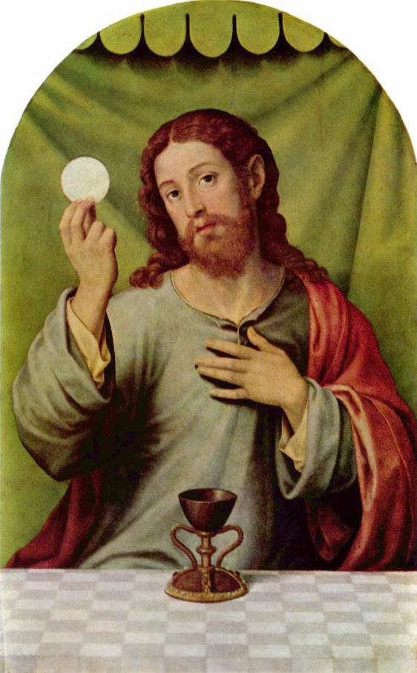
THE LAST SUPPER
What did Jesus say and do at the Last Supper
in the video,
that is the same as
what the priest
says and does at Mass?

Slide 9
FAMILY CONVERSATION
At the Lord’s Last Supper, the Apostles experienced God’s love for them in a way that was beyond anything they could have ever imagined.
Jesus’ offering of His Body and Blood to them left (most of) them speechless, humbled and in awe.
At the Sacrament of the Eucharist today,
we enter into the same moment with God.
As Heaven touches earth at the Consecration, Jesus offers all He is – His Body, Blood, Soul and Divinity – to us as well.
His same perfect sacrifice is made present again to us in the Eucharist.
Why do you believe that Jesus is present in the Sacrament of the Eucharist?
What is it about Holy Communion that shows that God loves you and wants to be part of your life now and forever?

Slide 10
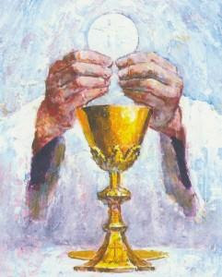
Your FAMILY AT-HOME MISSION is to:
Get ready to share about your family’s plan to celebrate the
Birth of Christ on Christmas Day and during the whole Christmas Season at Week 3’s gathering of families.
2. Watch the videos about the Sacrament of the Eucharist.
3. Parents find items or sacramental(s) that you and your children received at your First Holy Communion. These could be sacramentals, such as a prayer book, rosary, or crucifix/cross, or photos, etc.…
4. Bring those items to the Week 3 gathering.
5. Place your Last Supper Craft on your home altar next to your family bible and pray a decade of the Rosary together, meditating on the Fifth Luminous Mystery, The Institution of the Eucharist at the Last Supper.

Slide 11
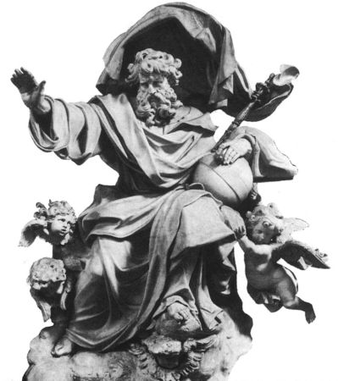
CLOSING PRAYER
Dear God Our Father,
As we prepare our hearts for Christmas, bring us closer to each other and to Your Son.
Give us the grace and strength we need every day.
Help us to always trust in You.
Come, Lord Jesus, lead all people closer to You.
In the name of the Father, and of the Son, and of the Holy Spirit. Amen.
Adapted from dynamiccatholic.com

