Slide 1
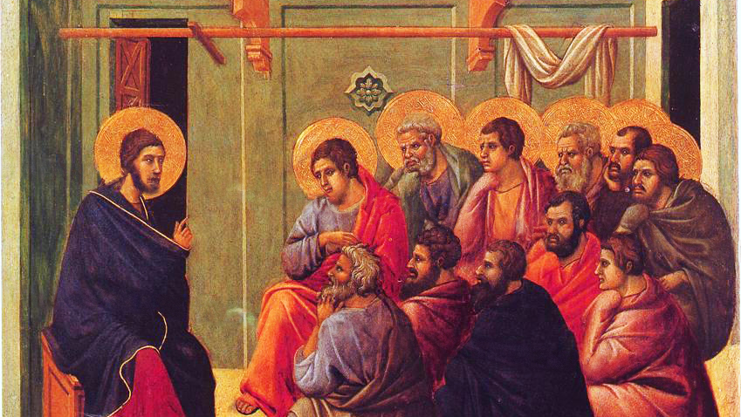
CALLED TO LOVE: THE ADVENTURE OF LIFE IN CHRIST
Topic: The Call to Love of Neighbor
The Fourth Commandment – Family & Community Life
The Last Six Commandments – Loving Yourself and Others

Slide 2
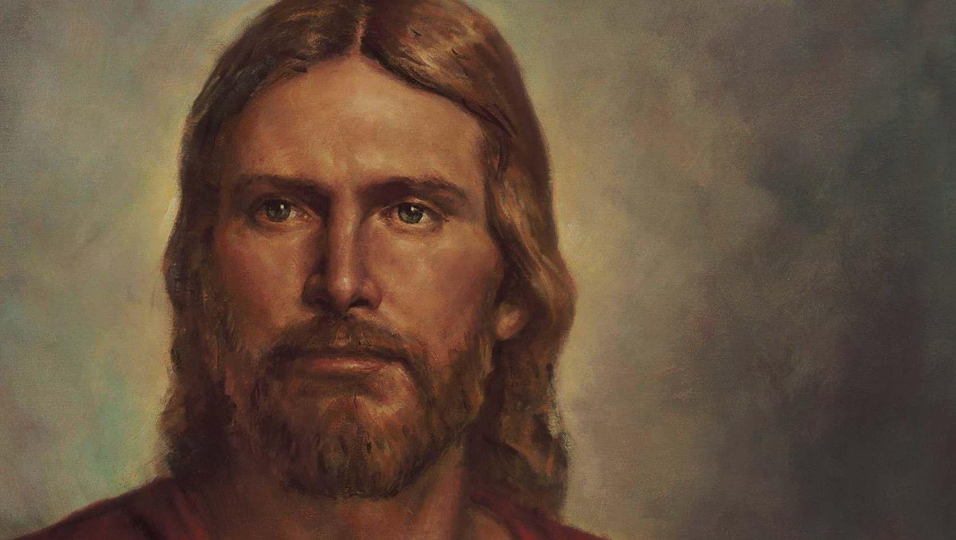
Lord Jesus Christ,
We entrust our family to You and ask for Your blessing and protection.
We love You Lord Jesus with all our hearts, and we ask that You help our family to become more like the Holy Family.
Help us to be kind, loving, and patient with one another.
Give us all the grace we need to become saints and Your faithful disciples. Amen.

Slide 3
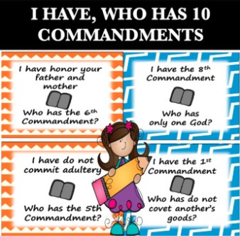
^{Ice Breaker}
I Have, Who Has 10 Commandments
https://www.teacherspayteachers.com/Product/I-Have-Who-Has-10-Commandments-Catholic-4575485

Slide 4
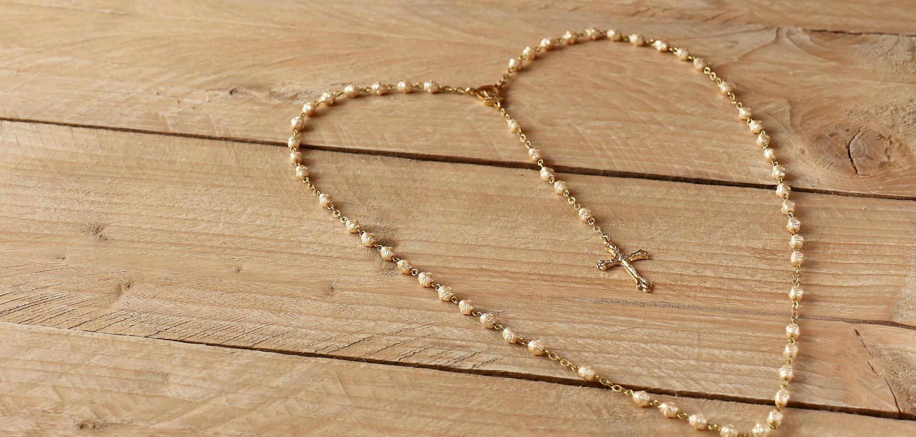
^{Family Sharing}
The last time we gathered your family made a list of special things you have displayed in your homes that show something about who you are and what your family likes.
Then you made a list of holy items you have in your home that show that your family lives the First Commandment of loving God and giving Him first place in your lives and in your homes.
What item did your family bring from your home?
(Or if you don’t have an item with you, describe an item from your home.)
Why is it important to you?

Slide 5
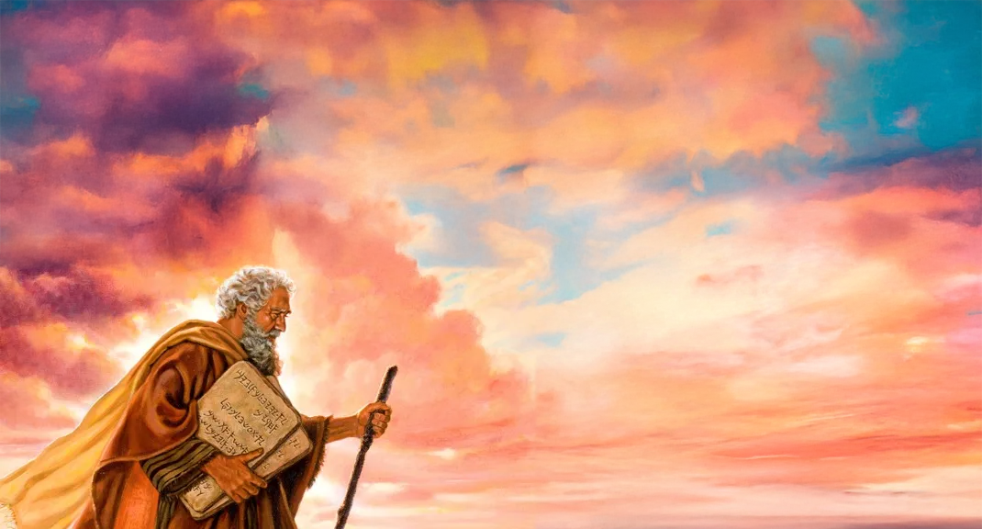
REVIEW
In the Ten Commandments, the first three commandments are all about the ways in which we should show our love for whom?
GOD!

Slide 6
REVIEW
What are the first three commandments?
I am the Lord your God. You shall have no other gods before me.
II. You shall not take the name of the Lord your God in vain.
III. Remember to keep holy the Lord’s Day.

Slide 7
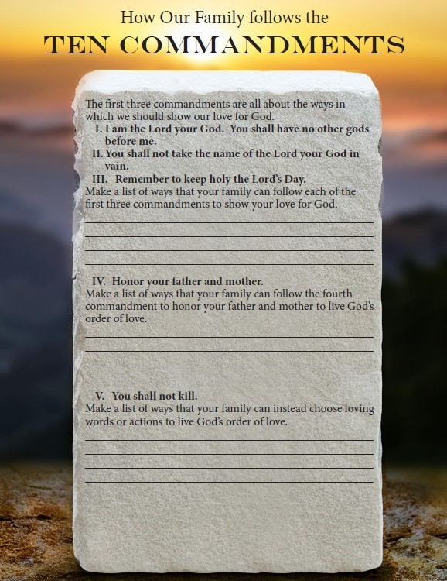
How Our Family Follows the 10 Commandments

Slide 8
The last seven commandments are all about the ways
in which we should show love for our neighbor and for ourselves.
This is God’s Order of Love.
https://www.youtube.com/watch?v=LrxwZNnIUWI
https://www.youtube.com/watch?v=iF4wa8WIMyw

Slide 9
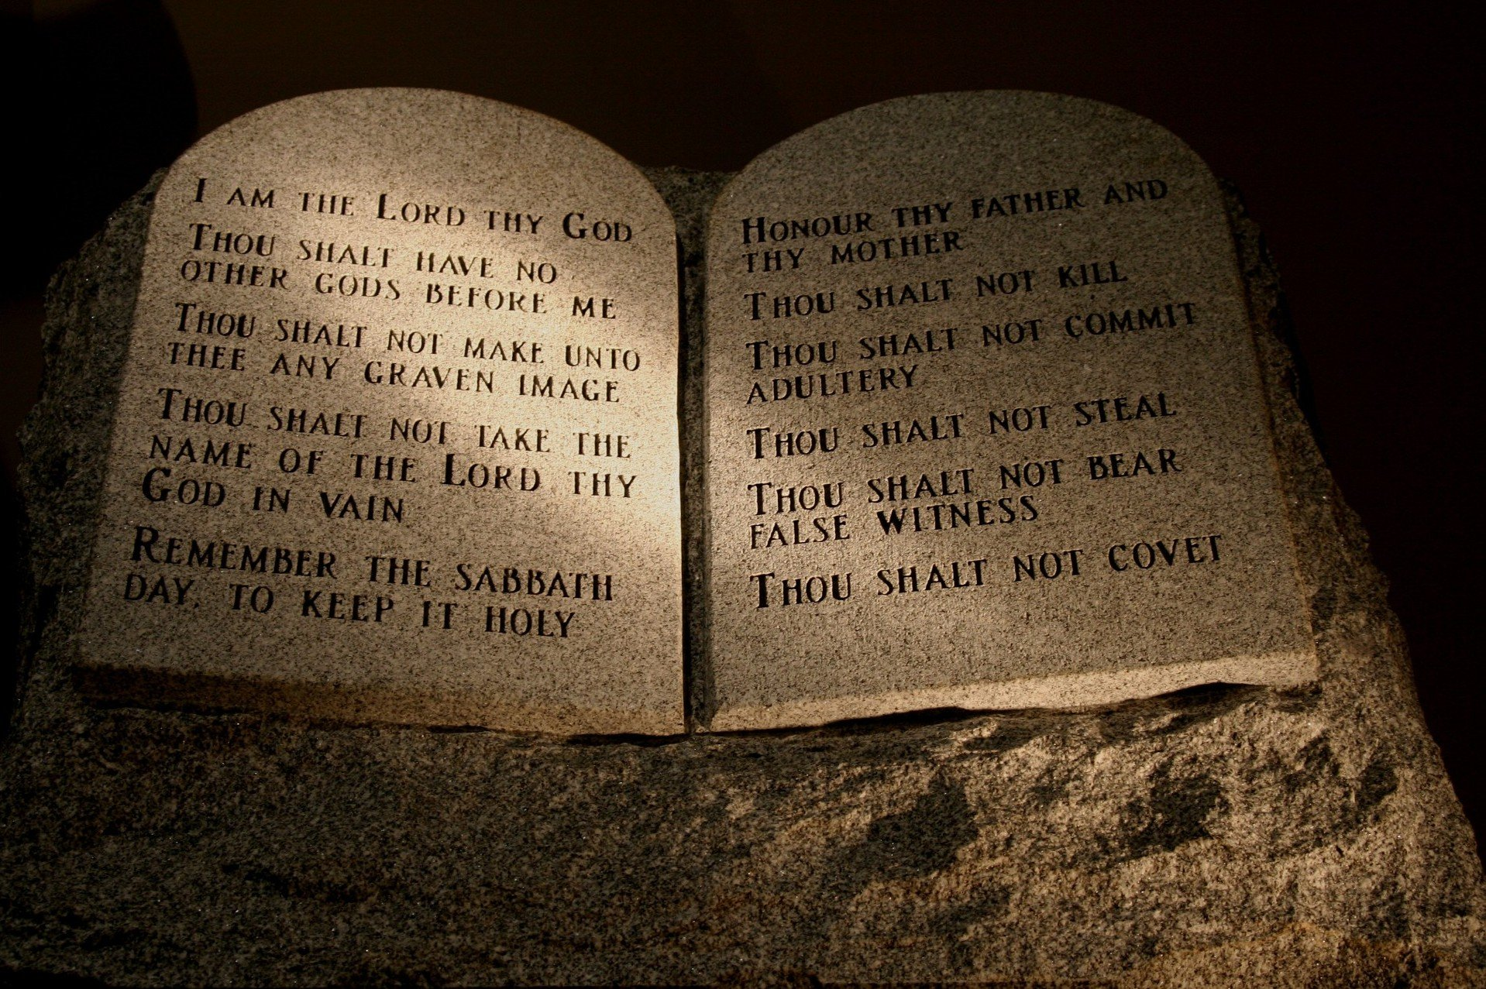
OPEN YOUR BIBLES to Ephesians 6:1-3 and read along!
The 4th Commandment:
“Children, obey your parents in the Lord, for this is right. ‘Honor your father and mother.’ This is the first commandment with a promise, ‘that it may go well with you and that you may have a long life on earth.’”
Make a list of ways that your family can follow the fourth commandment to honor your father and mother to live God’s order of love.
This Photo by Unknown Author is licensed under CC BY-SA

Slide 10
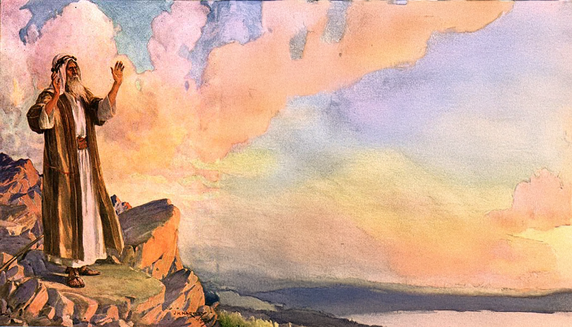
The 5th Commandment is
‘You shall not kill’.
This commandment is not just about murder.
Have we “killed or hurt” someone’s feelings with unkind words or actions?
Make a list of ways that your family can choose loving words or actions to live God’s order of love.

Slide 11
The 6th Commandment is
‘You shall not commit adultery’.
God created marriage, and it is very important that husbands and wives love one another and are faithful. God also wants us to remember that our bodies are temples of the Holy Spirit, so we must respect our bodies, dress modestly and live in God’s order of love.
Make a list of ways that your family can be faithful to one another and show respect for the holy gift of our bodies that are temples of the Holy Spirit to live God’s order of love.

Slide 12
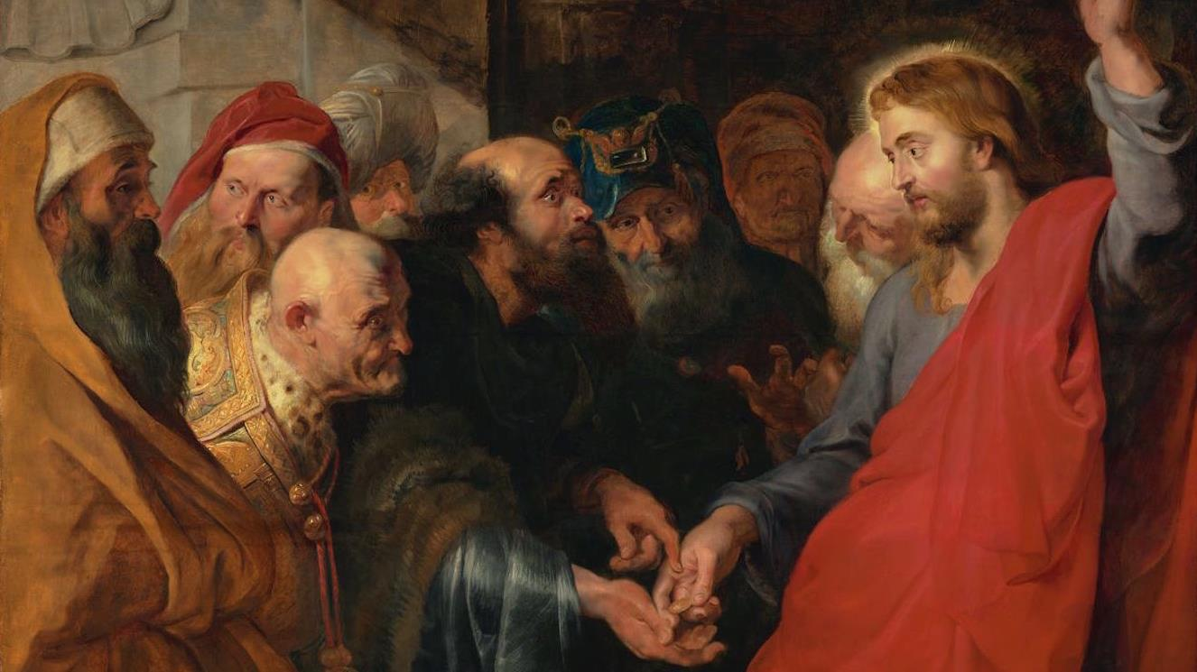
The 7th Commandment is
‘You shall not steal’.
Taking something that does not belong to us is dishonest and wrong. It is also the opposite of being generous and loving.
Make a list of ways that your family can be generous and give to one another and others outside your family to live
God’s order of love.

Slide 13
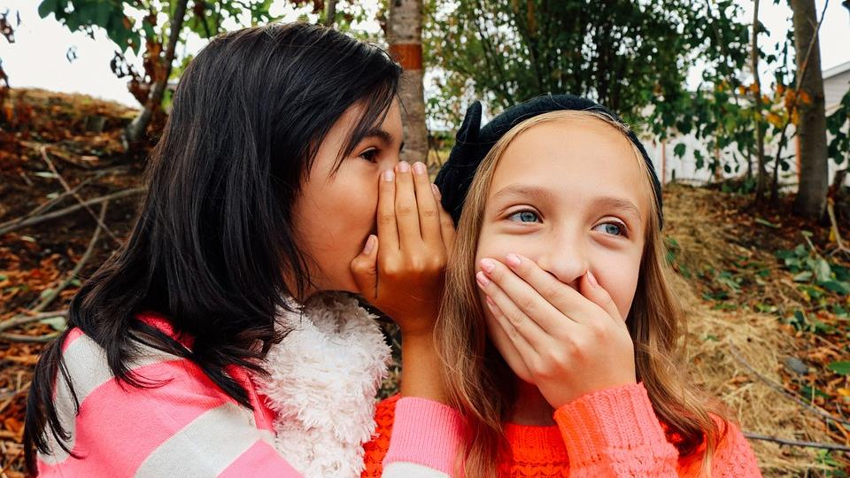
The 8th Commandment is
‘You shall not bear false witness against your neighbor’.
Gossip and bullying are hurtful, and words can really harm. Often what is said or written about others on social media is unkind or even cruel. But loving, kind words are also very powerful!
Write a compliment or words of praise about each family member.
Make a list of ways that your family can be kind to one another and careful with your words at home and outside your family to live God’s order of love.

Slide 14
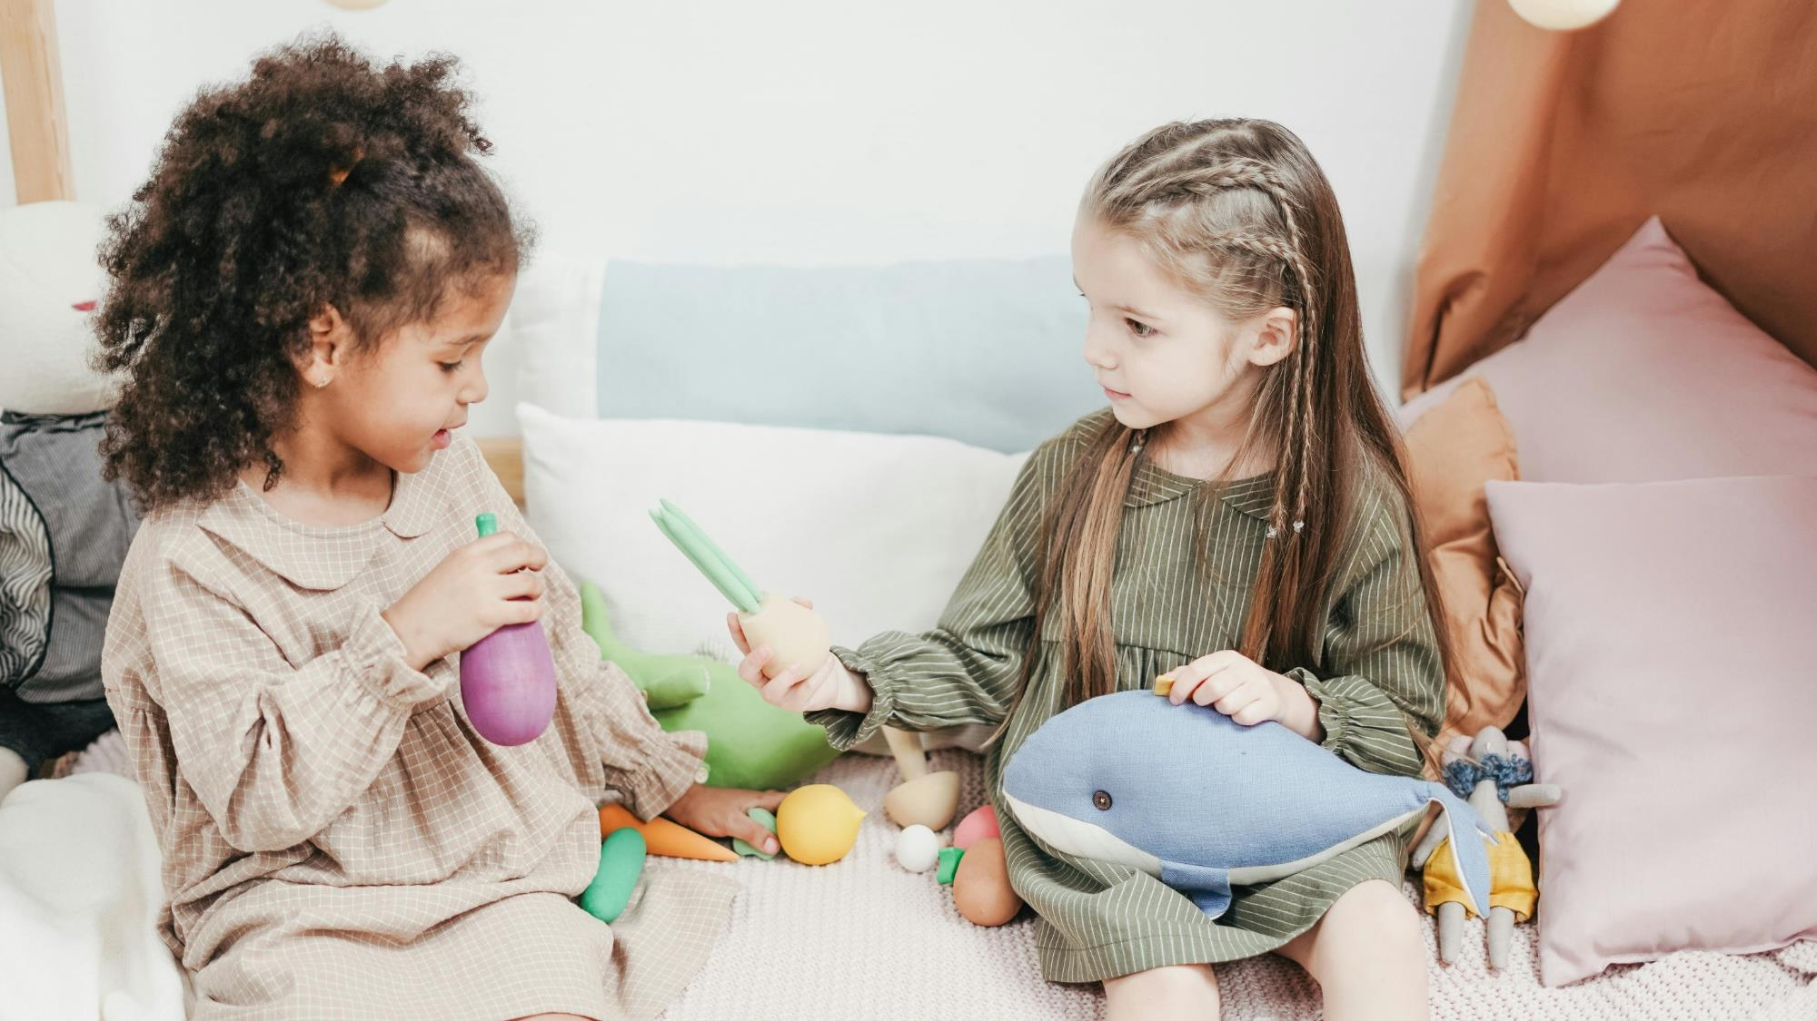
The 9th Commandment is You shall not covet your neighbor’s wife.
What does COVET mean?
The 10th Commandment is
You shall not covet your neighbor’s goods.
Covet means that we are jealous and, even more, envious of (saddened by) what someone else has. It is okay to see something that someone else has and decide, if of course it is God’s will for you, to work to get something good like that for yourself, but it is not okay to want the exact thing or person that belongs to another. That is coveting.

Slide 15
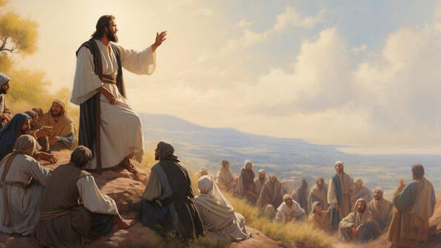
God wants us to be grateful for the beautiful gifts that He has given to us and to trust that He cares for us as our loving Father.
Make a list of the beautiful gifts God has given to your family so that you can live God’s order of love.

Slide 16
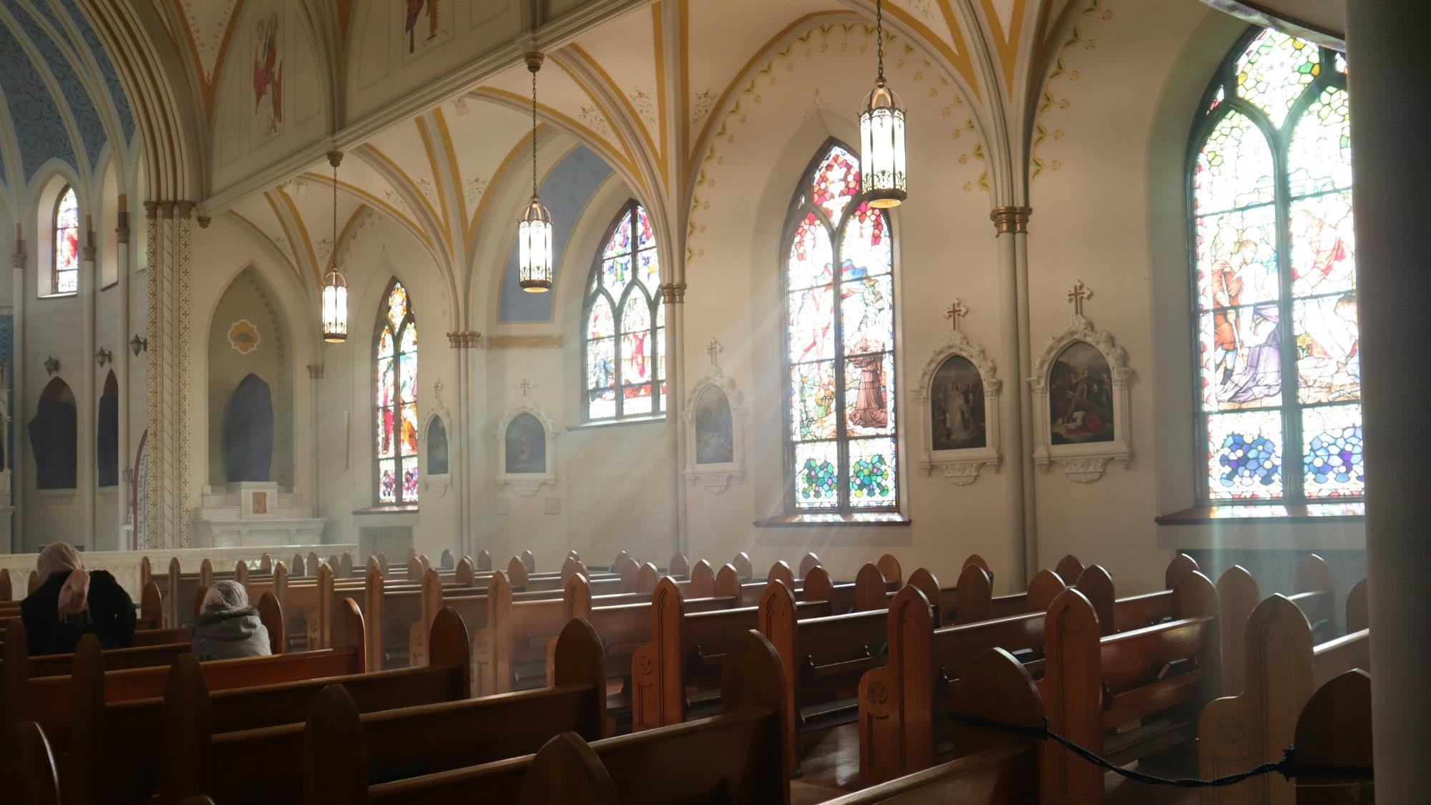
Ten Commandments Prayer Adapted from www.arnoldprays.co.uk
“Dear God,
Help us to put You first.
Remove all the distractions that stop us from focusing all of our attention upon You. Help us to recognize Your power and majesty in the world around us.”

Slide 17
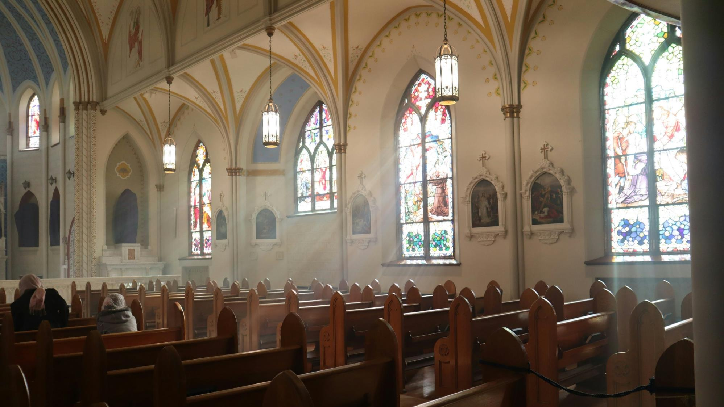
“Dear God,
We know that the words we say are powerful and can have a huge impact.
Help us to control the words we say and to think before we speak.
Help us to not misuse Your name and to value it above all other names.
Show us how we can glorify Your name, respect it and share it with other people.’

Slide 18
“Dear God,
Thank you for the rest that You provide us. Help us to take time out of our busy weeks to spend time with You.
We know that we need rest, help us to keep a regular time of Sabbath rest and to use it well.”

Slide 19
“Dear God,
Thank You for the people who care for me. Thank You for my family and those people who have helped me to grow and learn. Help me to care and respect each of these people. Guide the world to take better care of the elderly, stopping them from becoming isolated and lonely. Help us to remember that they have much to share with us.”

Slide 20
“Dear God,
Be with those people who have been hurt by others and those who have harmed others too. Help them to see alternative solutions and to work for peace and help them to repent and turn to You for forgiveness. Comfort those who have lost loved ones; may they know your peace and presence with them.”

Slide 21
“Dear God, Thank You for the gift of Holy Matrimony. Thank You that You bring people together in love and for the commitment that they make to each other and to You. Watch over and protect all marriages. Help all families to remain focused upon You and upon each other; protect them from the temptations that try to pull them away. Help them to see the beauty in their relationships and give them the wisdom and courage to work to maintain them.”

Slide 22
“Dear God,
Thank You for all the things that You have given to us. Be with those who feel that they need to steal in order to survive.
Provide them with the help and resources that they need. Bless them with people to support them and fair employment.”

Slide 23
“Dear God,
Thank You that you are the truth. Help us to remain honest, even when it takes great courage. Help us to admit our mistakes and to confess our sins before You. Guide us towards what is right and help us not to lie, whether for deception, personal gain or self-preservation.”

Slide 24
“Dear God,
Thank You for the many blessings that we receive each day from Your hands. Help us to be grateful and content with the wondrous gifts we have. Keep our eyes fixed upon You, not upon the possessions of other people. Help us not to compare ourselves to other people, but help us to remember who we are, Your beloved children.”
We ask this in the Holy Name of Jesus. Amen.

