Slide 1
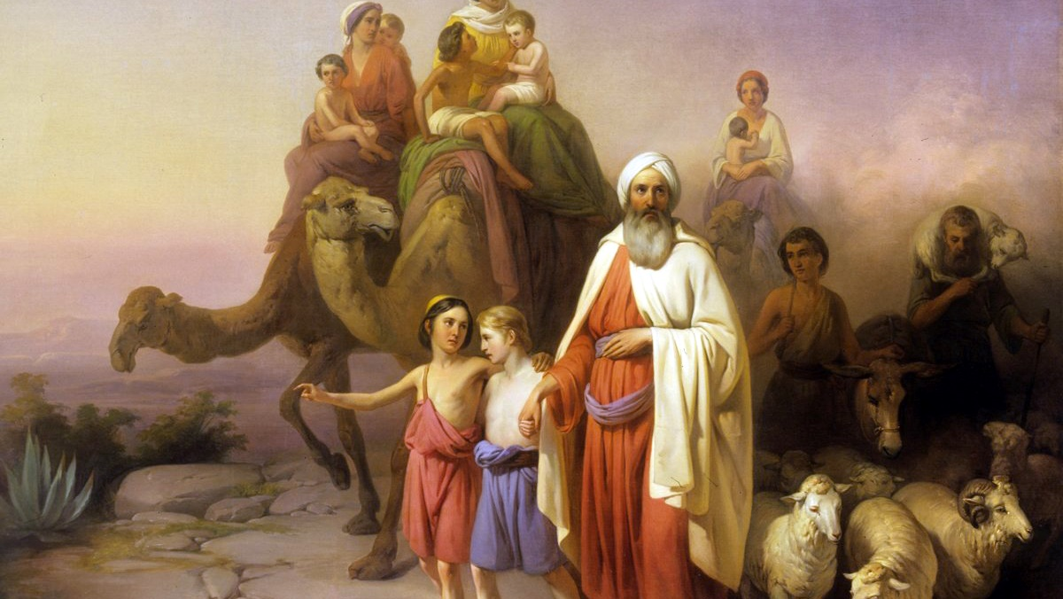
^{Families Forming Disciples}
GOD’S COVENANT WITH ABRAHAM

Slide 2
^{Opening Prayer}
Lord Jesus Christ,
We entrust our family to You and ask for Your blessing and protection. We love You Lord Jesus with all our hearts and we ask that You help our family become more like the Holy Family. Help us to be kind, loving, and patient with one another. Give us all the grace we need to become saints and Your faithful disciples.
Amen.

Slide 3
^{Ice Breaker}
Crocodile Race

Slide 4
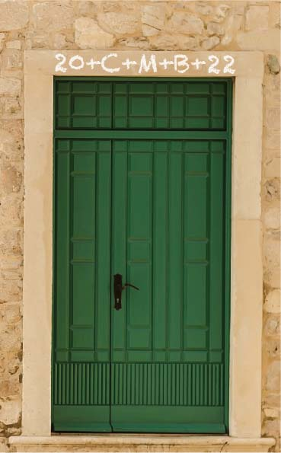
FAMILY SHARING
Each family shares about their
Family Epiphany Blessing experience and show the pictures of their front door.

Slide 5
REVIEW MAIN CONCEPT
God’s Story: Abraham and Sarah “God Keeps His Promises”
https://youtu.be/NdqrwGJYePQ

Slide 6
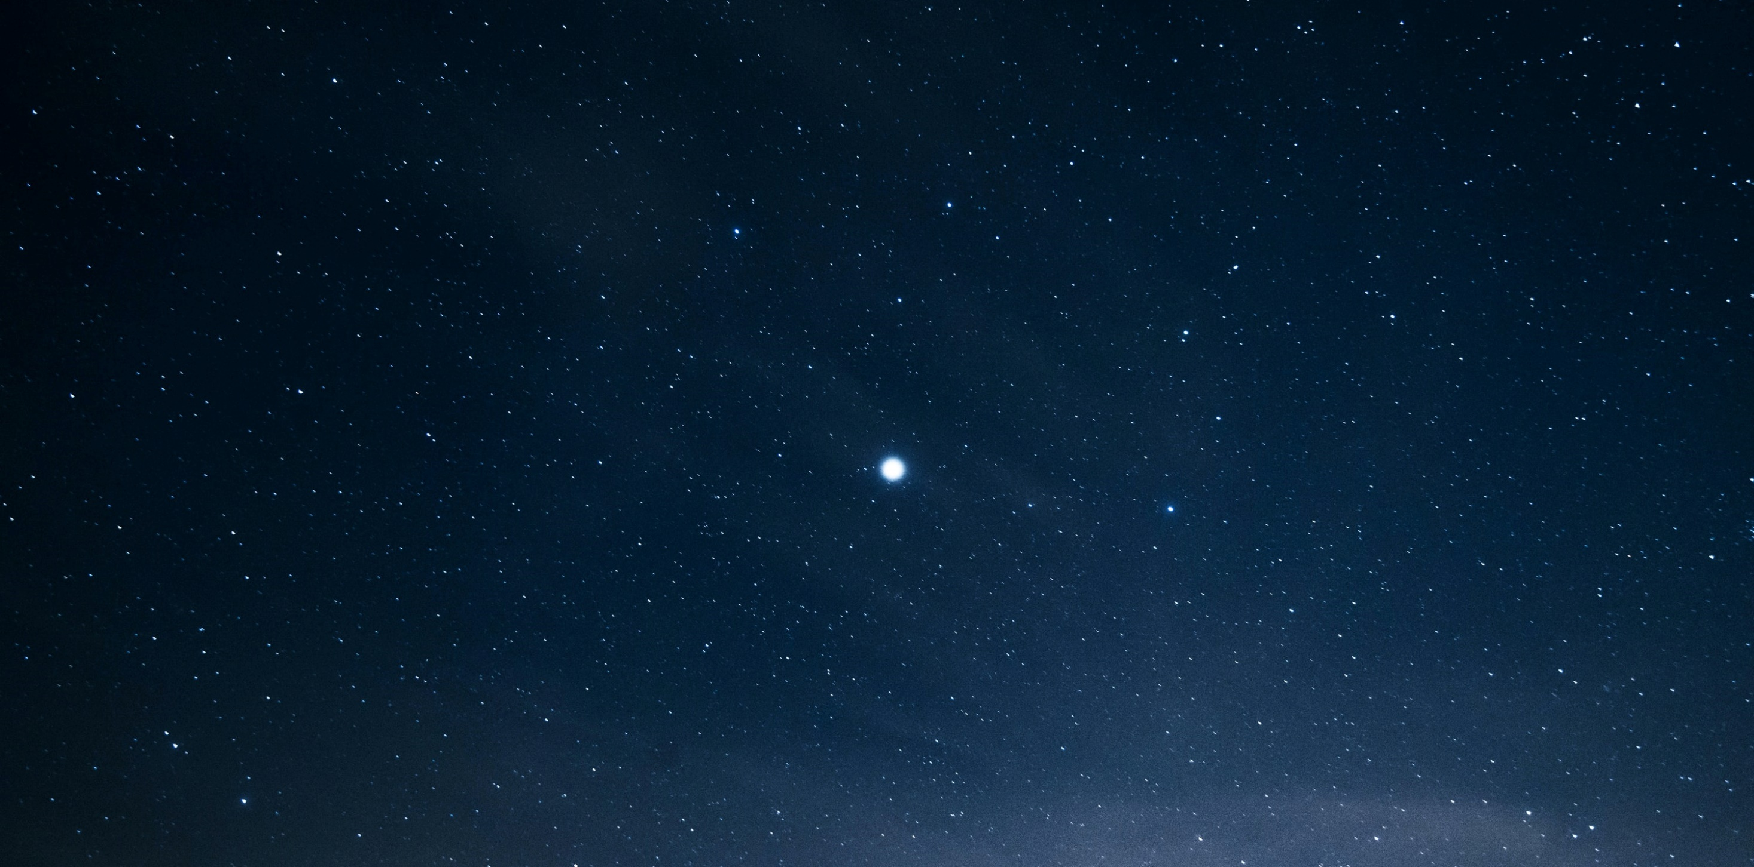
CONTENT
God told Abraham that we, his children, would be like the stars in the sky. As
Christians, we have the brilliant light of Jesus within us. In Baptism, we receive
Jesus into our hearts and souls by the Holy Spirit. Just as the three Magi followed
the light of the star that led them to the Christ Child, we must allow our love for
God to shine brightly too, because that is how we lead one another to Christ.
Jesus tells us: Let your light shine (see Mt 5:16).

Slide 7
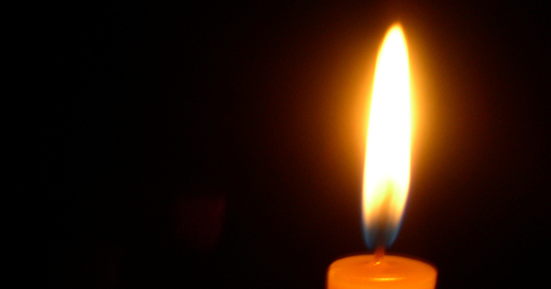
FAMILY CONVERSATION
Each person names two positive qualities in the person on their right that show the light of Christ within them. Examples of these qualities could be: joy, humor, caring, sacrifices, listening well, compassion, generosity, etc…

Slide 8
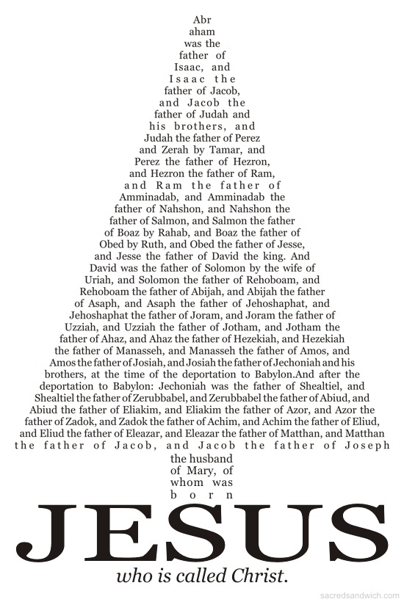
LET’S READ THE BIBLE
Let’s read the Bible!
Matthew 1:1-17

Slide 9
What is a Covenant?
https://www.youtube.com/embed/4q1ntNbQIP8?start=0&end=241

Slide 10
Family Activity
Make a list of all the ways that you can think of that you are living as disciples of Christ, and as blessings to one another and the world around you.

Slide 11
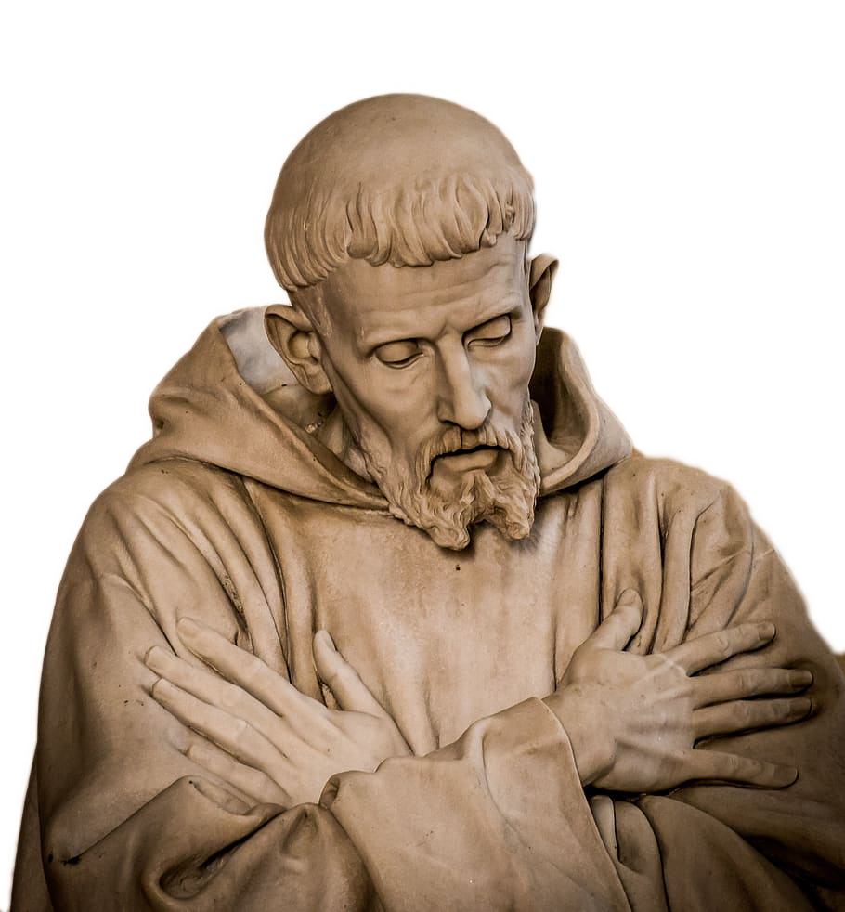
Closing Prayer
Prayer of St. Francis of Assisi
Lord, make me an instrument of your peace;
where there is hatred, let me sow love;
where there is injury, pardon;
where there is discord, union;
where there is doubt, faith;
where there is despair, hope;
where there is darkness, light;
and where there is sadness, joy.

