Slide 1
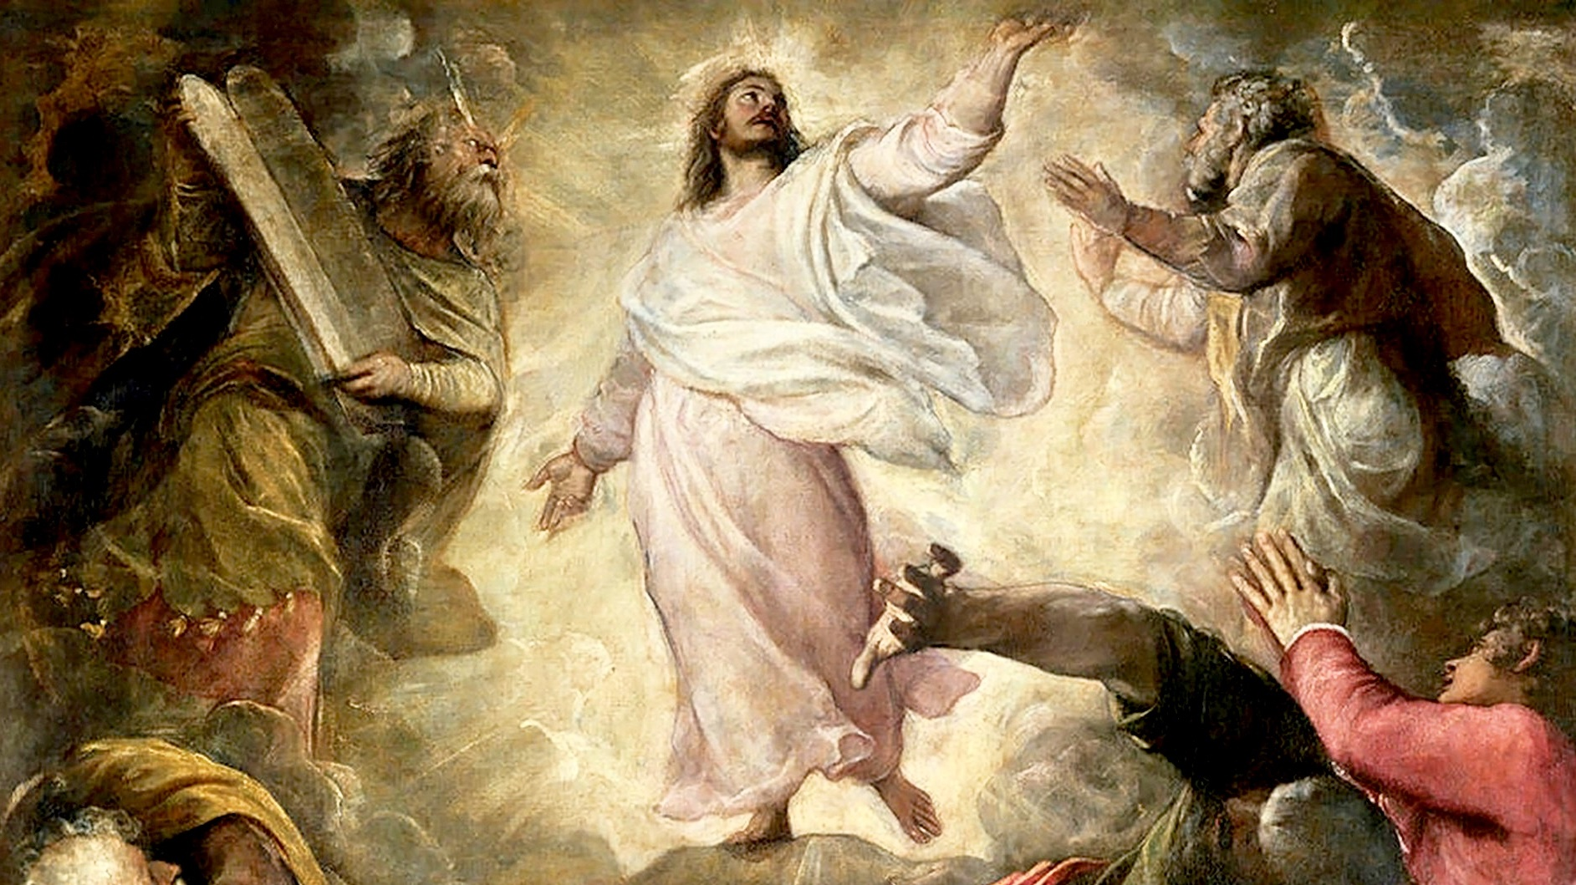
THE LIFE OF CHRIST: THE LUMINOUS MYSTERIES
THE TRANSFIGURATION & EPIPHANY

Slide 2
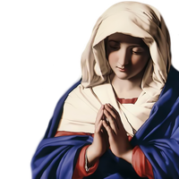
^{Opening Prayer}
Lord Jesus Christ, we entrust our family to You and ask for Your blessing and protection. We love You Lord Jesus with all our hearts and we ask that You help our family become more like the Holy Family. Help us to be kind, loving, and patient with one another. Give us all the grace we need to become saints and Your faithful disciples.
Amen.

Slide 3
^{Ice Breaker}
FIND SOMEONE WHO…
Find a different person for each box.
Can you get a bingo?

Slide 4
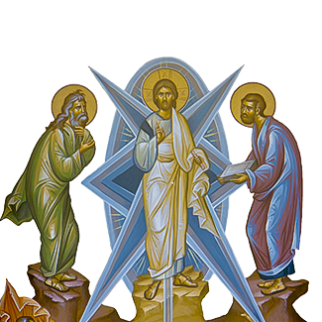
THE TRANSFIGURATION OF JESUS AND THE EPIPHANY

Slide 5
SMALL GROUP
Have you ever gone through a difficult time and something you remembered about God gave you hope and helped you?
Share about that time.

Slide 6
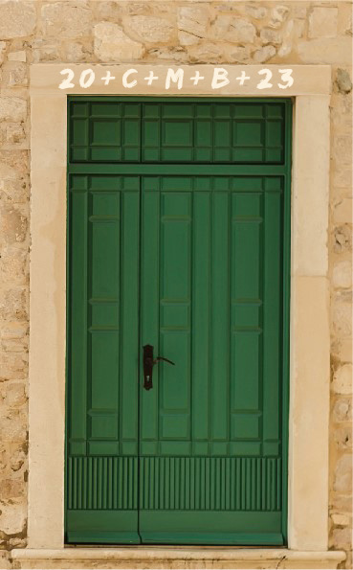
LARGE GROUP
Each family shares about their
Family Epiphany Blessing experience
and shows the picture of their
front doors.
How would you describe your experience?
How did it make you feel, about your family, your home, yourselves?

Slide 7
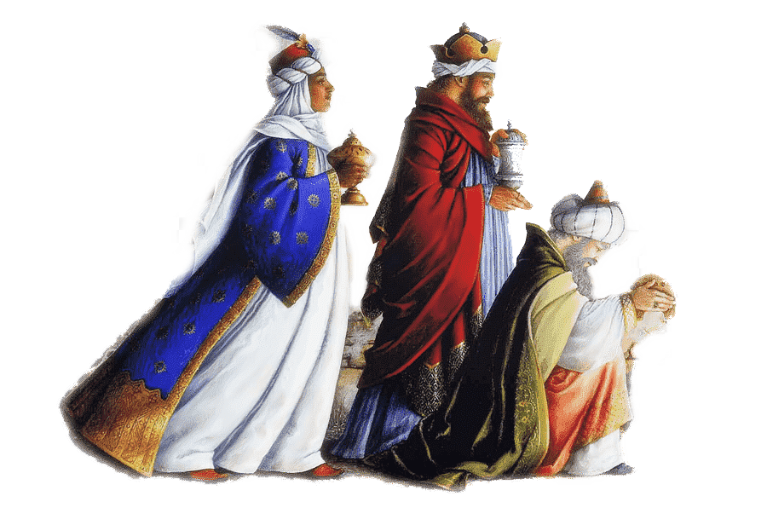
READ MATTHEW 2:1-12
Family Conversation:
The three kings followed a bright star that was shining in the darkness and that led them to the Baby Jesus. Light was important here for the wise men, as it was for Peter, James, and John during Jesus’ Transfiguration.
What are some examples of how the light of God’s grace leads you and your family to Jesus?
Does His grace lead you to pray together as a family?
Does His grace lead you to forgive one another?
Does His grace lead you to help each other?
Give some examples.

Slide 8
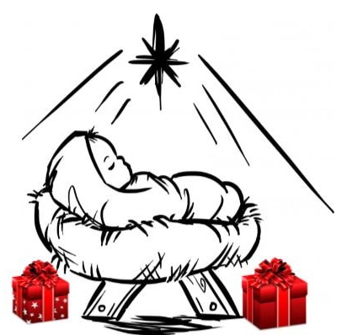
FAMILY ACTIVITY
What Gift Will You Give to Jesus?
Prayerfully think about what you can bring to Jesus Christ our King this year. Spend a few minutes praying and asking God to show you.
Write a prayer and begin the sentence with, “Because Jesus is the King of my life, I will ______________.” Then fill in the blank.
(Examples: “Because Jesus is the King of my life, I will show kindness to those who I sometimes find difficult to love.” or, “Because Jesus is the King of my life, I will spend more time in prayer talking to Jesus.” or, “Because Jesus is the King of my life, I will spend more time reading the Bible.”)
Families decorate a small cardboard or tin box and place your prayers into the box.
Take the boxes home and place them on your home altars as a reminder of the gifts you will bring to Jesus this year.

Slide 9
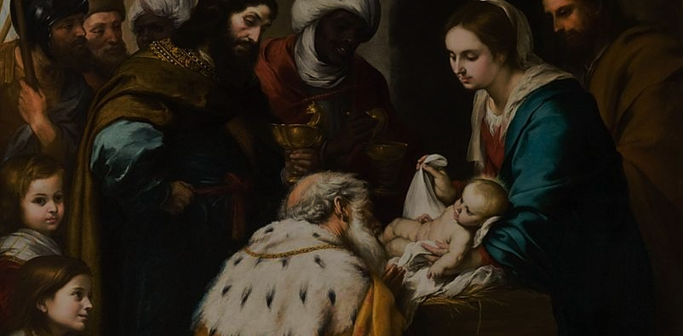
CLOSING PRAYER
O God, by the leading of a star You manifested Your only Son to the peoples of the earth:
Lead us, who know You now by faith and not by sight, to Your presence, where we may see Your glory face to face;
through Jesus Christ our Lord,
Who lives and reigns with You in the unity of the Holy Spirit, God, forever and forever. Amen.
Adapted from KathyrnShirey.com

