Slide 1
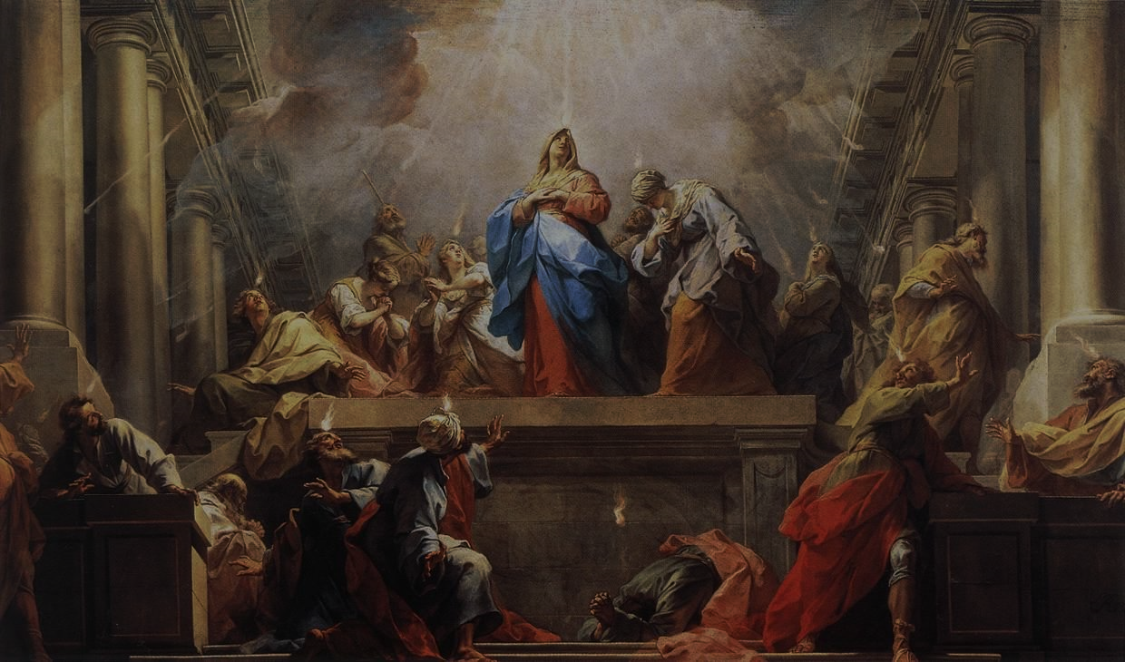
FAMILIES FORMING DISCIPLES
^{Lesson 9 – Week 3}

Slide 2
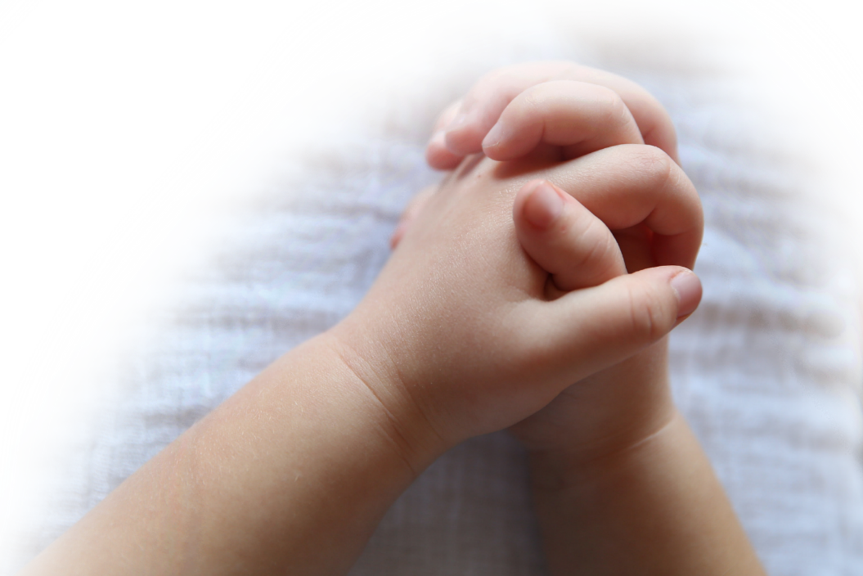
^{Opening Prayer}
^{Prayer to the Holy Spirit}
Come, Holy Spirit, fill the hearts of Your faithful.
And kindle in them the fire of Your love.
Send forth Your Spirit and they shall be created.
And You will renew the face of the earth.
^{Lord,}
by the light of the Holy Spirit
You have taught the hearts of Your faithful.
^{In the same Spirit}
help us to relish what is right
and always rejoice in Your consolation.
We ask this through Christ our Lord.
^{Amen.}

Slide 3
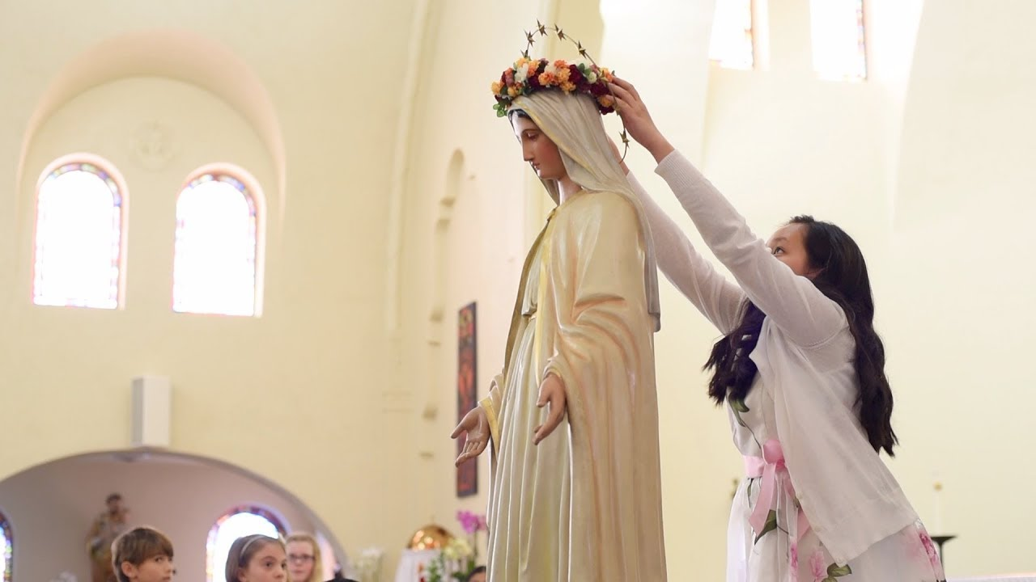
Materials
Rosaries
Rosary for Children Pamphlet
Music
Altar
Statue of Mary
One flower per person
Large vase(s)
Crown for Mary
Birthday Cake with plates, napkins, utensils
Ice cream is optional but preferred!

Slide 4
Ice Breaker
See which family can line up in order of the month of their birthdays the fastest

Slide 5
Family Sharing
What do you like best about
birthdays?

Slide 6
Content
What is sometimes called the
“birthday or baptism of the Church”?

Slide 7
Content
^{Answer: Pentecost}
Today we are going to learn about Pentecost and how the coming or Descent of the Holy Spirit strengthens us to live the mission Jesus has given to us in and through the Church.

Slide 8
Content
Video: Pentecost by Catholic Central
(1:45) https://youtu.be/a4EiXCUAmDo

Slide 9
Content
Video: Pentecost Catholic [Forever Changed], Catholic Minute (6:48)
^{https://youtu.be/dxBGdcmHdWE}

Slide 10
Prayer
Come Holy Spirit, come
Fill us with the grace that the Apostles experienced in the Upper Room
Renew our baptismal consecration and transform us
Anoint us with the fire of Your love
Release and pour out the fullness of Your Spirit within our family life
So that we may go out and preach the Good News
Holy Spirit, come
Holy Spirit, come
Holy Spirit, come
Glory Be…

Slide 11
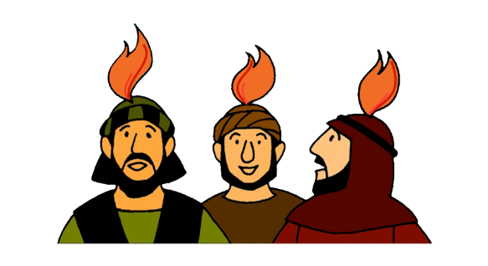
Family Sharing
How did receiving the Holy Spirit at Pentecost change the Apostles?
For those who are Confirmed, has receiving the Holy Spirit at your Confirmation changed you or given you strength to share in the Church’s mission of witnessing to Christ? If so, how?

Slide 12
Open Mic!

Slide 13
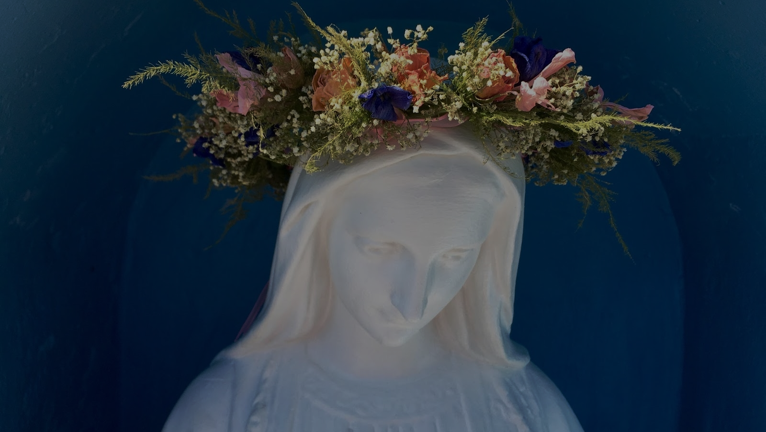
May Crowning
May Crowning Directions:
Decorate an outside altar (weather permitting, otherwise inside) where you have placed a statue of Mary.
Make a crown of flowers that will fit the statue. Let the smallest child carry the crown.
Give everyone else a flower to be placed in a vase on the altar.
Tell the children that the flower is a symbol of their love for their heavenly Mother.
Line up in a procession and sing a Marian song, like “Immaculate Mary,” as each family processes to the altar and places their flowers in the vase(s).
Pray: After the crowning, gather around the altar and pray the Fifth Glorious Mystery of the Coronation of Mary as Queen of Heaven and Earth.

Slide 14
Conclude
Since we have learned about Pentecost, the Birthday/Baptism of the Church,
conclude the Families Forming Disciples year by thanking God for the gift of faith and celebrating with birthday cake!

