Slide 1
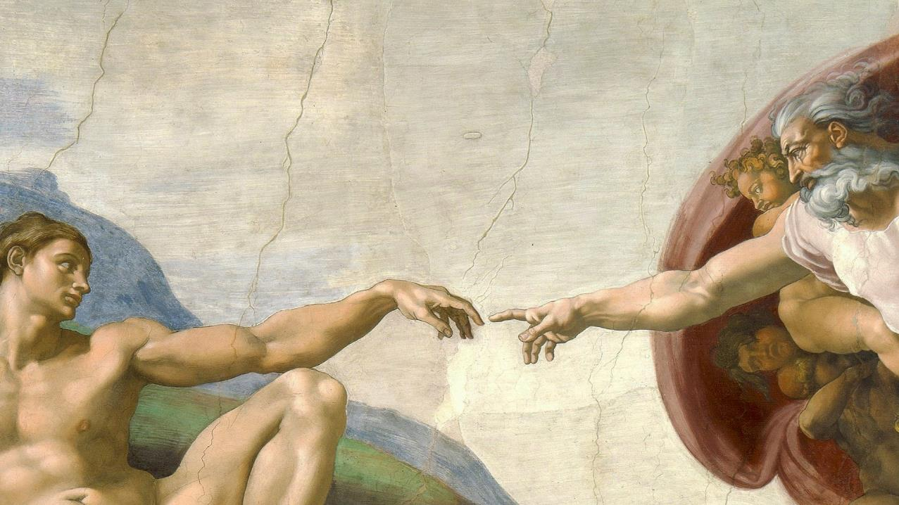
CALLED TO LOVE: THE ADVENTURE OF LIFE IN CHRIST
Topic: God Creates Order and Harmony

Slide 2
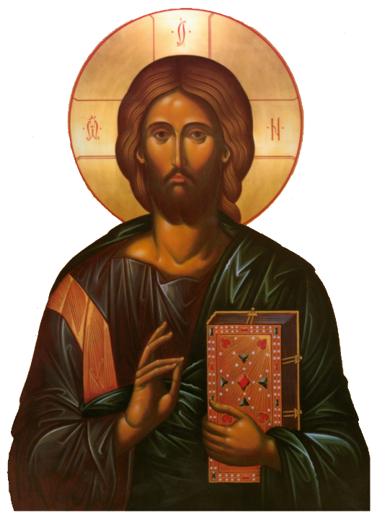
^{Opening Prayer}
Lord Jesus Christ, we entrust our family to You and ask for Your blessing and protection.
We love You Lord Jesus with all our hearts, and we ask that You help our family to become more like the Holy Family.
Help us to be kind, loving, and patient with one another.
Give us all the grace we need to become saints and Your faithful disciples. Amen.
This Photo by Unknown Author is licensed under CC BY-NC

Slide 3
^{Ice Breaker}
What if…?
What if you woke up as an animal tomorrow, what animal would you want to be?
What if it started to rain desserts tomorrow, what treat would you choose?
What if you could have one wish, for what would you wish?
This Photo by Unknown Author is licensed under CC BY-NC

Slide 4
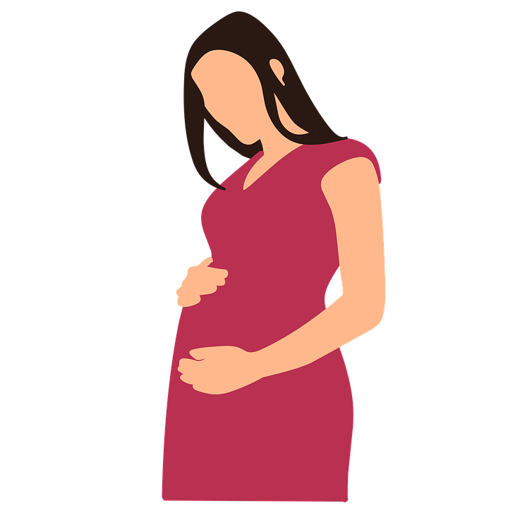
FAMILY SHARING
When a mother and father learn that they are going to have a child, how do they prepare?
Parents share with your children what you did to prepare for their birth.

Slide 5
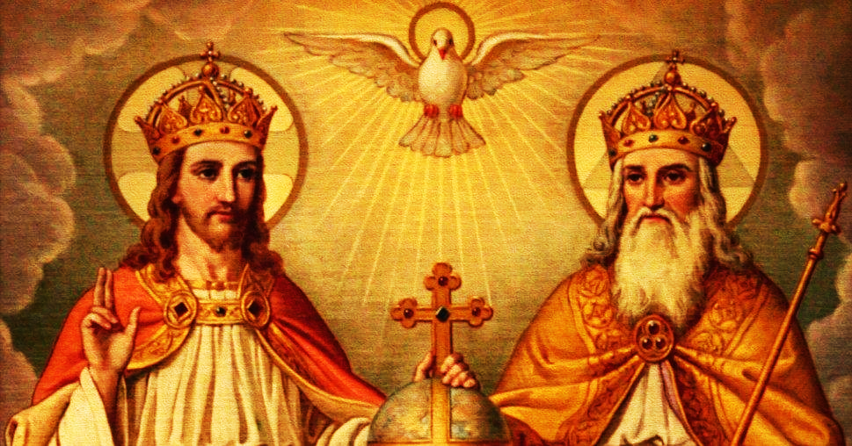
REVIEW
Last time we were together at Families Forming Disciples, we learned that the Holy Trinity is “Family” in a unique sense.
In fact, it is the first “Family” that ever existed. It always has existed and it will always exist, forever.
In the eternal life of the Trinity, God the Father, God the Son and God the Holy Spirit love each other with an eternal love.
God is love, and He also decides out of love to multiply and grow His larger family.
But first, God knew His children would need a home.
The Holy Trinity, the one God, was the first “parent” to ever prepare a home for His children.
This Photo by Unknown Author is licensed under CC BY-SA

Slide 6
REVIEW
Parents show their love for their baby even before he/she is born by gathering items the baby will need and putting their house in good order, so their home will be ready when the baby arrives.
This is exactly what the Holy Trinity, the first “Family” did.
The One God showed His great love for us by preparing a home for us, His children.

Slide 7
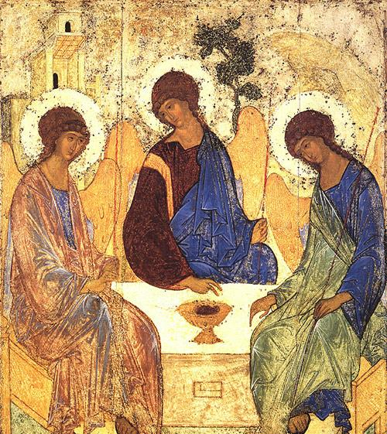
The Holy Trinity is the first Family that ever existed!
In fact, we read in the Bible that
God is love.
The Trinity – God the Father, God the Son and God the Holy Spirit- eternally loved each other and loved being Family so much that the One God decided, out of love, to multiply and grow His family.
So, God created us, human beings, in His own image and likeness, to love and be loved and to be His family!
This Photo by Unknown Author is licensed under CC BY

Slide 8
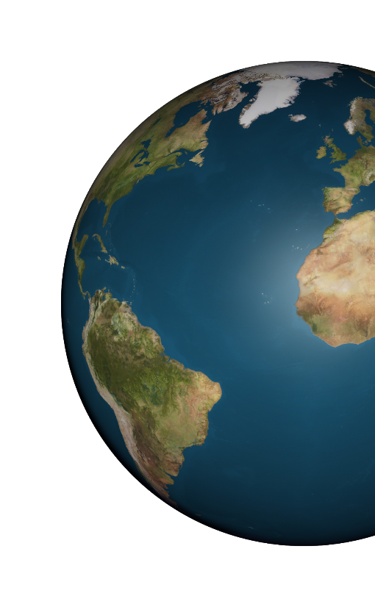
GENESIS 1:1
Genesis 1:1 tells us, “In the beginning God created the heavens and the earth. The earth was without form and void, and darkness was upon the face of the deep; and the Spirit of God was moving over the face of the waters.”
What words describe how the earth was at the very beginning of creation?

Slide 9
GENESIS 1:1
Genesis teaches us that God created everything out of nothing.
It also teaches us that God is a God of order, and God’s order brings us joy, peace and harmony.
He knew His children would need order to live on the earth, to thrive, to be healthy and grow.
As we listen to the First Story of Creation from the Bible, think about where we can see God creating order in the natural world as He was preparing the earth to become our home.

Slide 10
THE GOSPEL PROJECT FOR KIDS: THE CREATION STORY
https://www.youtube.com/watch?v=cstDniigA-w

Slide 11
CONVERSATION
In the First Story of Creation,
where did you see God creating
order (or patterns) in our natural world?

Slide 12
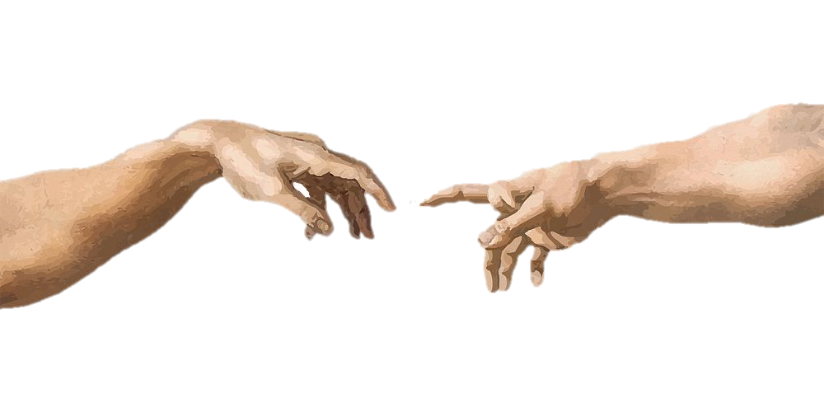
GENESIS 1:26
Then God said: “Let us make man in our image, after our likeness. Let them have dominion over the fish of the sea, the birds of the air, and the cattle, and over all the wild animals and all the creatures that crawl on the ground.”
What does it mean to be made in God’s image and likeness?
As human beings, we are made of a body and a _______?

Slide 13
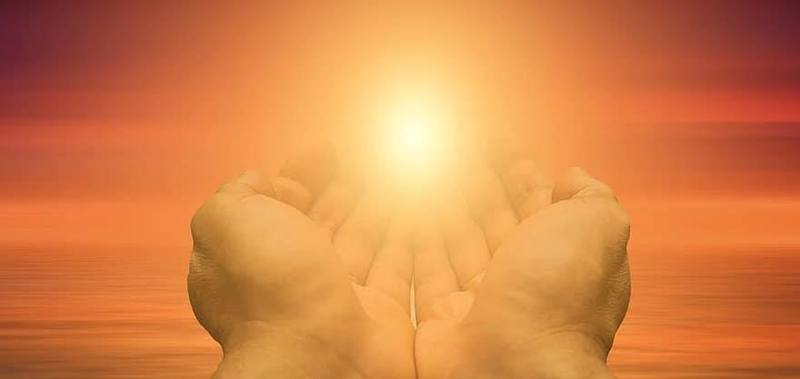
CONVERSATION
It is our soul that is most especially formed in God’s image and likeness!
Our soul is the very core of who we are, and it is directly created by God.
Our bodies share in the dignity of “the image of God” by being united to our souls.
God loves us body and soul, but it is our spiritual soul that distinguishes us most greatly from every other living creature in the world.
Of everything that makes us who we are, our soul is of the greatest value to God because He loves who each one of us is, to our very core!
Name some characteristics that people share with God that show we are made in His image and likeness.

Slide 14
GENESIS 1:27
God created man in his image,
In the divine image he created him;
Male and female he created them.

Slide 15
GENESIS 1:27
“God created man in his image.”
That means that we human beings have been created in the image of God.
No other visible creature has been created in the image and likeness of God!
God made us for Himself and He loves us as His children, above all other earthly creatures!
We have been formed out of God’s love with a very high dignity.

Slide 16
GENESIS 1:27
“In the divine image he created him.”
We are made in God’s image, which means that we have been created to live with God, to share His Divine Life, to be His very own family!
Our true home is with God!

Slide 17
GENESIS 1:27
“Male and female he created them.”
This means that the one God created his children as two distinct sexes or genders, male and female, to complement one another in God’s beauty and order.
Both male and female are made in the image of God.

Slide 18
GENESIS 1:27
The entire human race came from a male and a female (with God’s help).
This is God’s holy design for how His family would grow and how God’s life in us would continue from one generation to the next.
Genesis 1:28 “God blessed them, saying: Be fertile and multiply; fill the earth and subdue it.”
Here we see God lovingly giving His children an order for family life with God.
First God gave the man and the woman his blessing.
Then, He told them to be fertile and multiply.

Slide 19
GENESIS 1:4-31
vs 4- God saw how good the light was
day & night
vs 10- God saw how good it was
sky & sea
vs 12- God saw how good it was
plants
vs 18- God saw how good it was
sun, moon & stars
vs 21- God saw how good it was
swimming creatures & birds
vs 25- God saw how good it was
cattle, creeping things, wild animals
vs 31- God looked at everything he had made, and he found it very good.
Each time God saw how good something He had created was, it meant that it was in accordance with God’s will.
Because He loved us even before we were born, God created order to bring us peace and harmony.

Slide 20
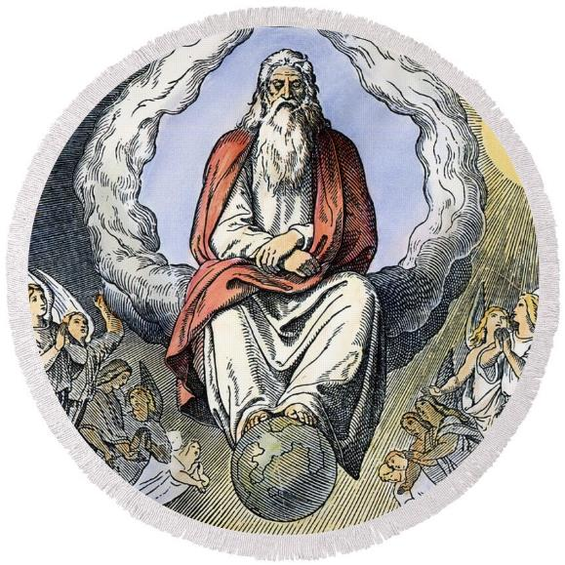
GENESIS 2:1-41
God rested on the
Seventh Day!

Slide 21
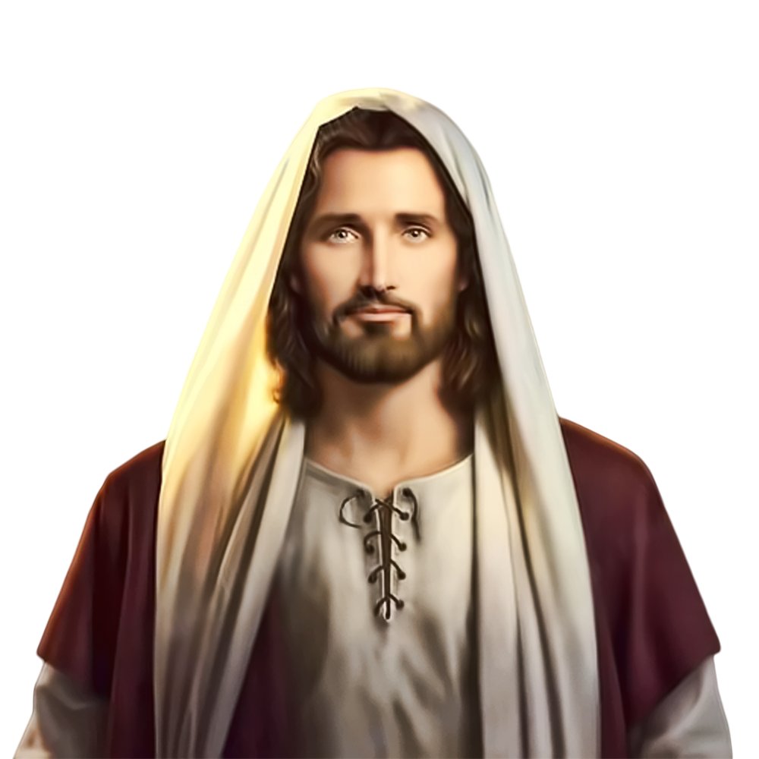
FAMILY CONVERSATION/ACTIVITY
“Come to me, all you who labor and are burdened, and I will give you rest. Take my yoke upon you and learn from me, for I am meek and humble of heart; and you will find rest for yourselves. For my yoke is easy, and my burden light.” Matthew 11:28-30
As we read in the Bible, part of God’s loving order for His children is to rest on and to keep holy the sabbath day. God waits for us to be with Him every day, but He especially longs for us to spend time with Him on the Lord’s Day.
This is out of His infinite love for us, because God, who is all knowing, sees how difficult our lives can be and how greatly we need His grace to keep going and stop to rest in His arms.
How does your family keep holy the Lord’s Day?
What else can your family do to keep holy the Lord’s Day?

Slide 22
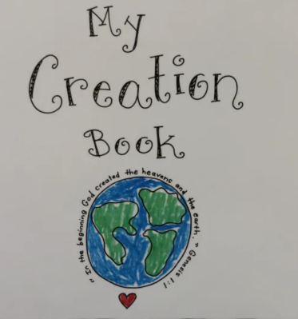
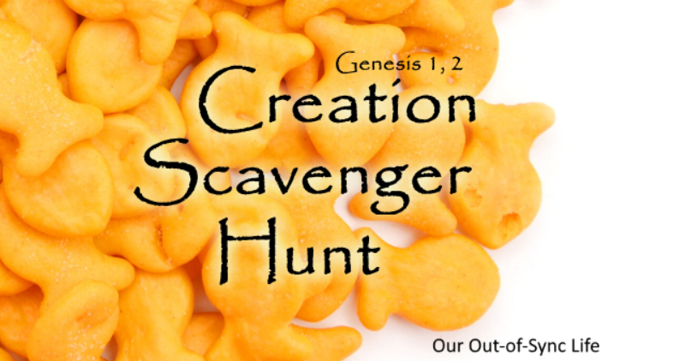
CREATION ACTIVITY

Slide 23
MISSION ACTIVITY
Your Family At-Home Mission is to:
Watch the videos about The Creation Story and Adam and Eve and All Saints Day.
This is the month of the Rosary, so place your family rosary on your home altar next to your family bible.
On November 1st, All Saints Day, we celebrate and show God that we are grateful for the saints who are in Heaven and for all the help they give us. Choose an activity from the video to do with your family or join another family and make it a special event! &/or Choose a book about a favorite saint and read it together at dinner or before bedtime.
To prepare for All Souls Day, find a picture of a family member or friend of the family who has died that you would like us all to pray for during Week 3 and on All Soul’s Day, or draw a picture of that person if you don’t have a photo. Place the photo or picture on your home altar/prayer corner. Bring the picture to the Week 3 gathering.
Gather in your prayer space/around your home altar as a family. Take a moment to be silent with God together, and say a prayer for your family member or family friend, and for one another. Then end by praying a decade of the Rosary.

Slide 24
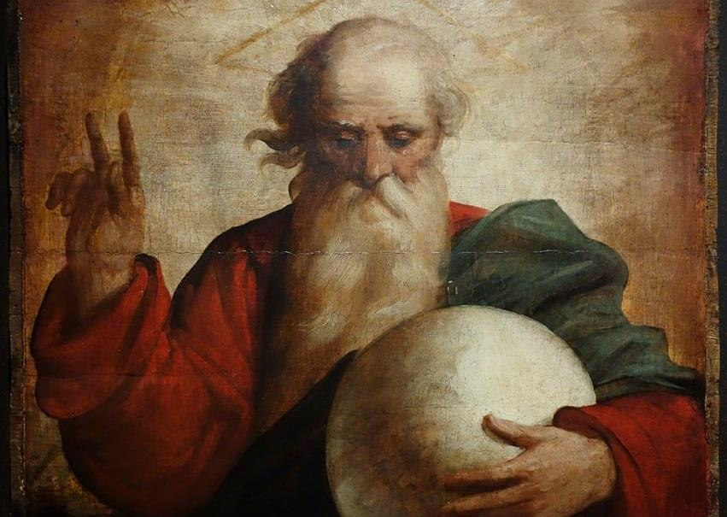
Dear God,
You are the fount of all blessings, source of all life, and giver of all grace:
We thank You for the gift of life: for air, food, and water; for the love of family and friends; for all the things without which we couldn’t continue to live.
We thank You for the mystery of creation: for the beauty that the eye can see, for the marvels that the ear can hear, for all the amazing mysteries that fill the universe with wonder.
Help us to grow in knowledge and appreciation of Your Creation, To be good stewards of what You have given us,
And to always remember that every good gift comes only from You. Amen.

