Slide 1
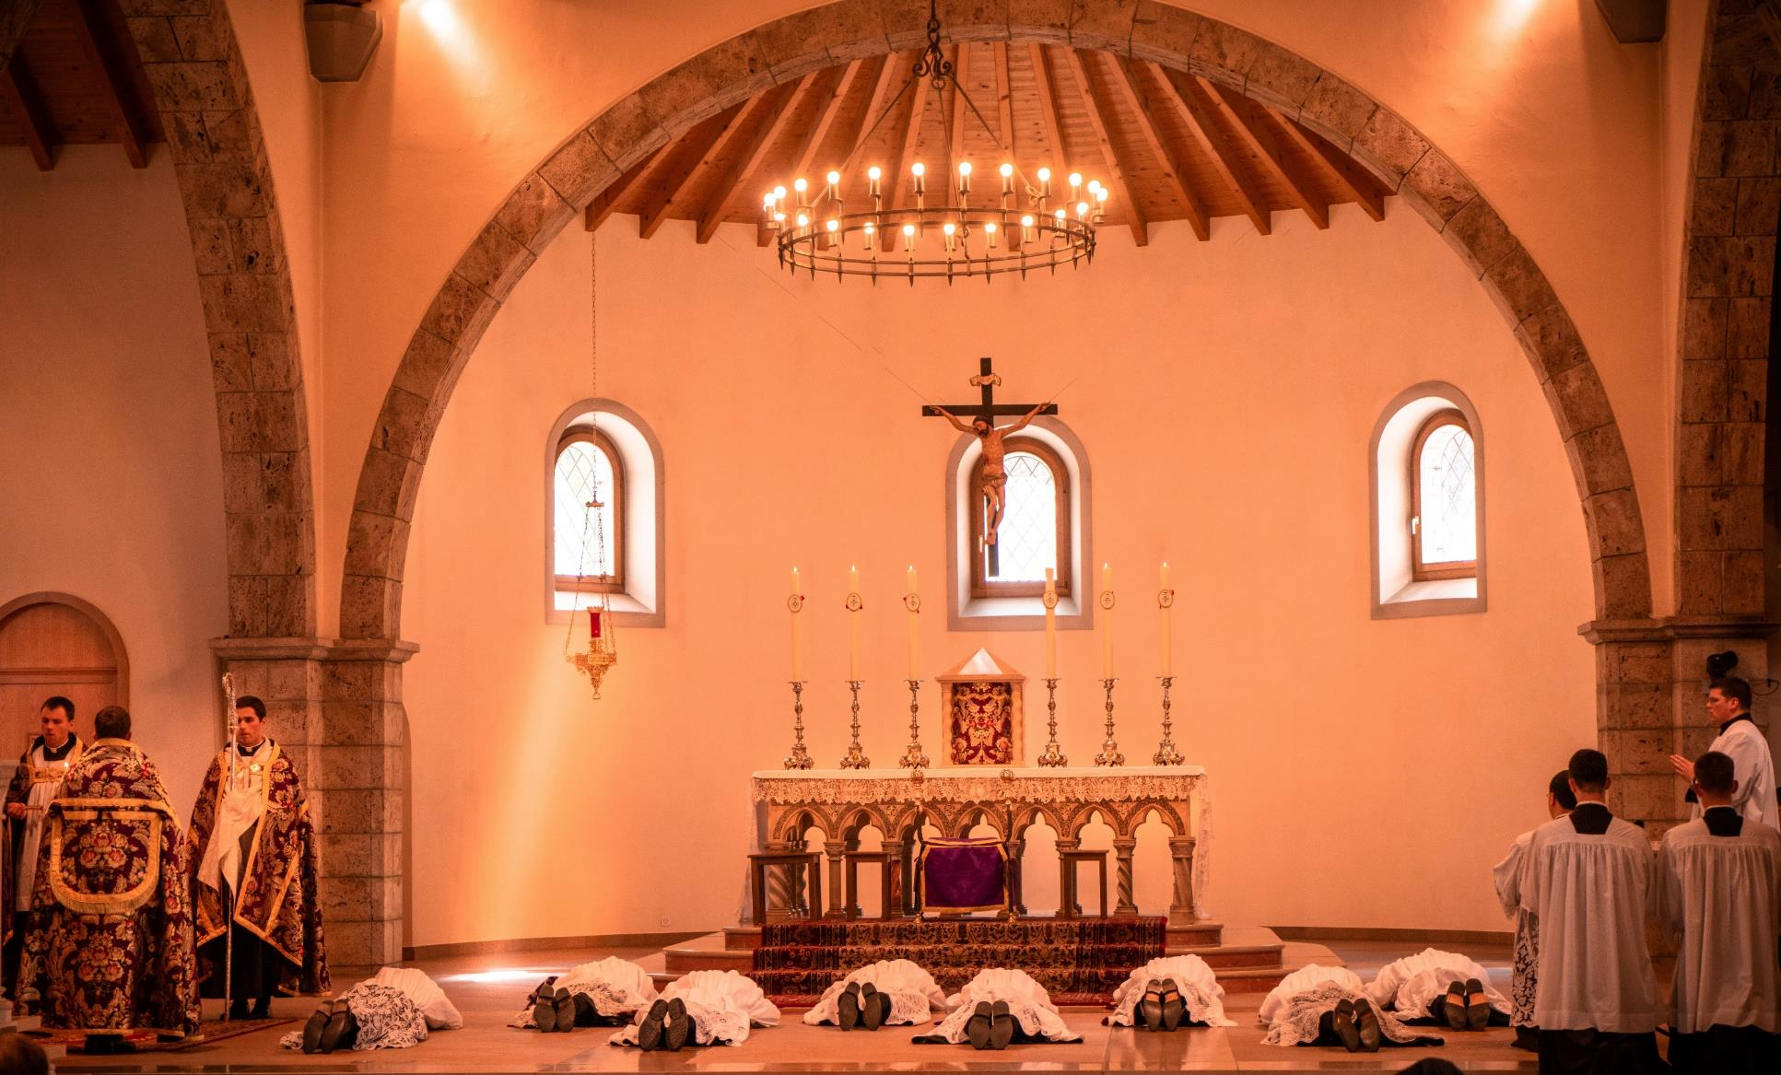
GOD’S SAVING LOVE FOR US:
LITURGY AND THE SEVEN SACRAMENTS
SACRAMENTS AT THE SERVICE OF COMMUNION AND MISSION: HOLY ORDERS

Slide 2
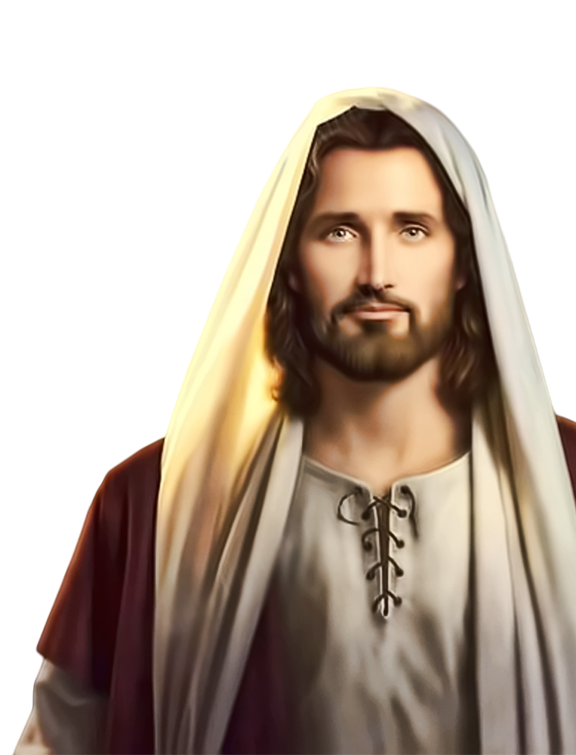
^{Opening Prayer}
Lord Jesus Christ, We entrust our family to You and ask for Your blessing and protection.
We love You Lord Jesus with all our hearts, and we ask that You help our family to become more like the Holy Family.
Help us to be kind, loving, and patient with
one another.
Give us all the grace we need to become saints and Your faithful disciples. Amen.
This Photo by Unknown Author is licensed under CC BY-NC

Slide 3
KEEP THE BALLON UP!
How to Play:
Arrange families so each group has four or more players facing each other in a circle.
Blow up a balloon and have the leader toss it into the air in the middle of the circle.
With the balloon in the air, the leader calls out someone’s name, and they move to bump the balloon in the air to keep it from falling to the floor.
When they hit the balloon up, they must call out someone else’s name to follow and then return to their spot.
The called person then moves to hit the balloon up, repeating the process.
Continue until the balloon reaches the floor.
Adapted from connectusfund.

Slide 4
REVIEW
What are your favorite Holy Week Activities and/or your Family Holy Week Plans?
This Photo by Unknown Author is licensed under CC BY

Slide 5
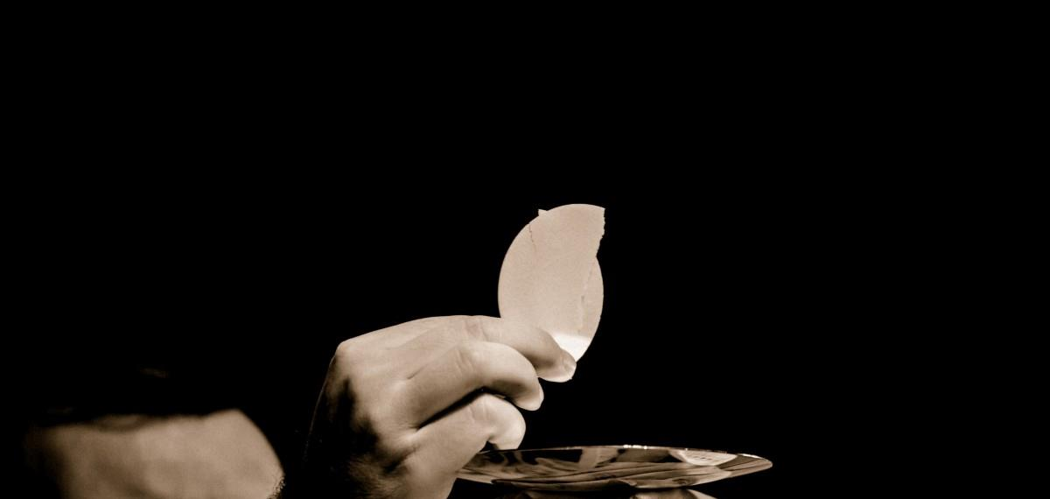
MAIN CONCEPT
The Sacraments at the Service of Communion and Mission are the Sacraments of Holy Orders and Matrimony (marriage).
In Holy Orders, some baptized men of the Church are set apart or consecrated to serve the whole Church as priests.
Because Jesus wants to be closer to us, to heal us and to keep His promise to always be with us, in addition to the common priesthood of all believers, God has continued to call some men to the ministerial priesthood. These men, through priestly ordination, receive the Sacrament of Holy Orders to act in the person of Christ Himself while celebrating the sacraments.
They are called to continue the mission that Jesus gave to his Apostles to proclaim the Gospel, celebrate the sacraments and serve the spiritual needs of God’s children.

Slide 6
FAMILY BIBLE ACTIVITY
In the Bible we read that it was Jesus Himself who established the ministerial priesthood.
Each family has a bible, paper & pencil and receives a different Bible verse to:
Find in the Scriptures
Discuss what was happening in the story
Record reasons why the verse shows that Jesus was instituting the Sacrament of Holy Orders, calling the Apostles to continue His ministry of the priesthood
Families share their verses and reflections
with the large group.
• Lk 22:19
• Jn 20:21
• Jn 20:22
• Mt 28:19,20
• Jn 21:15,16
• Acts 1:8

Slide 7
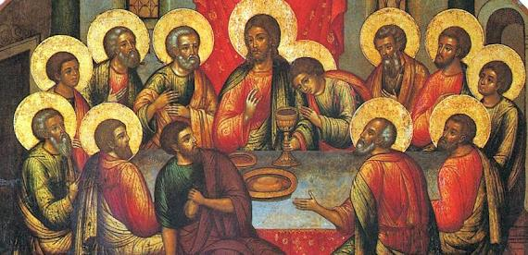
LECTIO or VISIO DIVINA LUKE 22:7-20
(Family members to find a comfortable place to sit together as a small group.)
It was on Holy Thursday at the Last Supper that Jesus instituted two very important sacraments.
These were the institution of the Holy Eucharist and the institution of the priesthood (Holy Orders).
These sacraments are intimately linked, because there is no priesthood without
Jesus in the Blessed Sacrament, and there is no Holy Eucharist without the priest.
This Photo by Unknown Author is licensed under CC BY-SA-NC

Slide 8
SACRAMENTS 101: Holy Orders
https://www.youtube.com/watch?v=q904xIwxnSc

Slide 9
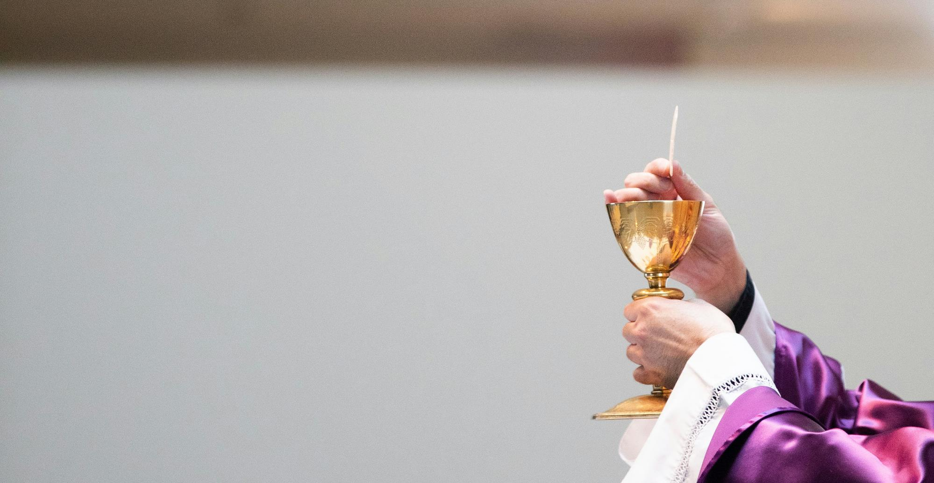
FAMILY ACTIVITY
“Ask a Priest”
&/or
“Thank You Father!”

Slide 10
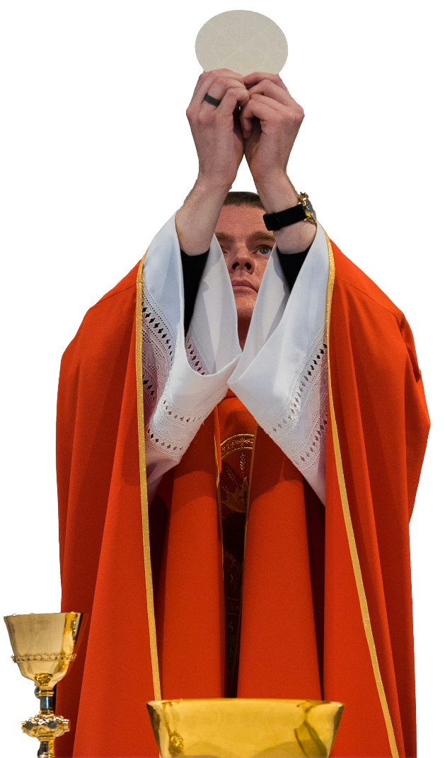
CLOSING PRAYER
Gracious and loving God,
We thank you for the gift of our priests, deacons and bishops.
Through them, we experience your presence in the sacraments.
Help them to be strong in their vocation.
Set their souls on fire with love for your people.
Amen.

