Slide 1

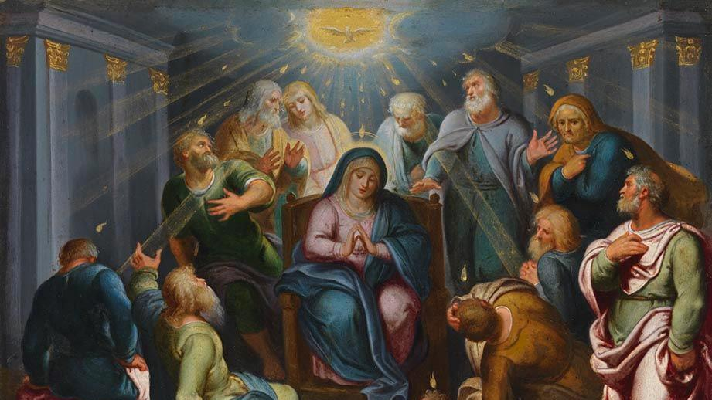
CALLED TO LOVE: THE ADVENTURE OF LIFE IN CHRIST
TOPIC: LIVING IN THE HOLY SPIRIT
Holy Spirit and the Church & Gifts and Fruits of the Holy Spirit

Slide 2
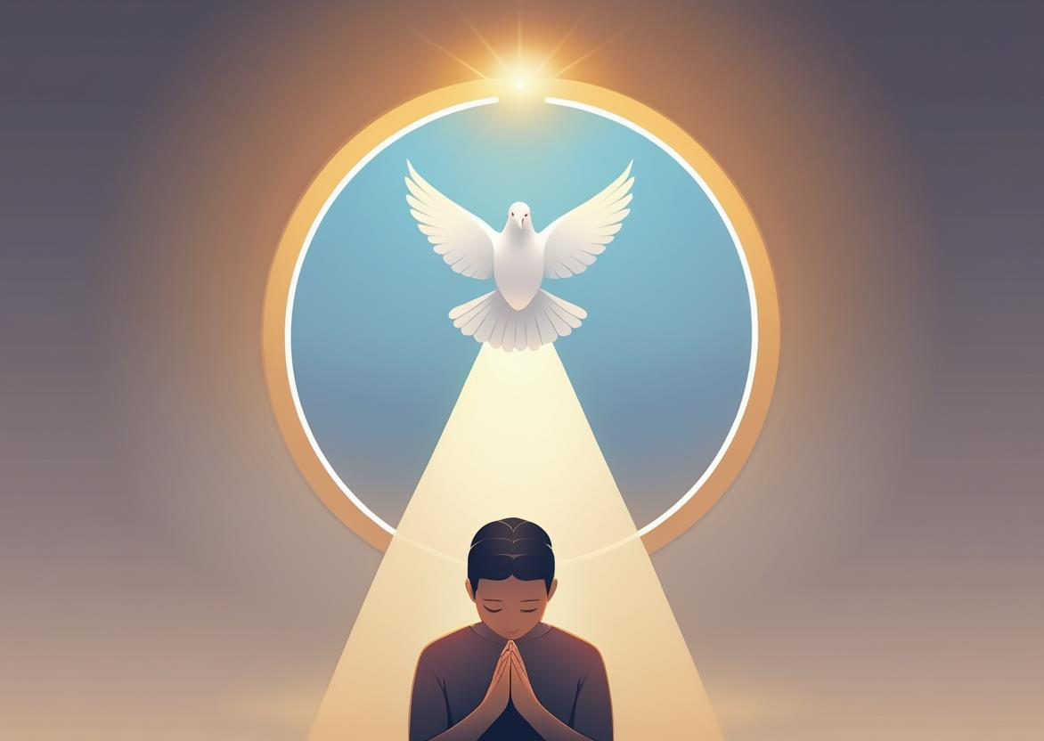
^{Opening Prayer}
Lord Jesus Christ,
We entrust our family to You and ask for Your blessing and protection.
We love You Lord Jesus with all our hearts, and we ask that You help our family to become more like the Holy Family.
Help us to be kind, loving, and patient with one another.
Give us all the grace we need to become saints and Your faithful disciples.
Amen.

Slide 3
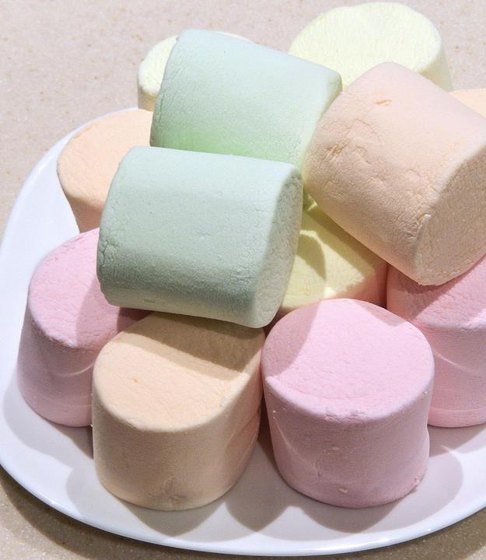
^{ICE BREAKER}
The Marshmallow Challenge
Each family is given 20 marshmallows, 30 toothpicks and a specified length of time, often 5-10 minutes, to design and build a tower by using only marshmallows and toothpicks.
When the timer runs out, families measure the height of their towers.
The winning team is the one with the highest tower that can stand on its own for at least 10 seconds.
Adapted from https://blog.heyhi.sg

Slide 4
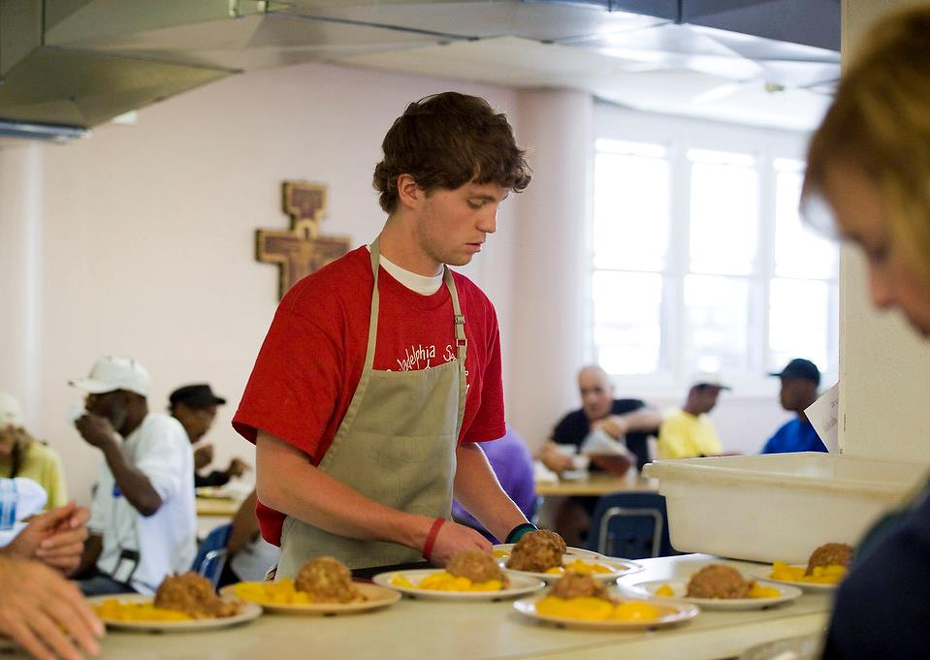
^{Family Sharing}
Jesus tells us in Matthew 7:12, “Do unto others, whatever you would have them do to you. This is the law and the prophets.”
This is one of the laws of divine love that we are called to observe, which is why it is God’s will for all families to learn and live Catholic Social Teaching.
At home during, Week 2, you prayed and discussed how God is calling your family to live the Easter Season.
Share the ways your family will answer the Father’s call to spread the love of Jesus.

Slide 5
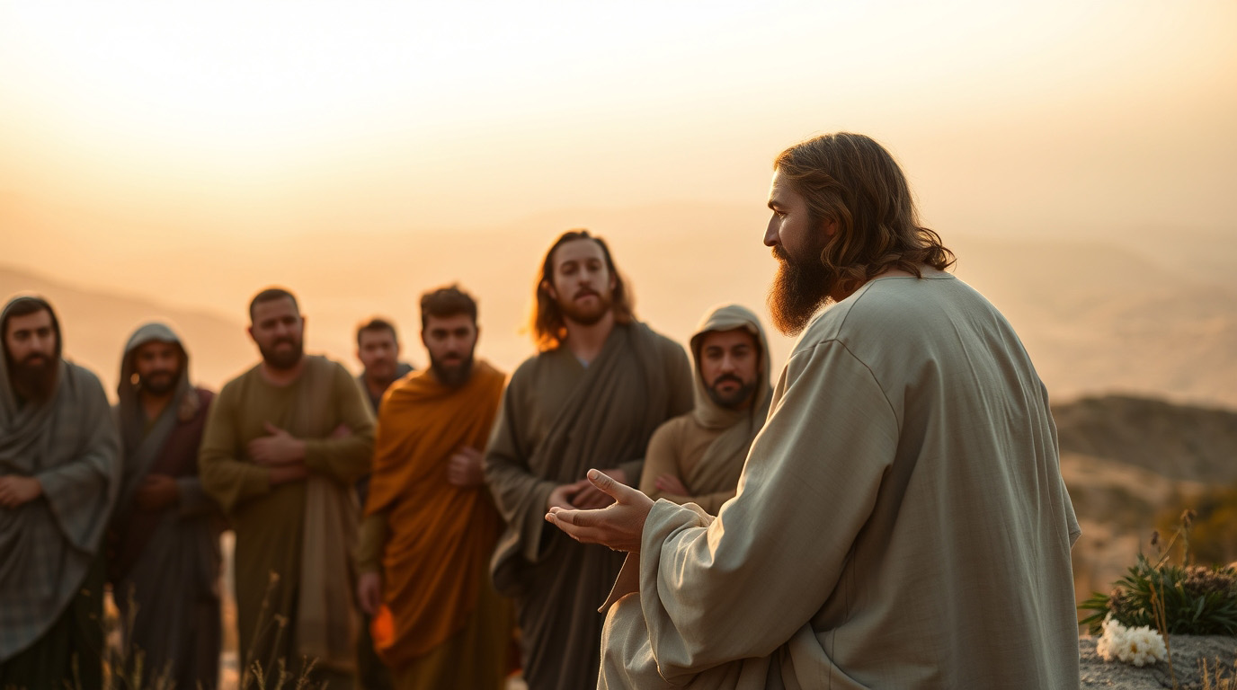
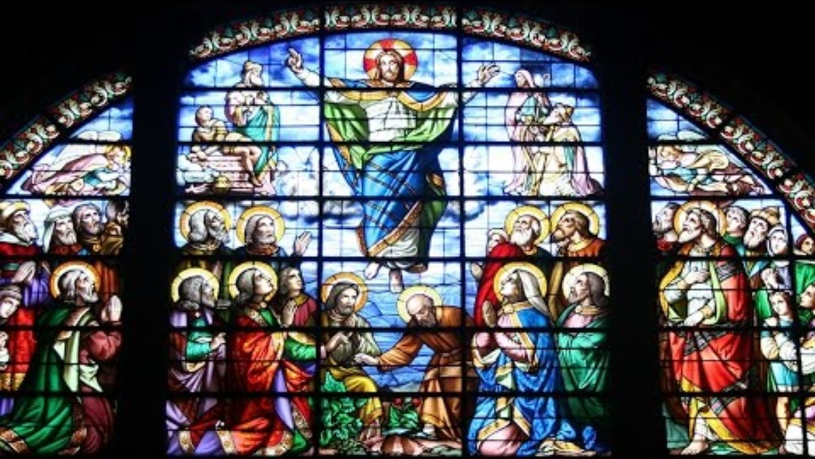
REVIEW
Last time we were together, we also learned about the Ascension of Jesus into Heaven and the Great Commissioning.
For review watch: Ascension Day HD by Catholic Online
or Read: Acts 1:6-12.
https://www.youtube.com/watch?v=mmE4uon5OBk

Slide 6
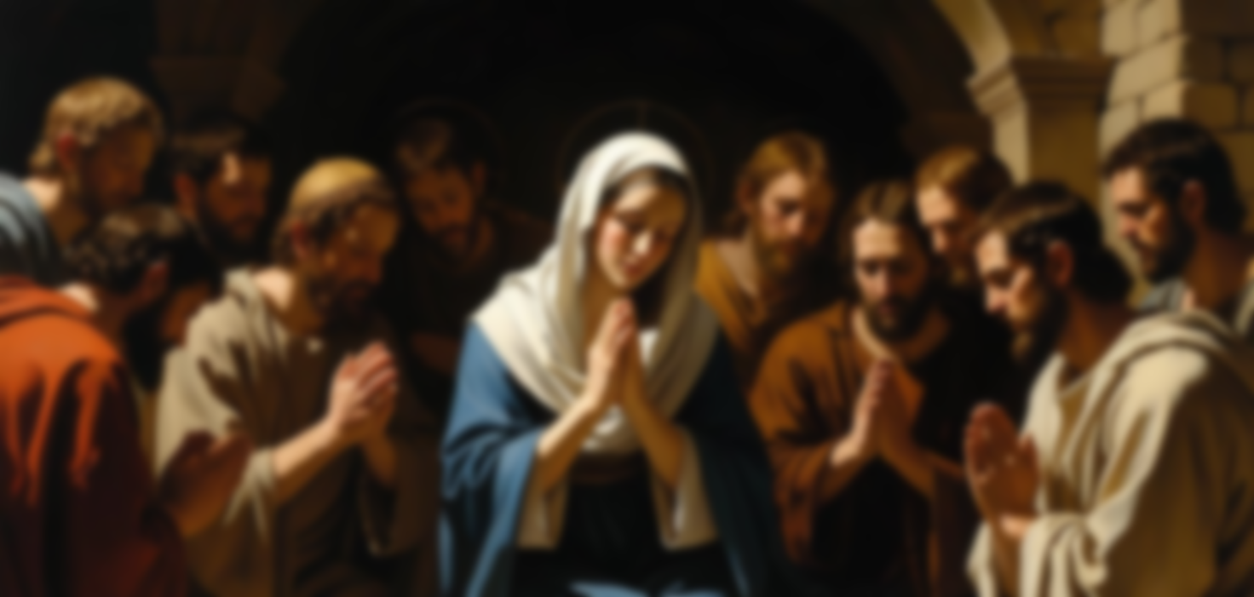
THE FIRST NOVENA
“Then they returned to Jerusalem from the mount called Olivet, which is near Jerusalem, a Sabbath day’s journey away.” Acts 1:12
The Bible tells us that the Apostles, Holy Mother Mary and some disciples went to the upper room, where Jesus had given Himself to the Apostles in the Eucharist at the Lord’s Supper. There they prayed and fasted for nine (9) days, while they waited for the Holy Spirit to come upon them, as Jesus had commanded them to do.

Slide 7
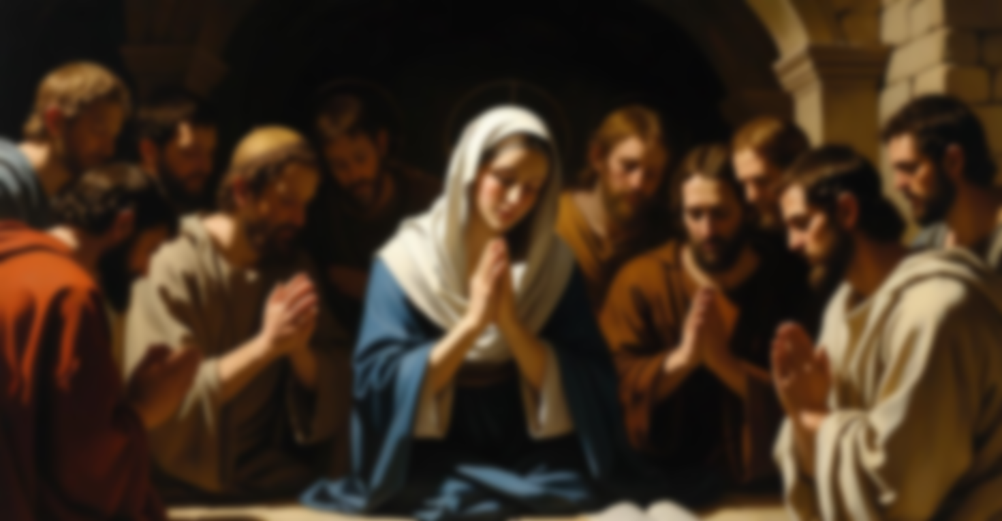
THE FIRST NOVENA
A novena is a nine-day period of prayer, often dedicated to a specific intention. The first novena, also known as the Pentecost Novena or Novena to the Holy Spirit, is known to be the one prayed by Jesus’ disciples and the Blessed Virgin Mary after Jesus’ ascension.

Slide 8
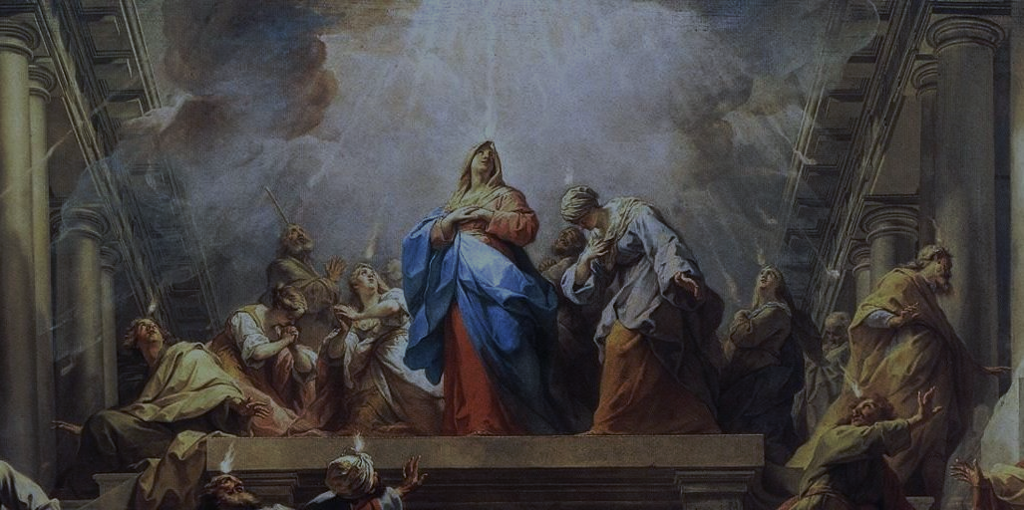
ACTS 2:1-4
At the moment that the Holy Spirit descended upon the Apostles and disciples, the Church as the Body of Christ came to life!
The Holy Spirit is the soul of the Church!
The Holy Spirit is the soul of the Church, which is the Body of Christ and the Temple of the Holy Spirit. (Catechism of the Catholic Church)

Slide 9
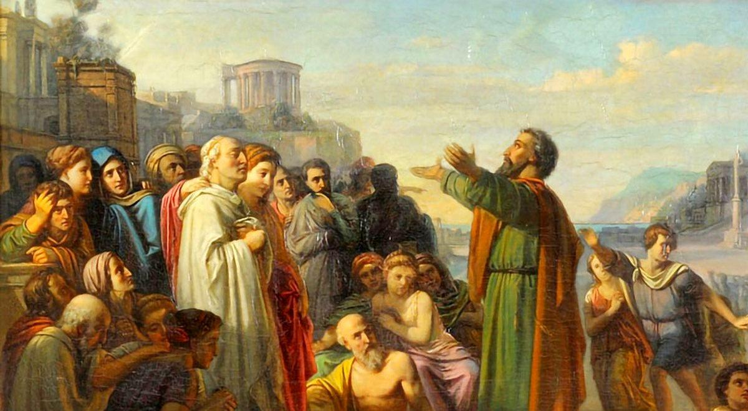
ACTS 2:1-4
The Holy Spirit, the Third Person of the Trinity, suddenly and immediately began guiding and empowering the Apostles and disciples “to make disciples of all nations, baptizing them in the name of the Father, and of the Son, and of the Holy Spirit,” teaching them to observe all that Jesus had commanded.
The Holy Spirit guides the Church and empowers its members to fulfill their mission in the world. (Catechism of the Catholic Church)

Slide 10
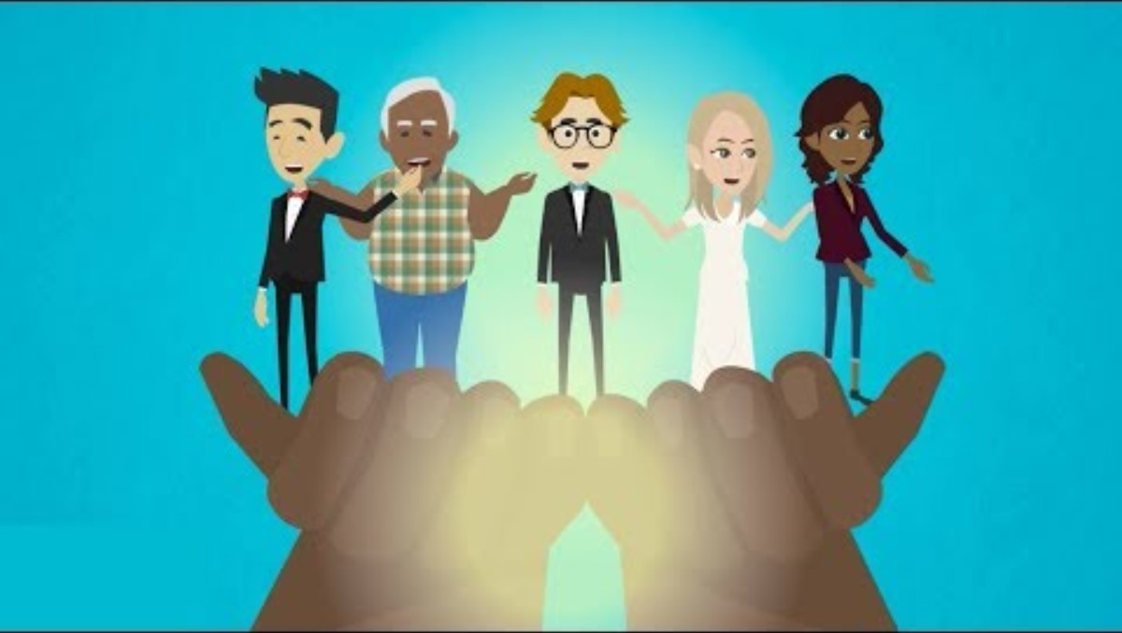
Acts 2:5-13 & 38-41
The Apostles and disciples were no longer acting on their own strength, but the power of Divine Love, the Holy Spirit, was acting through them!
Catholic Kids Media Video - Pentecost Cycle C
https://www.youtube.com/watch?v=BwqdGgDpz2k

Slide 11
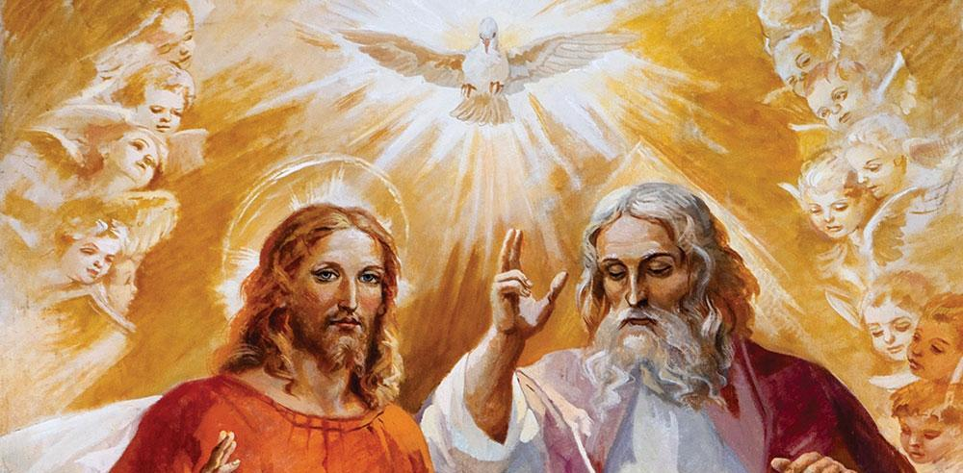
THE HOLY SPIRIT AND THE SACRAMENTS
The Holy Spirit (united with God the Father and God the Son) acts powerfully through all the Sacraments.
For example, in the Sacrament of Confirmation, the Holy Spirit gives us a renewed outpouring of His seven gifts of wisdom, understanding, counsel, fortitude, knowledge, piety, and fear of the Lord.

Slide 12
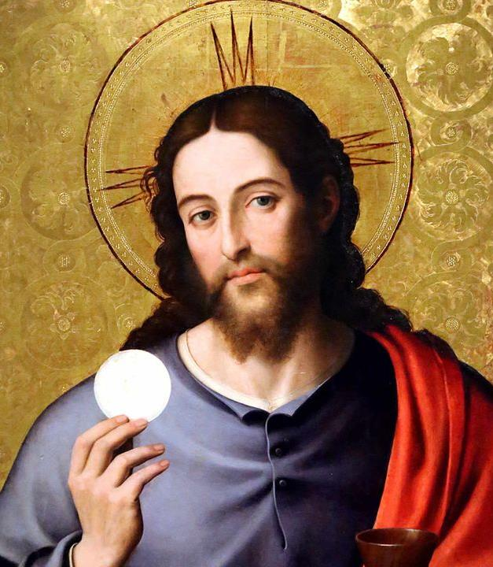
God does not expect or even desire for us to develop the gifts on our own; first, because we can’t do it and second, because we were created to live our lives with God! The gifts are given to us to show us who He is, to live in His Divine Love and then, to love others as He loves us!
However, it is by intentionally spending time with the Lord in prayer, in the Sacred Scriptures and in the Seven Sacraments, that the gifts of the Holy Spirit grow within us!
The Holy Spirit gives many types of gifts to us, the Body of Christ, His Church.
Without these gifts, the Church would never be able to spread the love of God throughout the world, or for that matter anywhere, even within our homes.

Slide 13
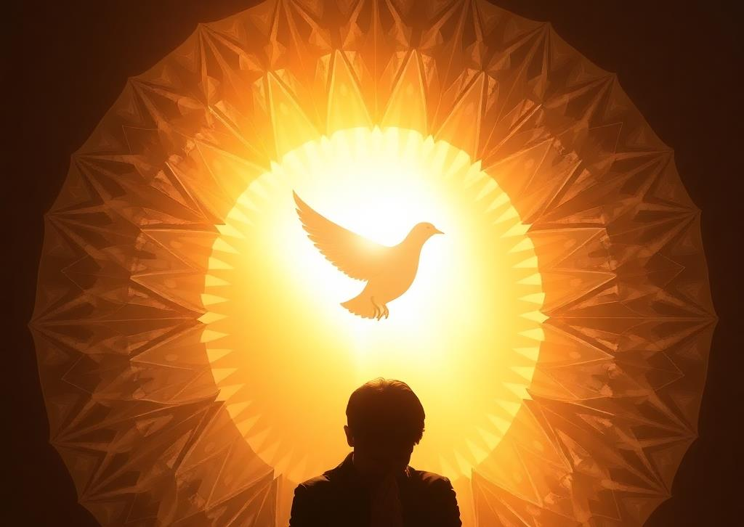
GALATIANS 5:13-25
If we choose to remain in God, we will grow beautiful fruits of love, joy, peace, patience, kindness, generosity, faithfulness, gentleness and self-control.
These are the fruits that the Holy Spirit wants to grow within us, because they make us able to love with His divine love!

Slide 14
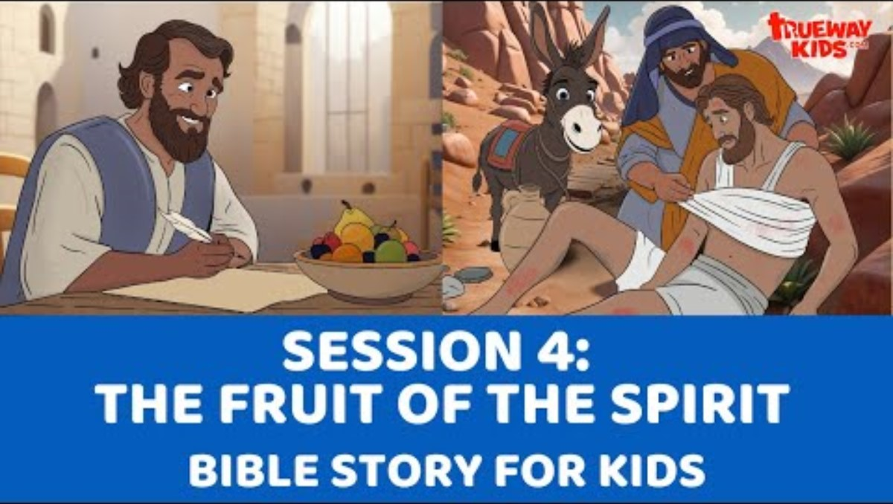
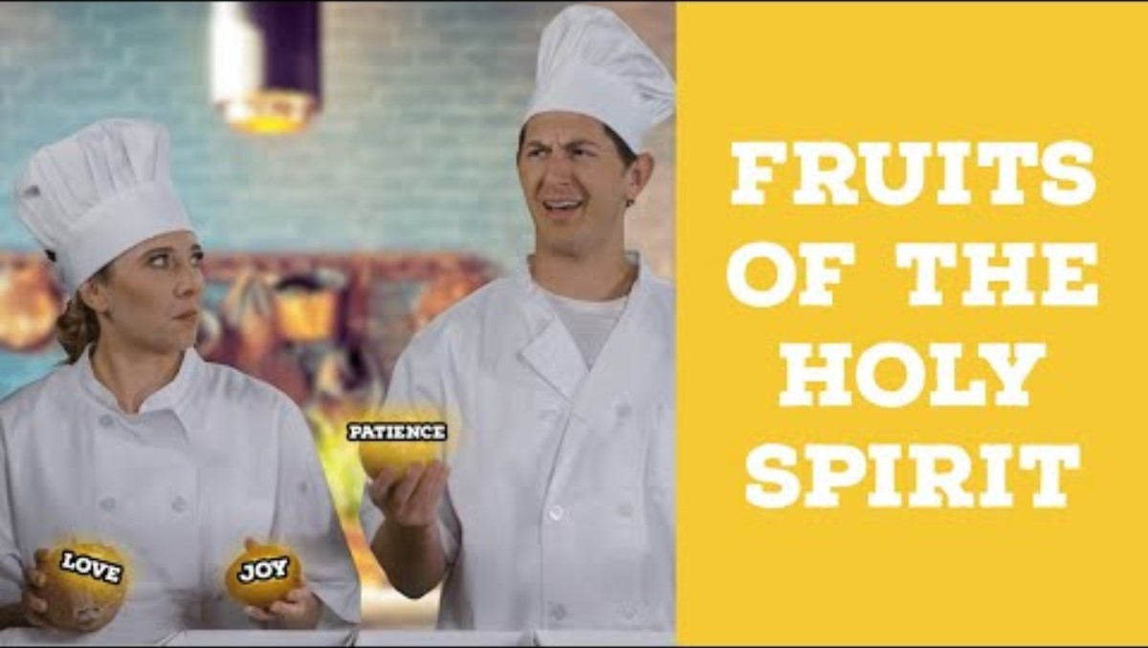
FAMILY CONVERSATION
Watch:
The Fruit of the Spirit - Bible Lesson for Kids | Holy Spirit Series | Trueway Kids
Or Fruits of the Holy Spirit | Catholic Central
https://www.youtube.com/watch?v=aHHos-sfi5o
https://www.youtube.com/watch?v=2ccGHb5q4xs

Slide 15
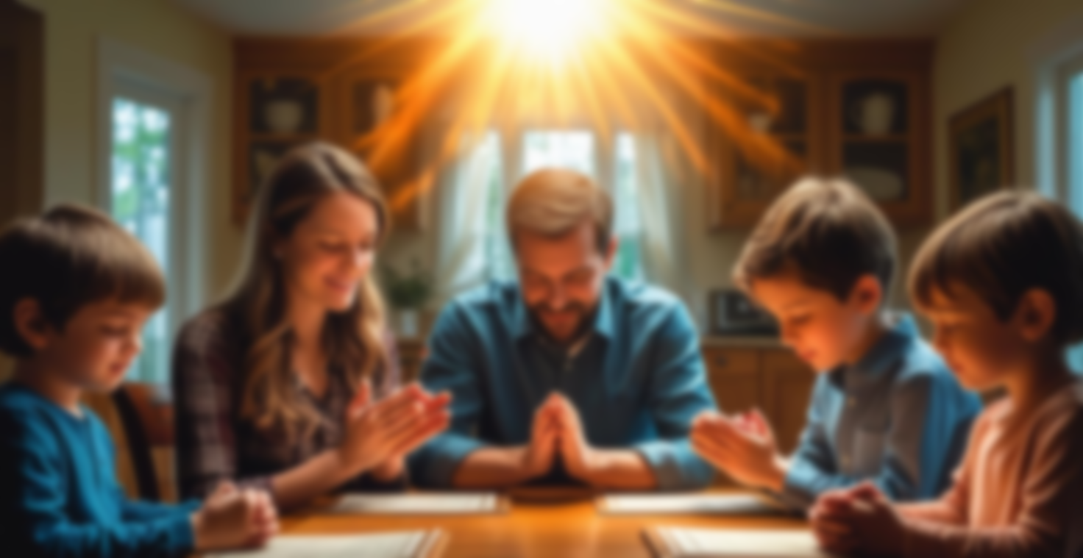
FAMILY CONVERSATION
Each family receives the Fruits of the Spirit handout.
It is all too easy to think of the times when we fail to live in the Holy Spirit. Thankfully, Jesus is always with us, just waiting for us to ask Him to forgive us and to pour His love and mercy out upon us, to give us the grace to start again!
Read the Fruits of the Holy Spirit.
Then consider ways and or times that you have seen those Fruits of the Holy Spirit in the members of your family.
Share your examples with one another.

Slide 16
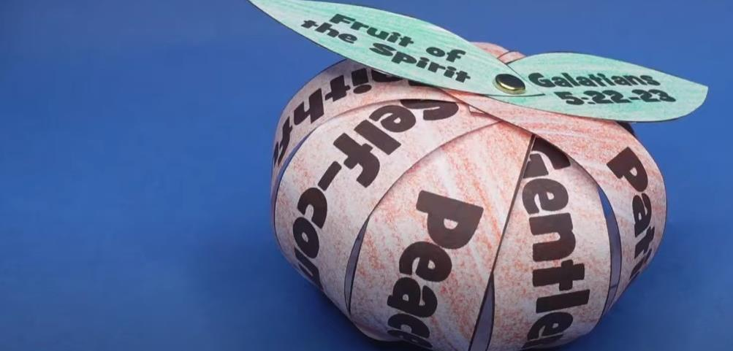
FAMILY ACTIVITY
Each family works together to create the Fruit of the Spirit Easy Bible craft for kids to be placed on the families’ home altars.
By Truway Kids

Slide 17
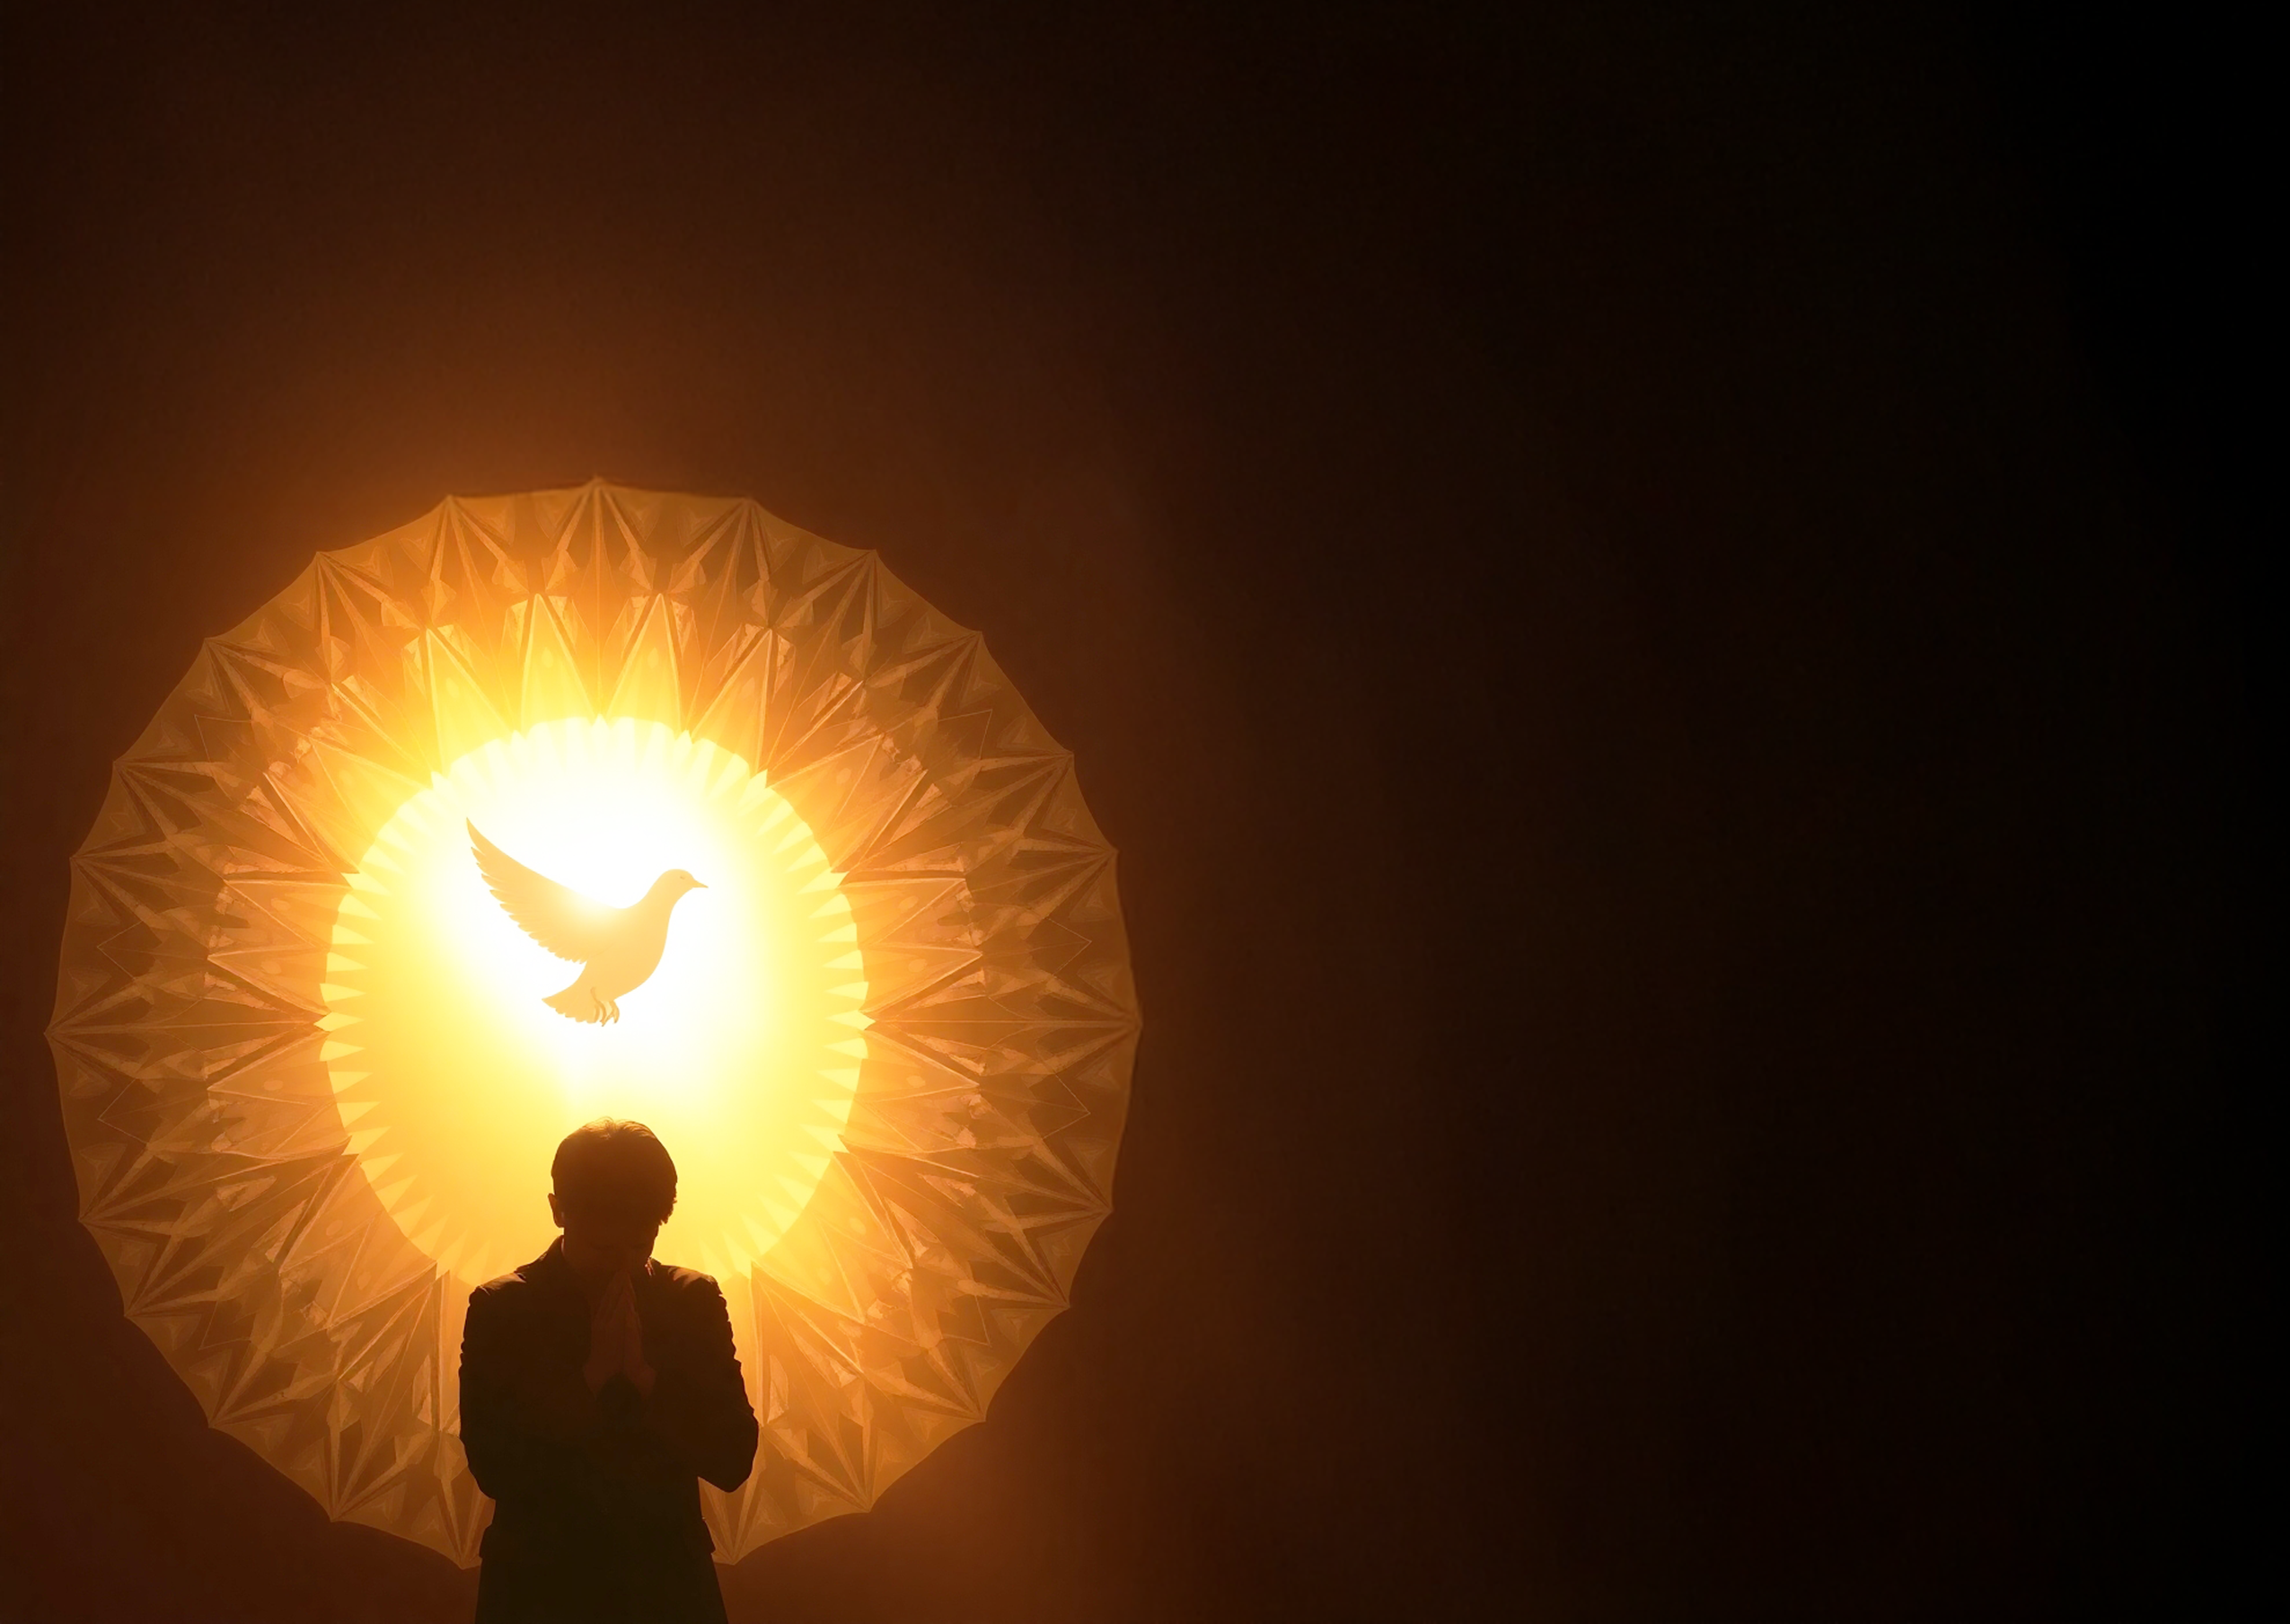
Prayer to the Holy Spirit
Come, Holy Spirit, fill the hearts of Your faithful and kindle in them the fire of Your love.
Send forth Your Spirit and they shall be created, and You shall renew the face of the earth.
Let us pray.
O God, who have taught the hearts of the faithful by the light of the Holy Spirit, grant that in the same Spirit we may be truly wise and ever rejoice in His consolation.
Through Christ our Lord.
Amen.

