Slide 1
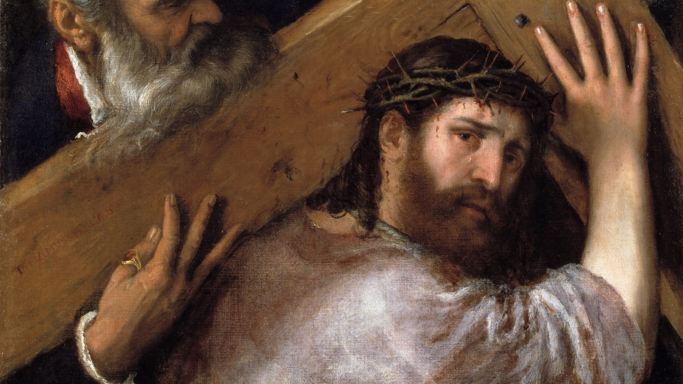
THE LIFE OF CHRIST: THE SORROWFUL MYSTERIES

Slide 2
^{Opening Prayer}
Lord Jesus Christ, we entrust our family to You and ask for Your blessing and protection. We love You Lord Jesus with all our hearts and we ask that You help our family become more like the Holy Family. Help us to be kind, loving, and patient with one another. Give us all the grace we need to become saints and Your faithful disciples.
Amen.

Slide 3
^{Ice Breaker}
What makes you happy when you are sad?
Where would you fly if you had wings?

Slide 4
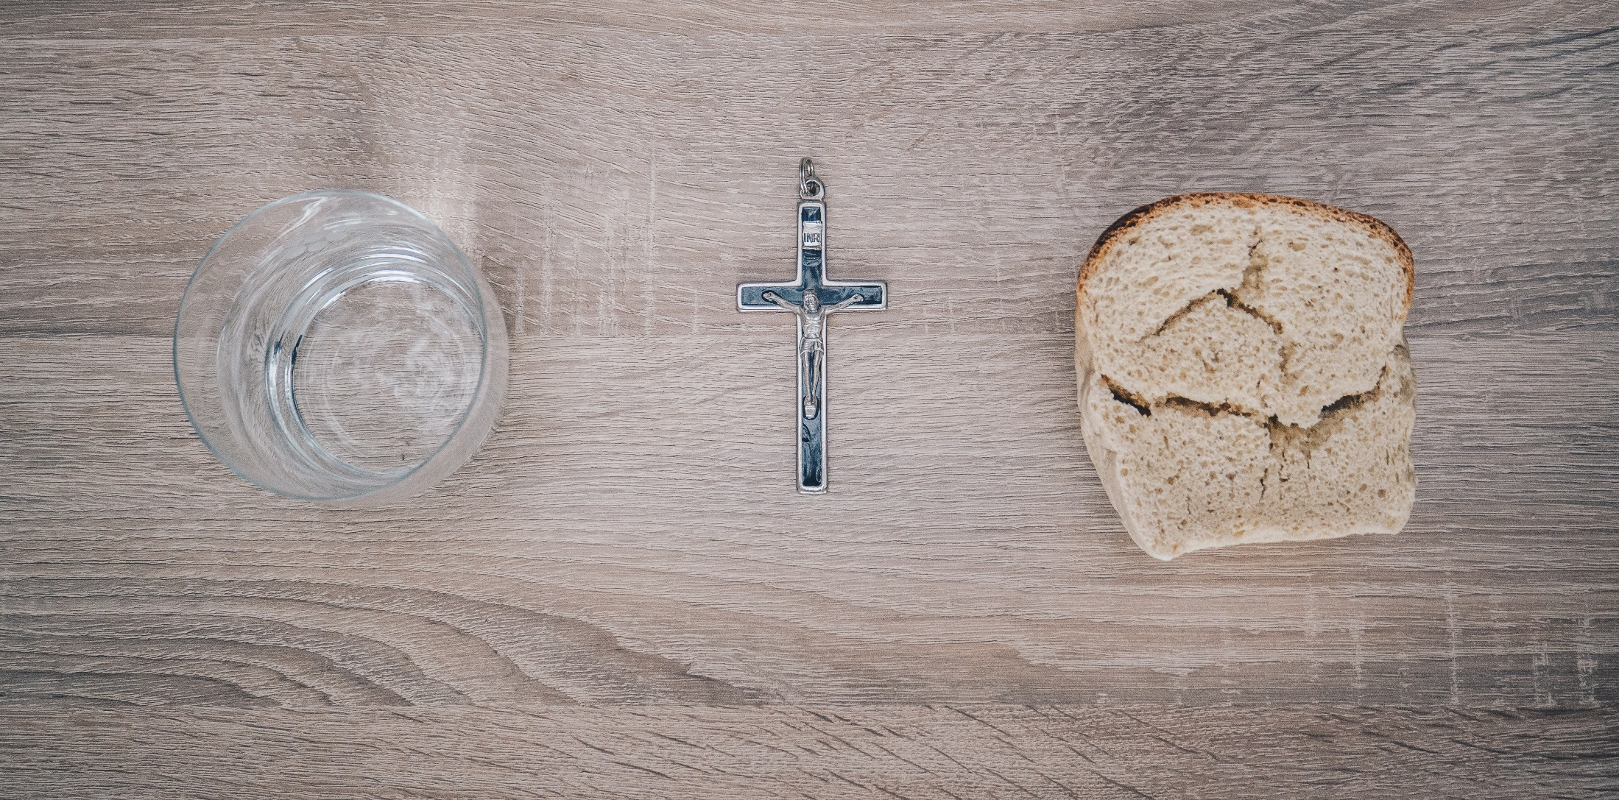
LENT
How is God calling you to grow closer to Him this Lent?
What sacrifices are you going to do to show God’s love to others?

Slide 5
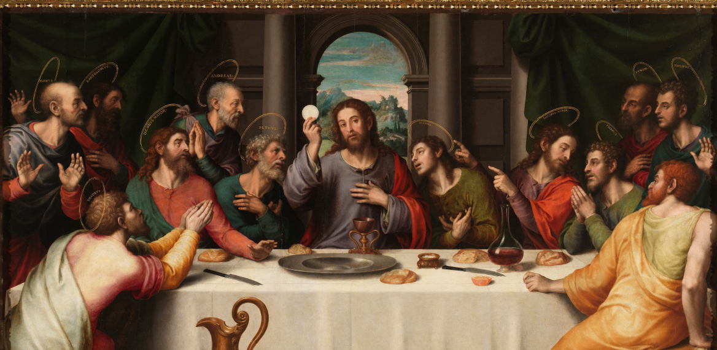
^{THE LAST SUPPER}

Slide 6
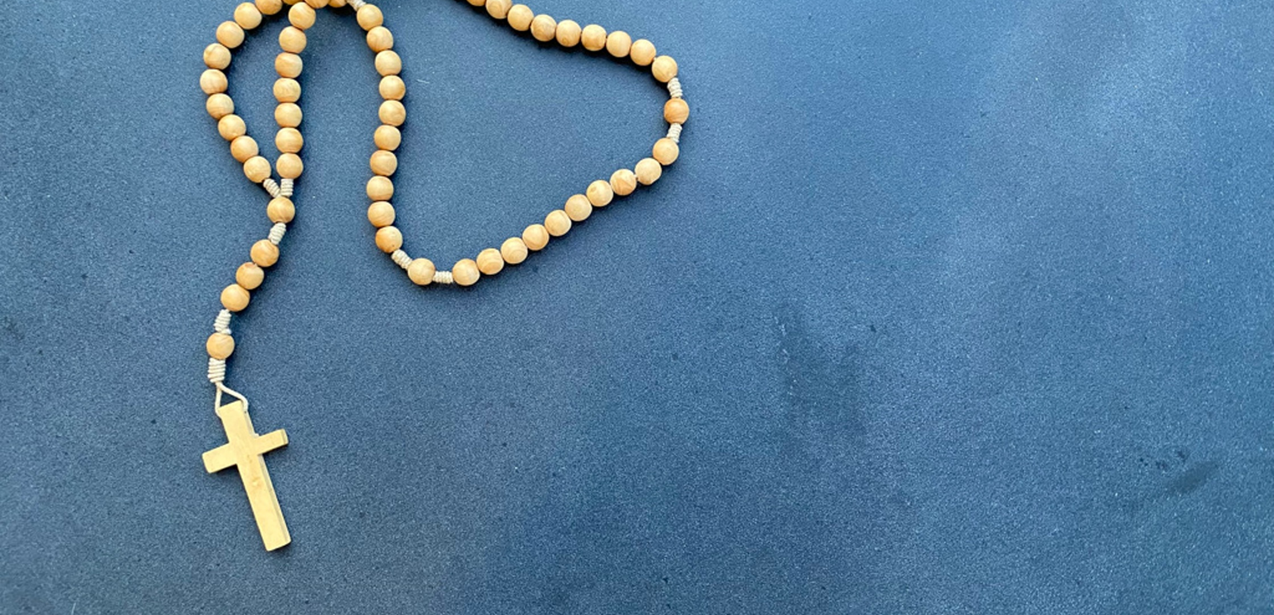
THE SORROWFUL MYSTERIES
The Second Sorrowful Mystery, The Scourging at the Pillar (John 18: 33-19:1)
The Third Sorrowful Mystery, The Crowning with Thorns (John 19:2-5)
The Fourth Sorrowful Mystery, The Carrying of the Cross (John 19:16-18)
The Fifth Sorrowful Mystery, The Crucifixion (John 19:25-30)

Slide 7
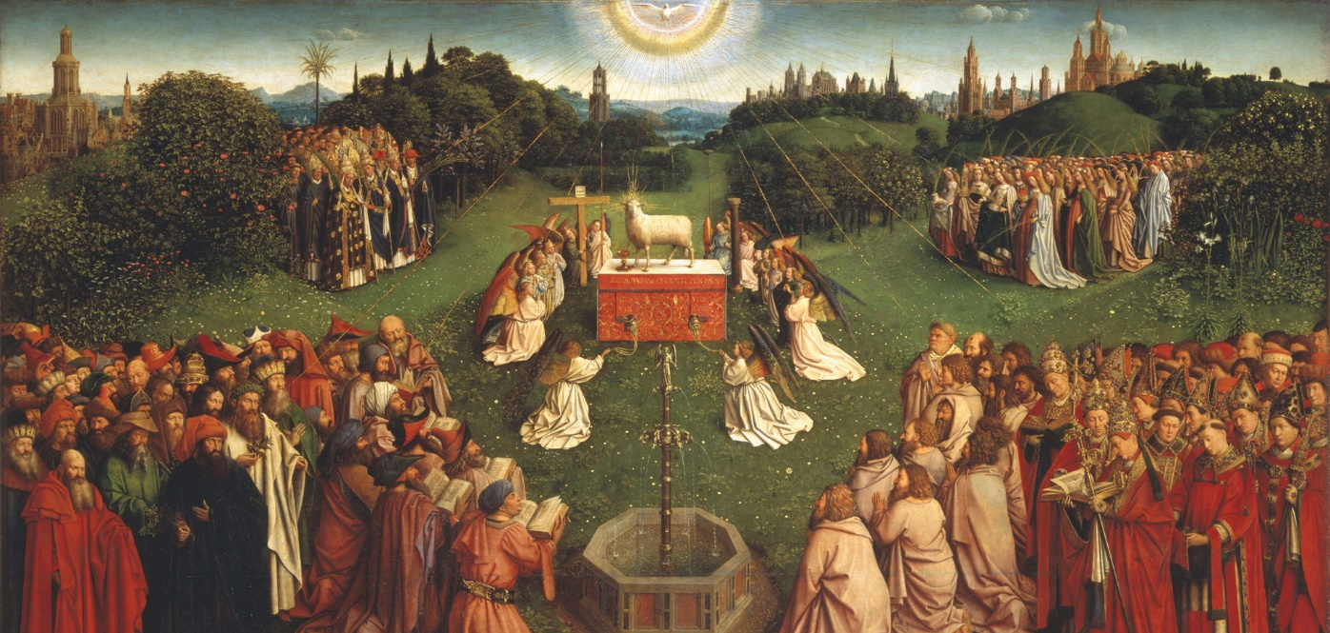
Jesus, The Lamb of God

Slide 8
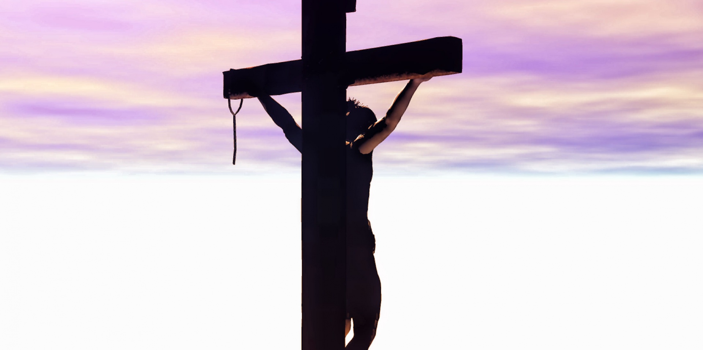
FAMILY CONVERSATION
We have reflected on how Jesus suffered and died out of love for us.
What does it mean to unite our suffering with
Jesus’ suffering?
Has there been a moment or difficult time in your life when you thought about Jesus and realized that He went through the same type of suffering that you were experiencing?
(Parents, grandparents, and/or guardians can help lead and model the sharing.)
When Jesus was on the cross, there was a time when He felt the depths of human anguish as if God His Father had left Him, but that was not true. Sometimes, like Jesus, we can feel as if God is not with us too.
Now as you look back on your own struggles,
how do you think God was there giving you the grace to get through it?

Slide 9
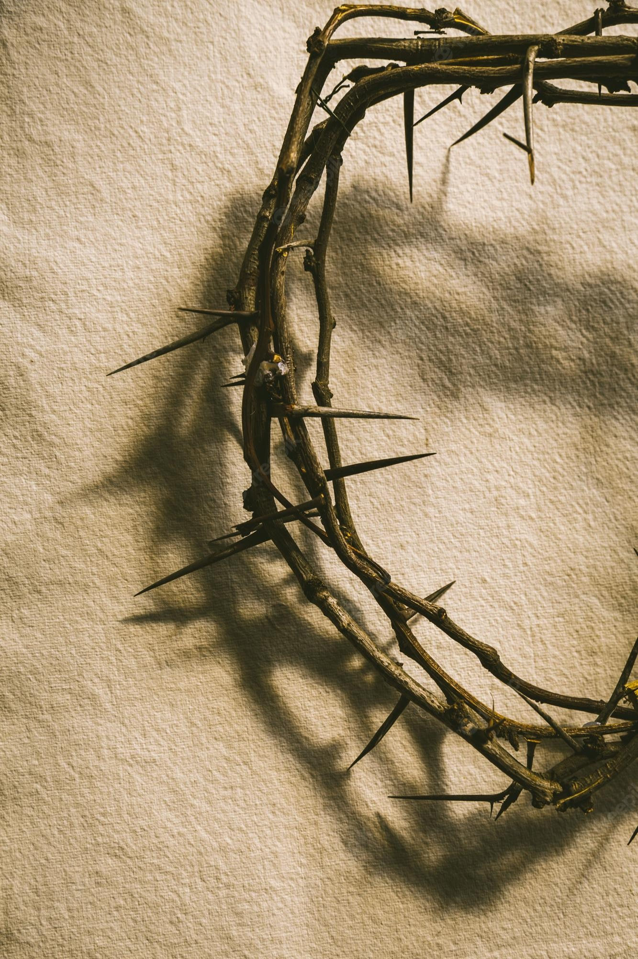
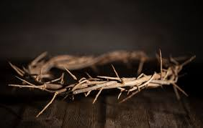
FAMILY ACTIVITY
Crown of Thorns

Slide 10
Three Pillars of Lent

Slide 11
CLOSING PRAYER
Come, Holy Spirit, and be with our families as we seek to know You,
learn from You, and love You more.
Fill us with Your presence.
Be our guide just as You led Jesus,
for we too seek to follow in His footsteps
and do the Father’s will.
Be with us, O Holy Spirit of Peace.
Glory be…

