Slide 1
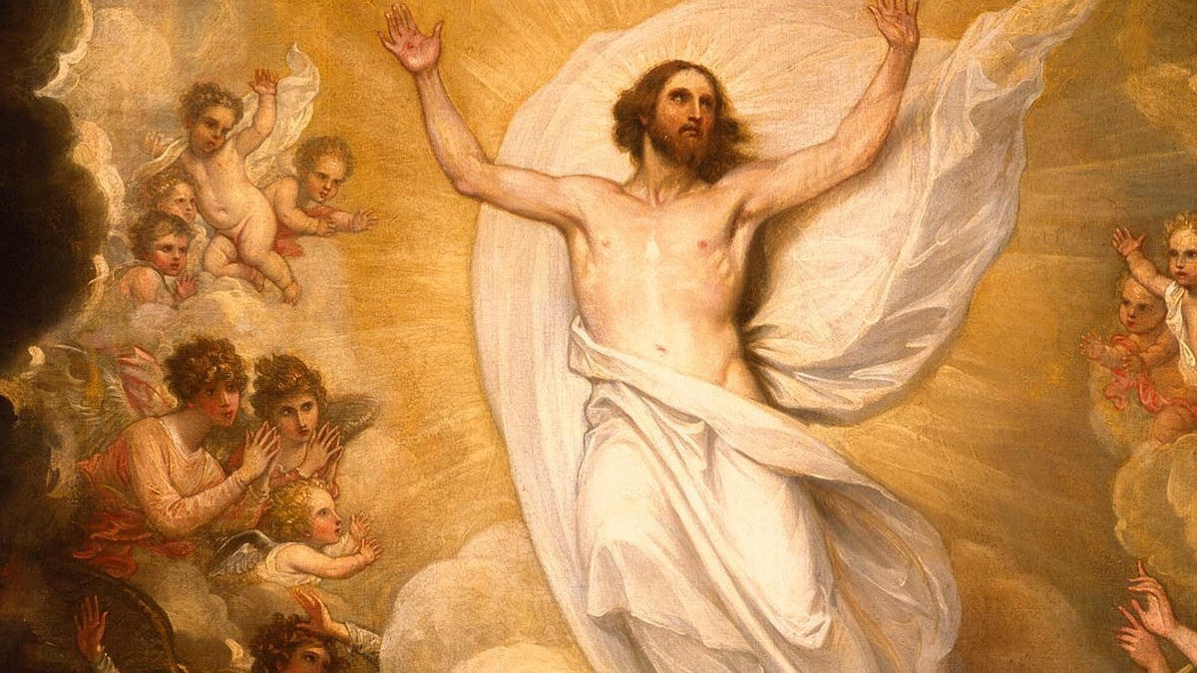
THE LIFE OF CHRIST: THE GLORIOUS MYSTERIES

Slide 2
^{Opening Prayer}
Lord Jesus Christ, we entrust our family to You and ask for Your blessing and protection. We love You Lord Jesus with all our hearts and we ask that You help our family become more like the Holy Family. Help us to be kind, loving, and patient with one another. Give us all the grace we need to become saints and Your faithful disciples.
Amen.

Slide 3
^{Ice Breaker}
Family Relationship Web
1. What kind of music do you like?
2. What’s your favorite sport to play?
3. Tell about the pet(s) you have, or the pet you wished you had.
4. What’s your favorite ice cream flavor?
5. What instrument(s) do you play, or do you want to learn?
6. Which cartoon character do you wish was real?
7. What’s the weirdest thing you’ve ever eaten?
8. Do you have any hidden talents?
9. How would you spend a rainy day?
10. What’s the most unusual thing in your school bag right now?
11. Is your personality similar or different to someone else in your family? If so, how are you the same or different?
12. What’s the most meaningful gift you’ve ever received? OR What’s a meaningful gift you have given?
13. What’s the bravest thing you’ve ever done?
14. What was your favorite book?
15. What’s the first thing you do in the morning?

Slide 4
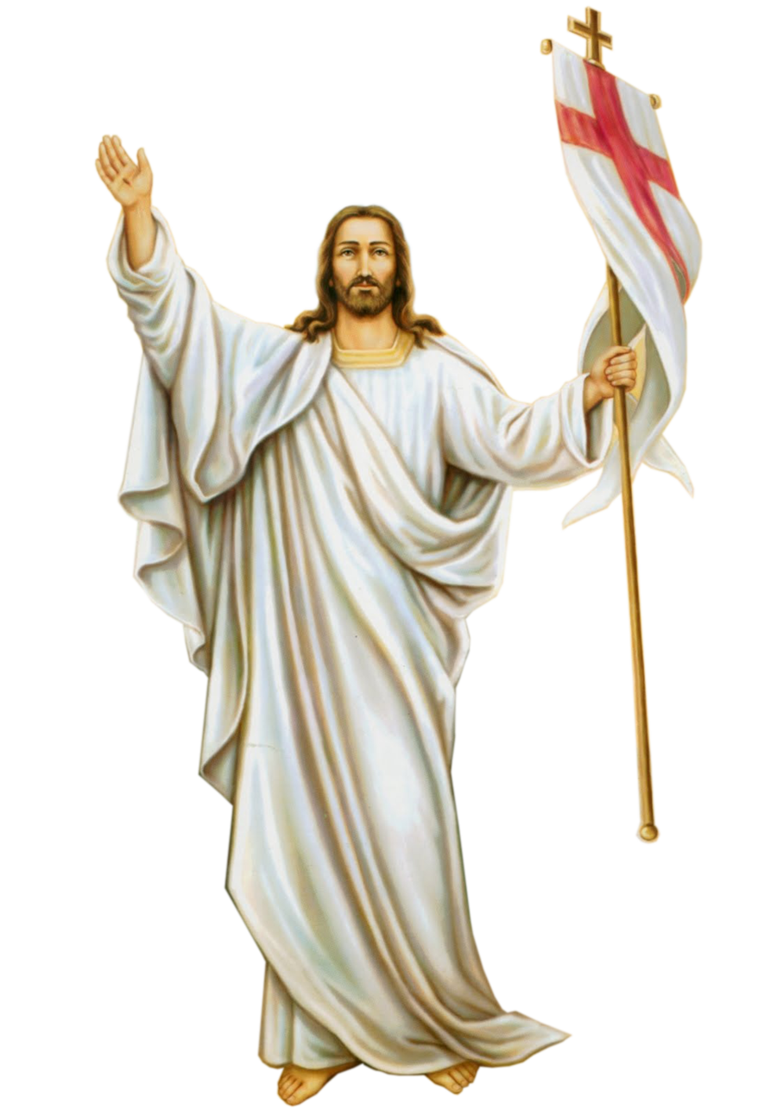
HAPPY EASTER! CHRIST IS RISEN!
This month we are going to begin learning about
the Glorious Mysteries of the Rosary, specifically,
the Resurrection of Our Lord and
the Ascension!
The Glorious Mysteries are the events that happened after the death of Jesus.

Slide 5
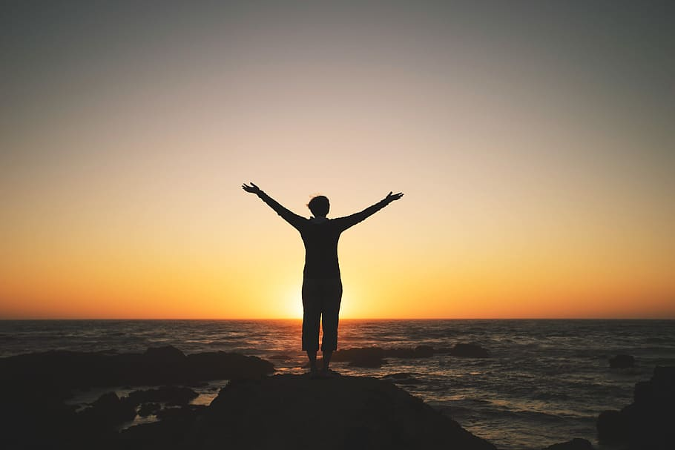
“In the Glorious Mysteries, we not only see the beautiful glory of God, but we see the incredible dream that God has for each one of us.
He wants us to live lives of incredible joy and purpose, and ultimately live with him for eternity.” dynamiccatholic.com

Slide 6
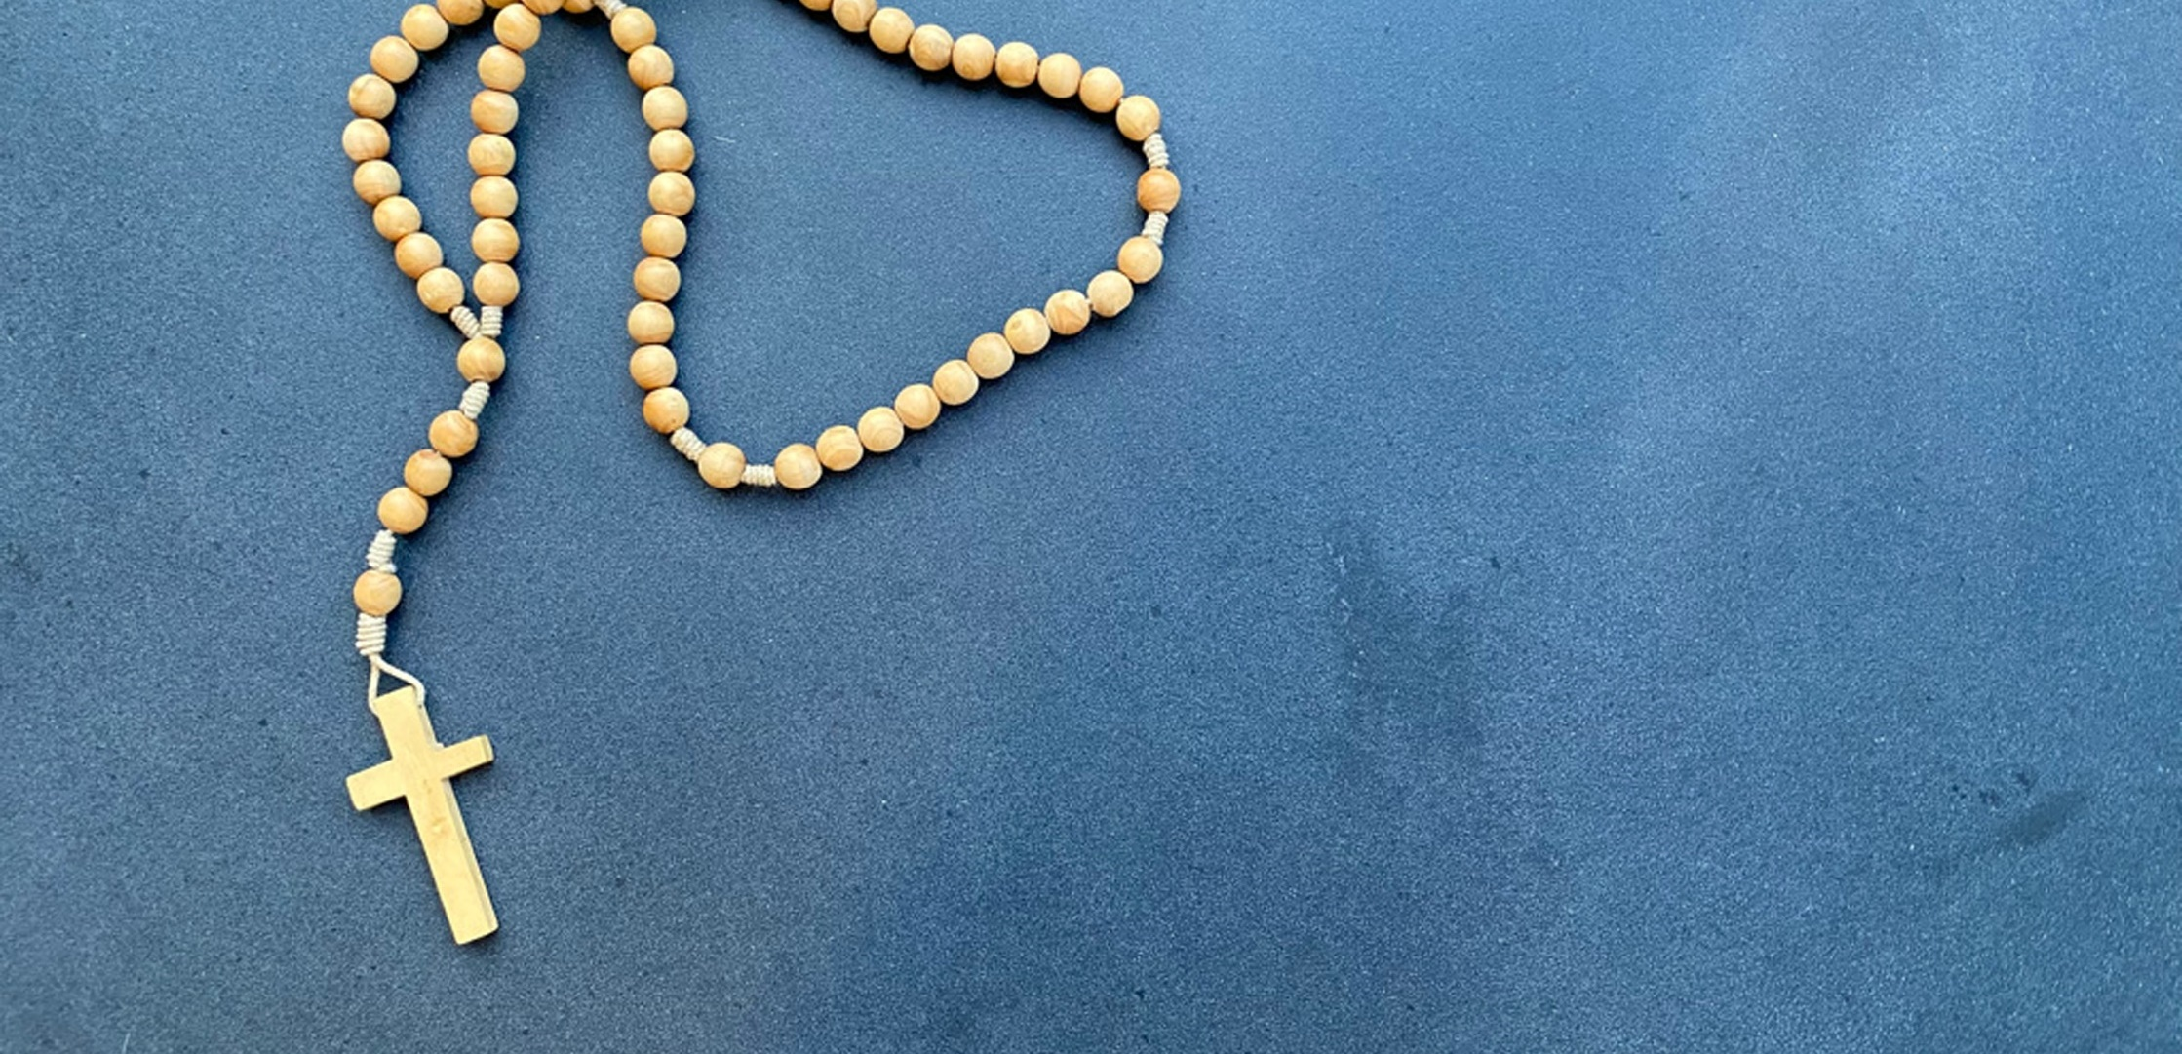
The First Glorious Mystery, The Resurrection of the Lord
John 20:1-23

Slide 7
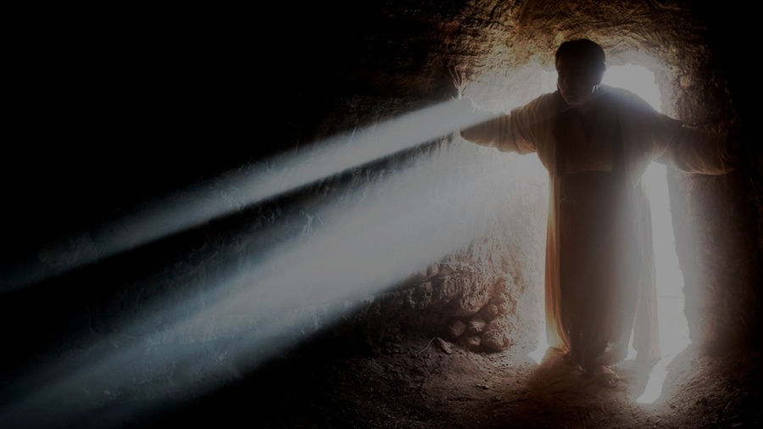
FAMILY CONVERSATION
What is the most important thing that has ever
happened to you?
How did that event change your life?
Jesus’ Resurrection from the dead is the most significant event ever written about in the entire Bible and in all of human history.
Why do you think the Resurrection is so important?
How do you think Jesus’
Resurrection changed the lives of Mary Magdalen,
the Apostles, and the other disciples?
Why is Jesus’ Resurrection important to you?
What does the Resurrection mean for you and your family?

Slide 8
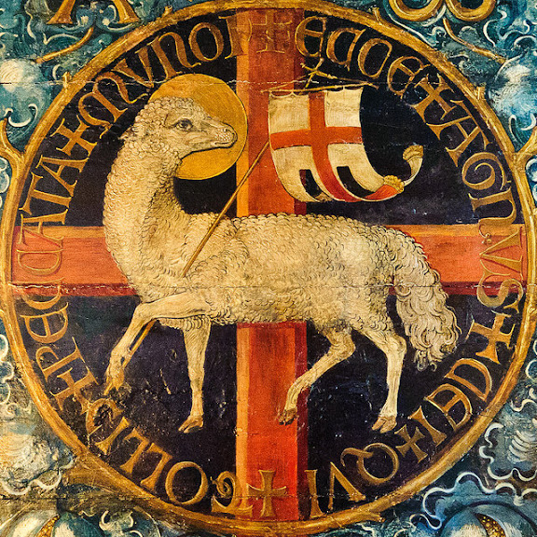
PASCHAL MYSTERY

Slide 9
PASCHAL CANDLE
&/or
Paschal Candle Chuck Knows Church
https://www.youtube.com/watch?v=GQjeYrx_-Cs
Catholic 101: The Paschal Candle
https://www.youtube.com/watch?v=edMubmM2HfU

Slide 10
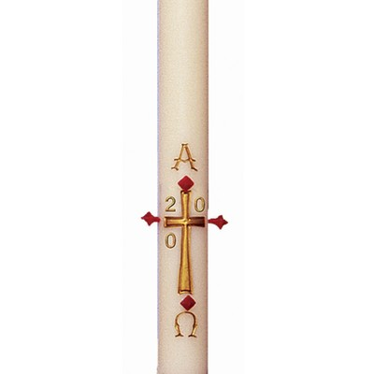
Your Family At-Home Mission is to:
1. Watch, together as a family, the video(s) that are appropriate for your children’s age level.
2. Read the 50 Ways to Celebrate the 50 Days of Easter with Your Children article.
3. Create your Family’s Plan for Living the Easter Season.
4. Place your Paschal Candle on your family’s home altar and pray together a decade of the Rosary meditating on the Resurrection of Jesus.
5. Light the candle each time you pray together during the Easter Season.
6. Lastly, please complete the Families Forming Disciples Family Survey.

Slide 11
CLOSING PRAYER

