Slide 1
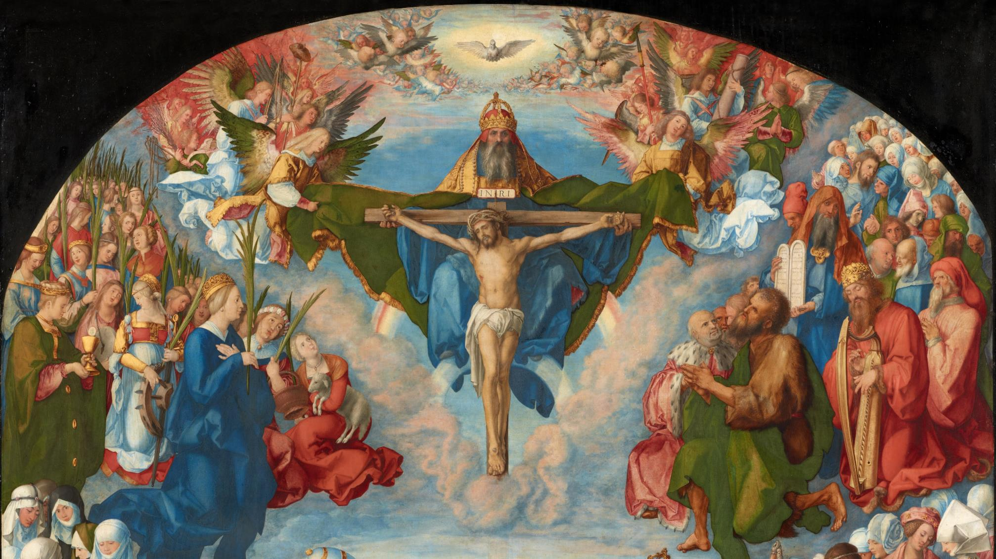
GOD’S SAVING LOVE FOR US:
LITURGY AND THE SEVEN SACRAMENTS

Slide 2
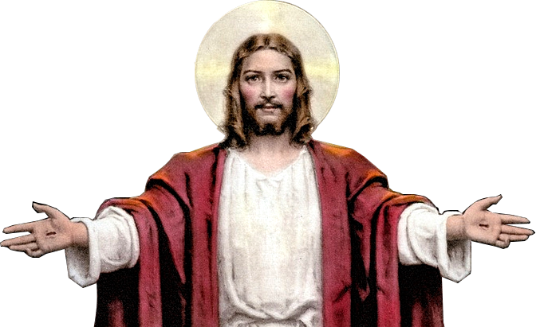
^{Opening Prayer}
Lord Jesus Christ, we entrust our family to You and ask for Your blessing and protection.
We love You Lord Jesus with all our hearts, and we ask that You help our family to become more like the Holy Family.
Help us to be kind, loving, and patient with one another.
Give us all the grace we need to become saints and Your faithful disciples. Amen.

Slide 3
^{Ice Breaker}
Please introduce yourselves
and state your
favorite
color, candy, or dessert!

Slide 4
Question?
What is the first part of the Bible called?

Slide 5
It is truly a blessing to welcome you to another year of
Families Forming Disciples!
Our hope is that you are journeying together as a family, growing closer to God and to each other.
God loves you and longs to live as part
of your family.
He calls you to be a Domestic Church!

Slide 6
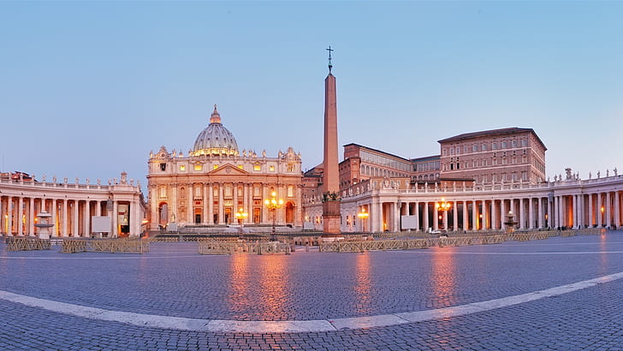
CATHOLIC

Slide 7
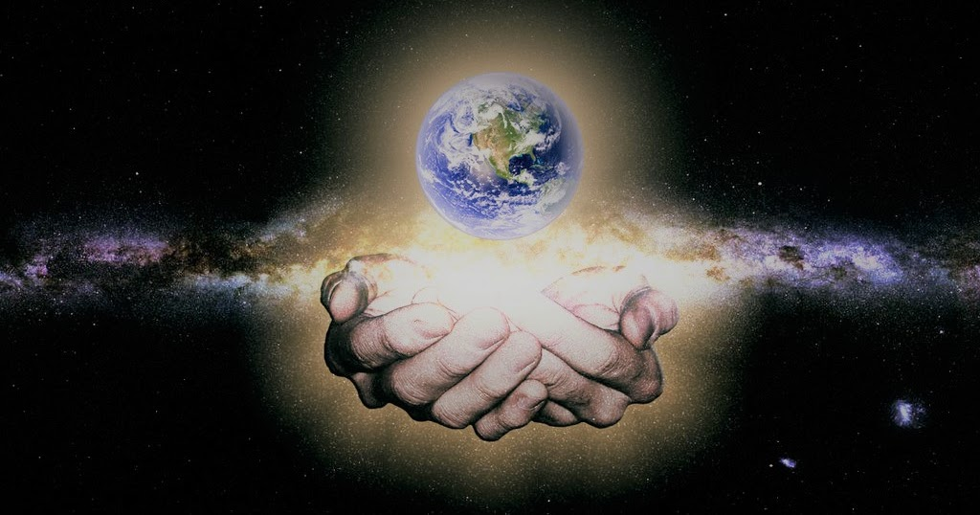
UNIVERSAL

Slide 8
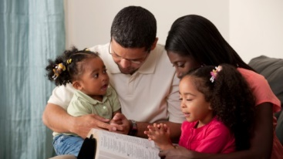
DOMESTIC

Slide 9
https://www.youtube.com/watch?v=d4aPfMzY1hs

Slide 10
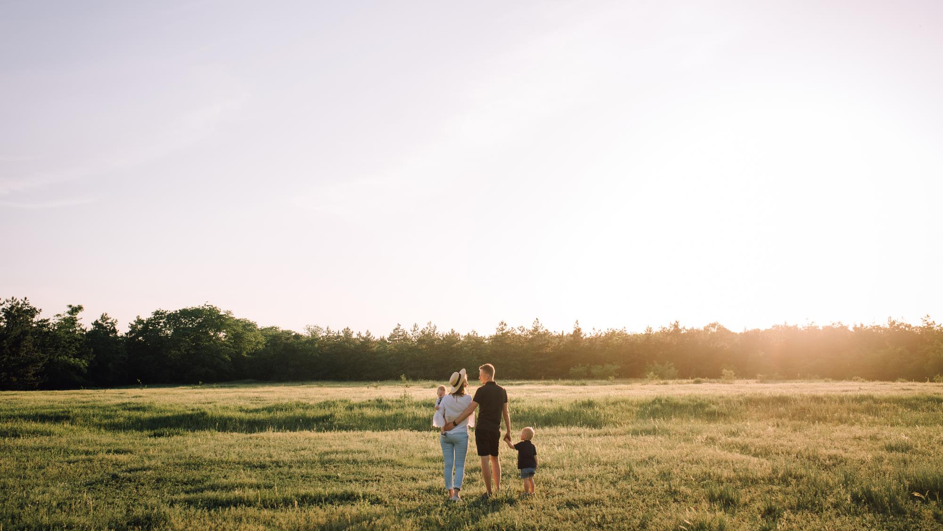
CONTENT
Both the Domestic Church and the Universal Church need one another, because there is no Domestic Church without the Universal Church, and the Universal Church cannot grow without the Domestic Church!

Slide 11
FAMILY CONVERSATION
Being a Domestic Church is,
more often than not,
about showing love in ordinary ways. Though these simple ways may not always seem significant to us,
they are highly valued and beautiful to God.
Name ordinary ways that you love, cherish and sacrifice for one another, as well as how you show forgiveness to one another in your family.

Slide 12
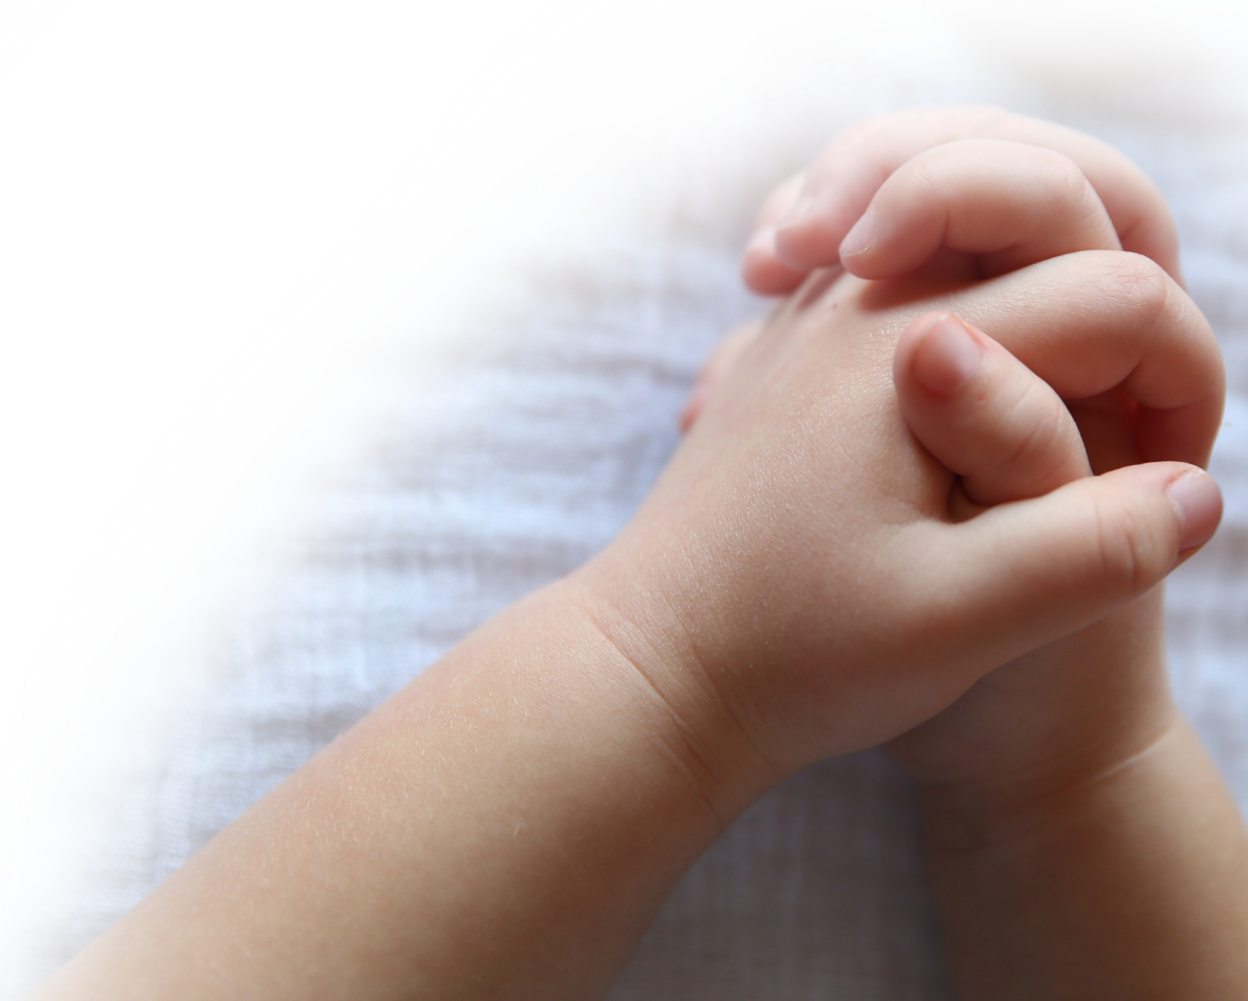
FAMILY PRAYER
1.Parent lights candle. 2. Family members share their special intentions for which they want to pray.
3. Families pray, The Holy Family: Building the Domestic Church Prayer below.
4. Families take their candles home and place them on their home altars to be used for family prayer!
Heavenly Father,
Thank you for the gift of our family!
Enlighten our hearts and minds that we may live more fully this vocation to love.
In our daily life and work, may we reflect the self-giving love which You, O Father, eternally show with
Your Son and the Holy Spirit.
Let your love be evident in the peace that reigns in our home and in the faith we profess and live.
May our family always be a place of generosity, understanding, forgiveness and joy.
Kindly give us the wisdom and courage to be witnesses to Your eternal design for the family;
and grant that the Holy Family of Nazareth may always guide our path to holiness as a family.
We ask this through our Lord Jesus Christ, your Son, who lives and reigns with You
in the unity of the Holy Spirit, God forever and ever. Amen. Hail Mary, …
(adapted from Knights of Columbus Family Prayer)

Slide 13
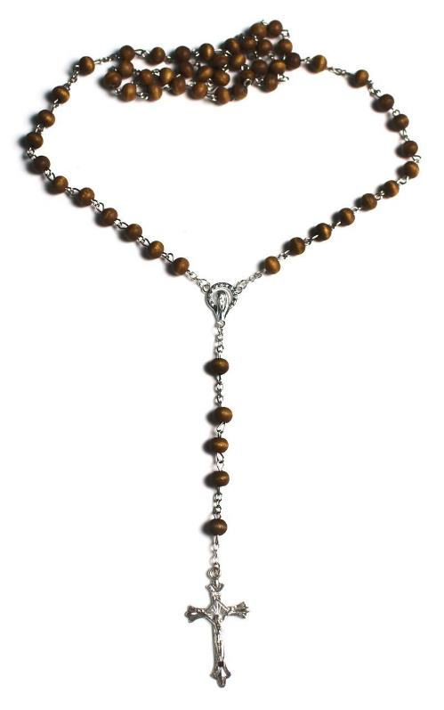
Your FAMILY At-Home MISSION
Watch the videos about the sacraments.
Reach out to a grandparent(s) or senior adult(s) in your family/ community and ask them:
Which sacrament do you remember the best and why?
Which sacrament were you the most excited about receiving and why?
Which sacrament has helped you the most and why?
III. Your family is called to be the Domestic Church and to be holy! Enjoy making Holy Halo Treats together!
IV. Place your blessed votive candle on your home altar/prayer space, and as a family, pray a decade of the Rosary in honor of
Mary’s birthday during the month of September!

Slide 14
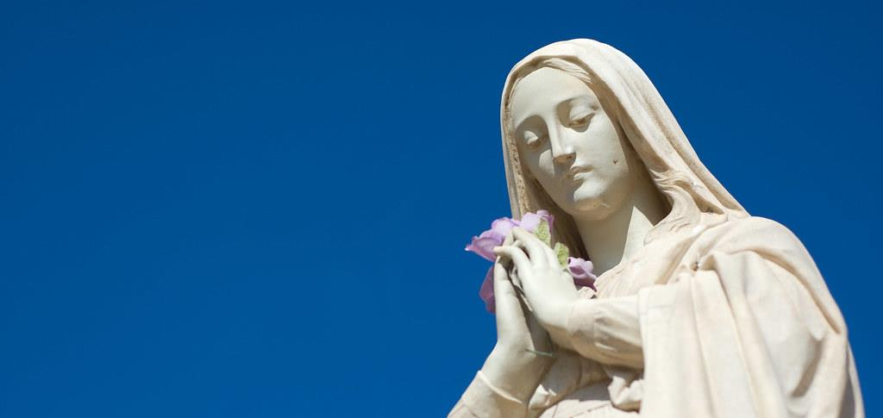
CLOSING CELEBRATION
The Feast of the
Nativity of the Blessed Virgin Mary
is celebrated
each year on the eighth of September.
Today we are going to celebrate both our Mother Mary’s birthday,
and the beginning of our
Families Forming Disciples Year!!!

