Slide 1
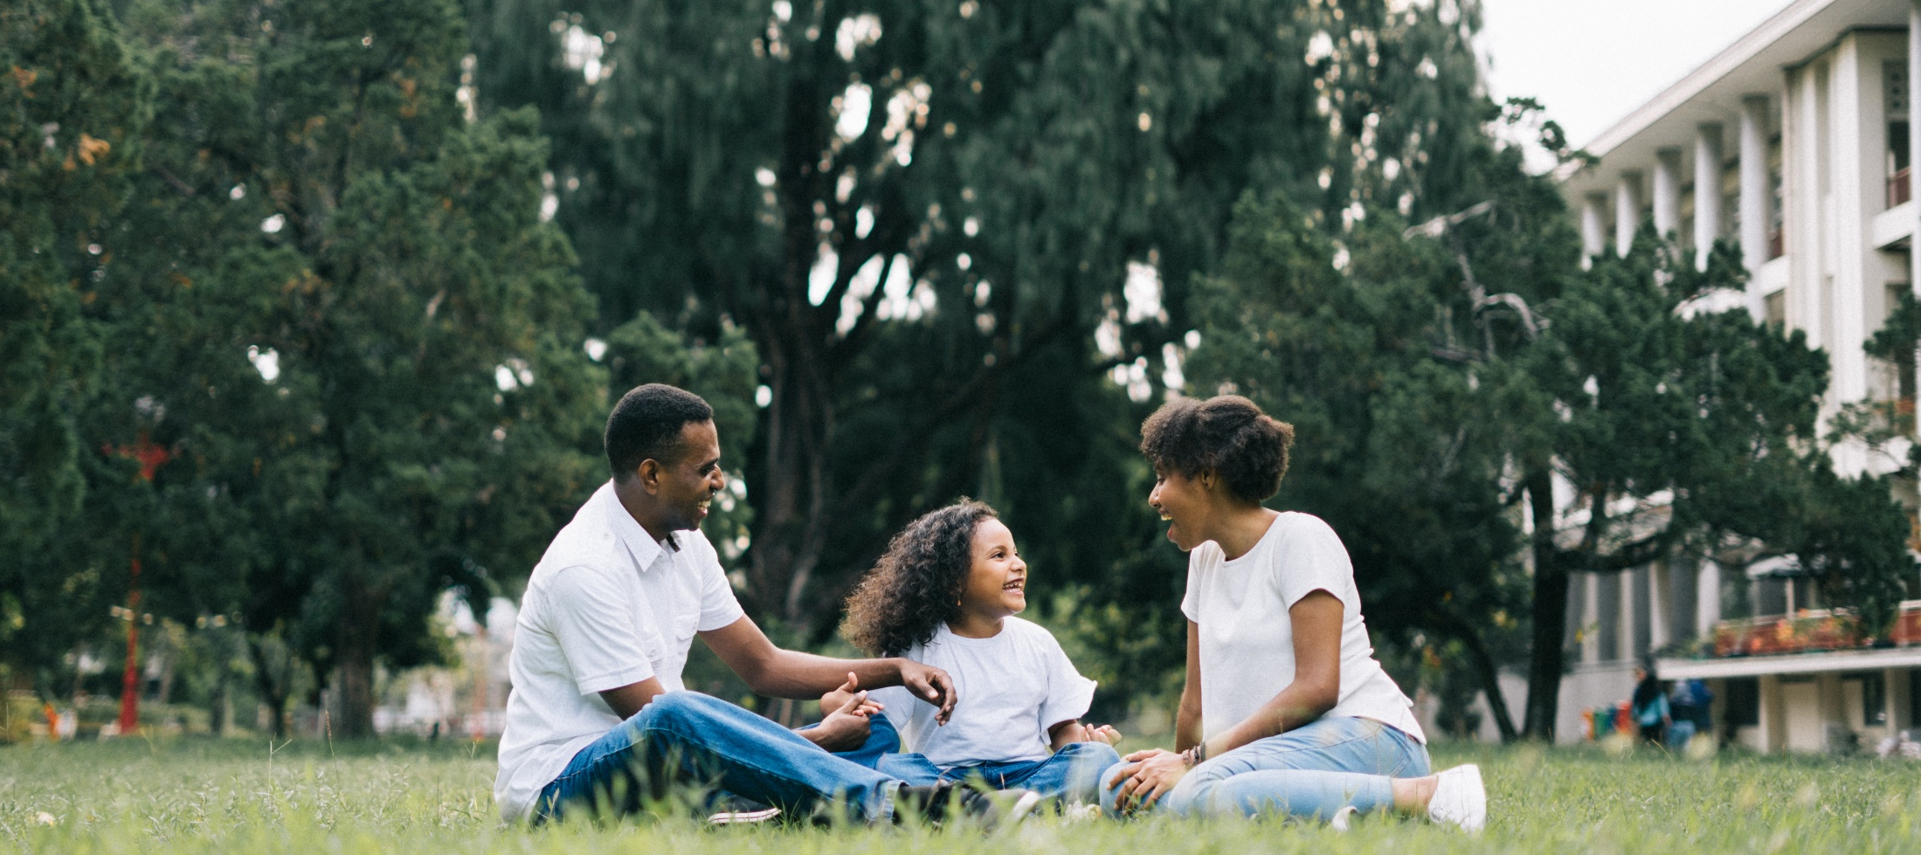
^{Families Forming Disciples}
Lesson 1 - Week 3
Topic: The Domestic Church & Parents as the Primary Educators of the Faith

Slide 2
^{Opening Prayer}
^{We bless your name, O Lord,}
for sending your own incarnate Son,
^{to become part of a family,}
^{so that, as he lived its life,}
he would experience its worries and its joys.
^{We ask you, Lord,}
to protect and watch over this family,
so that in the strength of your grace
its members may enjoy prosperity,
possess the priceless gift of your peace,
and, as the Church alive in the home,
bear witness in this world to your glory.
We ask this though Christ our Lord.
^{Amen.}
Catholic Household Blessings & Prayers © 2007, USCCB Publishing. All rights reserved.
Used with permission of the International Commission on English in the Liturgy Corporation.

Slide 3
^{Ice Breaker}
^{Use option not used in Week 1}
^{Option 1: Childhood Dream}
Ask the participants to share their childhood dream (what they want/wanted to be or do when they grow/grew up) and then ask them to reflect on how this correlates with their current aspirations (if applicable). Depending on the time and amount of people in the group you may ask them just to give you one-word responses, like astronaut, ballerina, teacher, etc.
^{Option 2: The Time Machine}
Ask the participants the following question(s): “If you were able to travel through time, what time period would you want to visit and why? If there was a person you would go back in time to meet, who would it be, and why?”

Slide 4
Concept Review
^{The Domestic Church and}
^{parents as primary educators.}

Slide 5
Families share their experiences
Each family will state their names
^{Show their prayer corner}
Explain why they chose the items they have placed on their home altar

Slide 6
Large group sharing
Large group shares about their experiences doing the Mission Activity
• What was it like to put together your prayer ^{corner?}
• What new things did you learn about your family when you made your home altar?
• How does having a prayer corner in your home bring you closer to God and closer to ^{one} ^{another?}

Slide 7
Next Meeting Date and Time

Slide 8
^{Close in Prayer}
Thank you, Father, for having created us and given us to each other in the human family. Thank you for being with us in all our joys and sorrows, for your comfort in our sadness, your companionship in our loneliness. Thank you for yesterday, today, tomorrow and for the whole of our lives. Thank you for friends, for health and for grace. May we live this and every day conscious of all that has been given to us.
^{Amen.}
From The Catholic Prayer Book, compiled by Msgr. Michael Buckley

