Slide 1
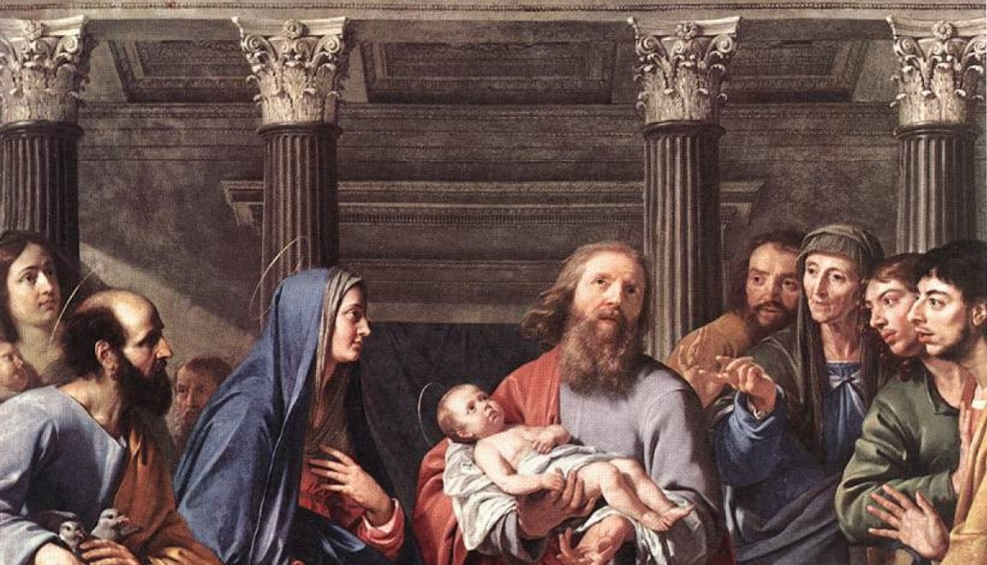
THE LIFE OF CHRIST: THE JOYFUL MYSTERIES
THE PRESENTATION IN THE TEMPLE

Slide 2
^{Opening Prayer}
Lord Jesus Christ, we entrust our family to You and ask for Your blessing and protection. We love You Lord Jesus with all our hearts and we ask that You help our family become more like the Holy Family. Help us to be kind, loving, and patient with one another. Give us all the grace we need to become saints and Your faithful disciples.
Amen.

Slide 3
^{Ice Breaker}
GREET LIKE A FRIEND!
First, form groups of about 8 people each. (Two or more families could be combined.)
Next, everyone greets each person like a stranger.
Then everyone greets each person like a friend!

Slide 4
Question?
Where did Joseph and Mary take baby Jesus when he was 40 days old?

Slide 5
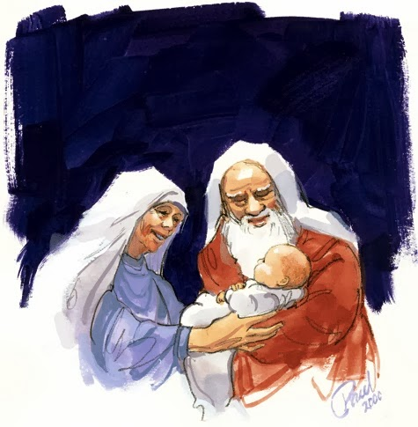
INTRODUCTION
Today we are going to learn about the Fourth Joyful Mystery of the Rosary, the Presentation in the Temple.
It is a moment in the life of Jesus, when he was forty days old and his parents took him to the temple and were greeted by Simeon and Anna.

Slide 6
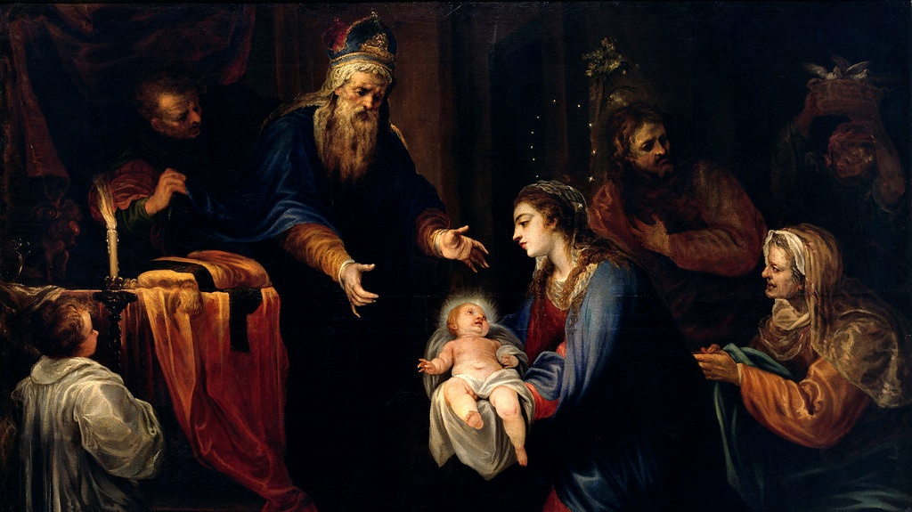
LUKE 2:22-40

Slide 7
VIDEO
https://youtu.be/UfZsL5EYW3E

Slide 8
Presentation in the Temple
Questions
1. Why did Mary and Joseph have to take Jesus to the temple?
2. What did God promise Simeon?
3. How did God keep His promise?
4. What did Simeon do when he saw Jesus?
5. Who was Anna?
6. What did she do when she saw Jesus?
7. Simeon told Mary, “Behold, this child is destined for the fall and rise of many in Israel, and to be a sign that will be contradicted (and you yourself a sword will pierce) so that the thoughts of many hearts may be revealed.” When Jesus grew up, how did this prophecy come true? How did a “sword” pierce Mary’s heart?

Slide 9
FAMILY CONVERSATION
In Luke 2:32 we read Simeon’s words that Jesus is a “light for revelation to the Gentiles, and glory for your people Israel.”
How is Jesus a light in your life today? How is Jesus a light in your family’s life?
Jesus calls us to love one another more deeply by sacrificing for one another and forgiving each other.
What moments of love and forgiveness has your family shared? How does Jesus bring your family closer together?

Slide 10
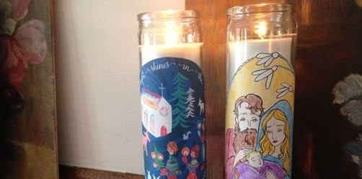
FAMILY ACTIVITY

Slide 11
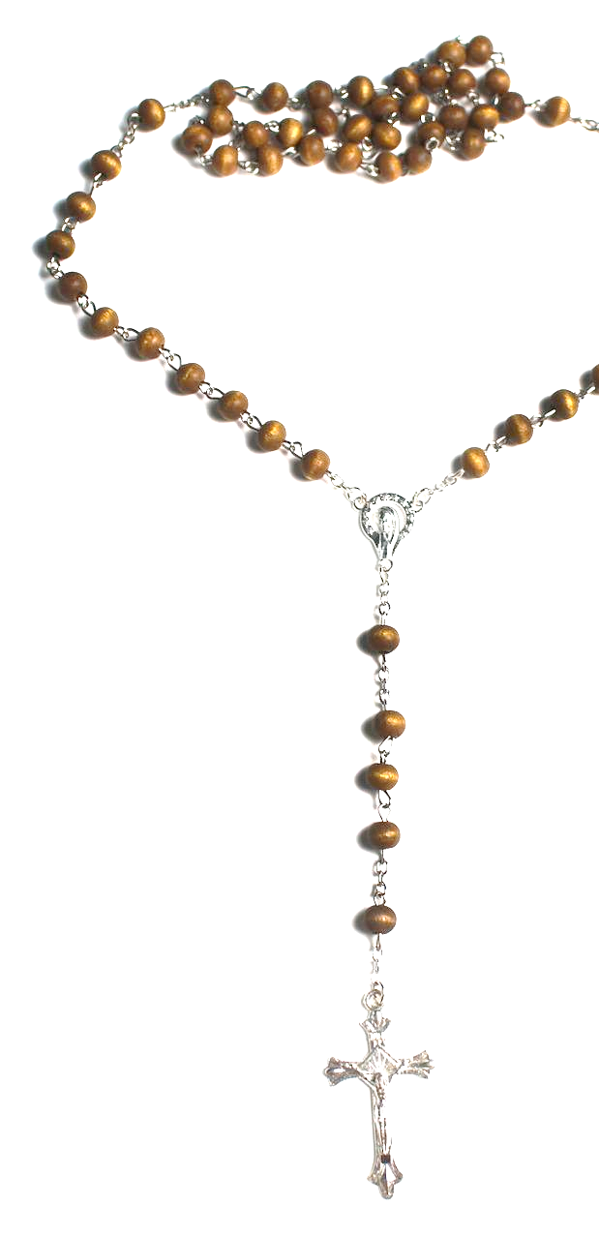
FAMILY MISSION
This is the month of the Rosary, so place your family rosary and/or your Jesus Is Our Light candle on your home altar next to your family bible.
On November 1st, All Saints Day, we celebrate and show God that we are grateful for the saints who are in Heaven and for all the help they give us.
Watch some or all of the videos on Week 2’s Family Guide
On November 2nd, All Souls Day, we pray for our loved ones who have died as well as for all those who are in Purgatory waiting for us to pray for them, so they too can go to Heaven and finally be with God forever!
Find a picture of a family member or friend of the family who has died that you would like us all to pray for during Week 3 and on All Soul’s Day, or draw a picture of that person if you don’t have a photo. Place the photo or picture on your home altar/prayer corner. (This can be the same person that you prayed for last year, or you can add as many people as you want.) Bring the picture to the Week 3 gathering.
Be ready to share about who the person is, and why he/she is important to your family. Also, did that special person have a favorite saint? Do you have a favorite saint? Why is that saint your favorite?
Gather in your prayer space/around your home altar as a family. Take a moment to be silent with God together, and say a prayer for your family member or family friend, and for one another. Then end by praying a decade of the Rosary together while meditating on the Presentation in the Temple or use the video to pray the Joyful Mysteries.

Slide 12
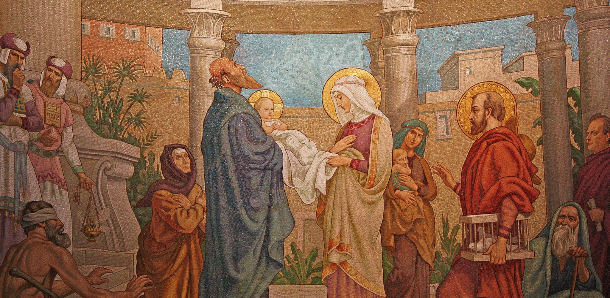
CLOSING PRAYER
O Lord, teach our family to embrace our responsibilities and fulfill them faithfully as Mary and Joseph did from the very beginning when they presented the baby Jesus to You in the temple.
Help us to be obedient and faithful to You. Grant us peace in everything we do to live our Catholic faith. Give us Your grace to do our best for You. Amen

