Slide 1
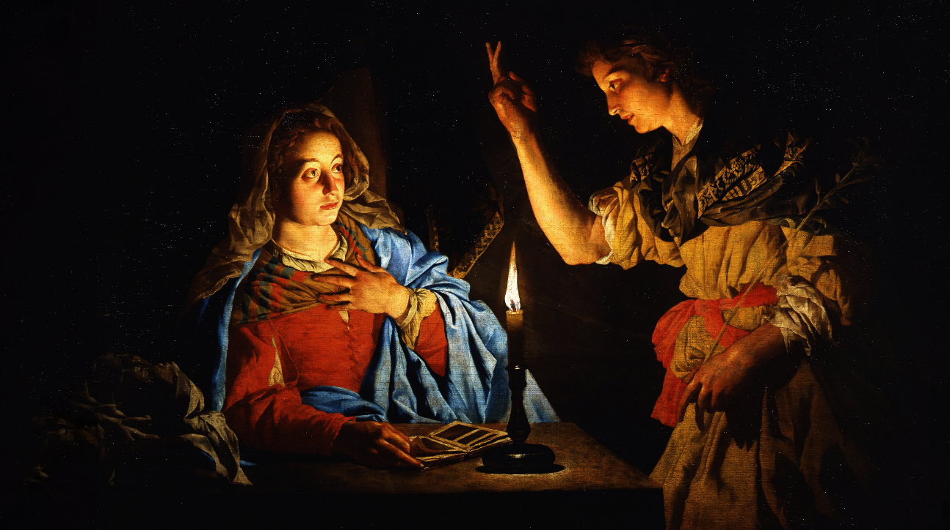
FAMILIES FORMING DISCIPLES
MARY & ISREAL

Slide 2
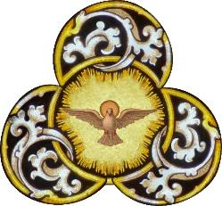
^{Opening Prayer}
Prayer to the Holy Spirit
Come, Holy Spirit, fill the hearts of Your faithful and kindle in them the fire of Your love. Send forth Your Spirit and they shall be created. And You shall renew the face of the earth.
O God, by the light of the Holy Spirit, You have taught the hearts of Your faithful. In the same Spirit help us to do what is right and always rejoice in His consolation. We ask this through Christ our Lord.
Amen.

Slide 3
^{Ice Breaker}
Face to Face
Set Up: Gather enough chairs for each person and set them up facing each other. Prepare the conversation topics ahead of time and place them in a box for the caller to hold.
How to Play: Family members will pair up and sit across from each other. When the caller calls out the topic, each team of two will have 30 seconds to discuss the answer. When the 30 seconds is up, the caller will tell the teams to switch partners and once everyone has a new partner the play will begin again with a new topic to discuss. Once all four questions have been discussed the game is over.
Ask questions appropriate for the age group. Some example topics could be:
1) “If you could create your own subject in school, what would it be?”
2) “If you could meet a saint, who would it be and why?”
3) “What is your favorite sandwich creation?”
4) "What is your favorite place to eat?"
Adapted from kidactivities.net

Slide 4
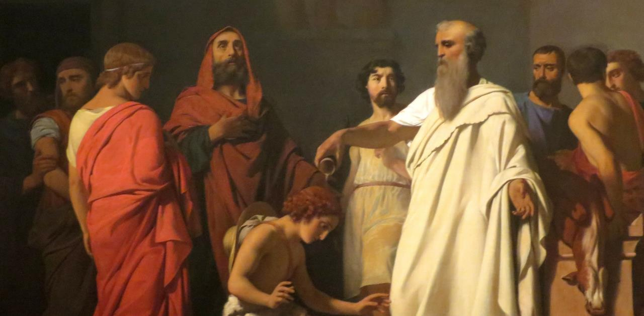
Question?
Does anyone remember what Samuel of the
Old Testament’s
job was?

Slide 5
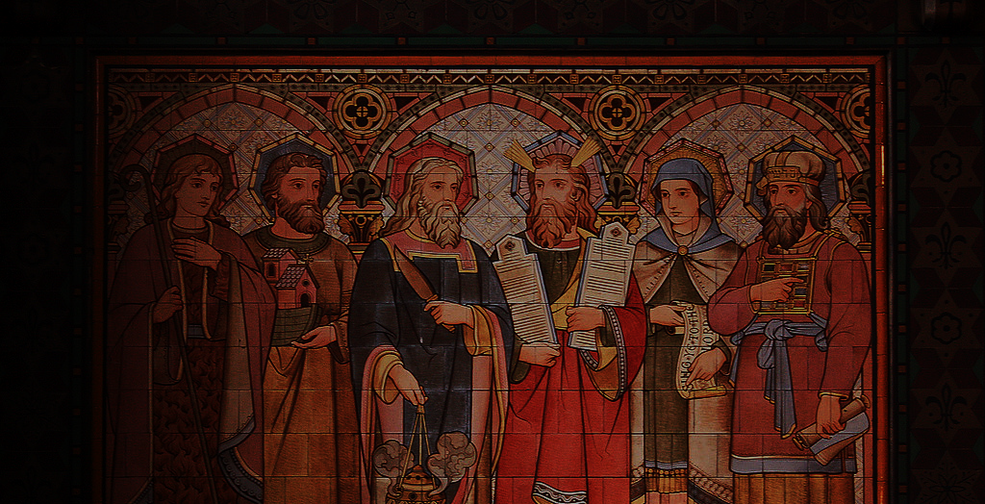
Answer:
PROPHET
Who are the Old Testament
PROPHETS?

Slide 6
Watch: Prophets | Catholic Central
https://youtu.be/1g1gByYQJZA

Slide 7
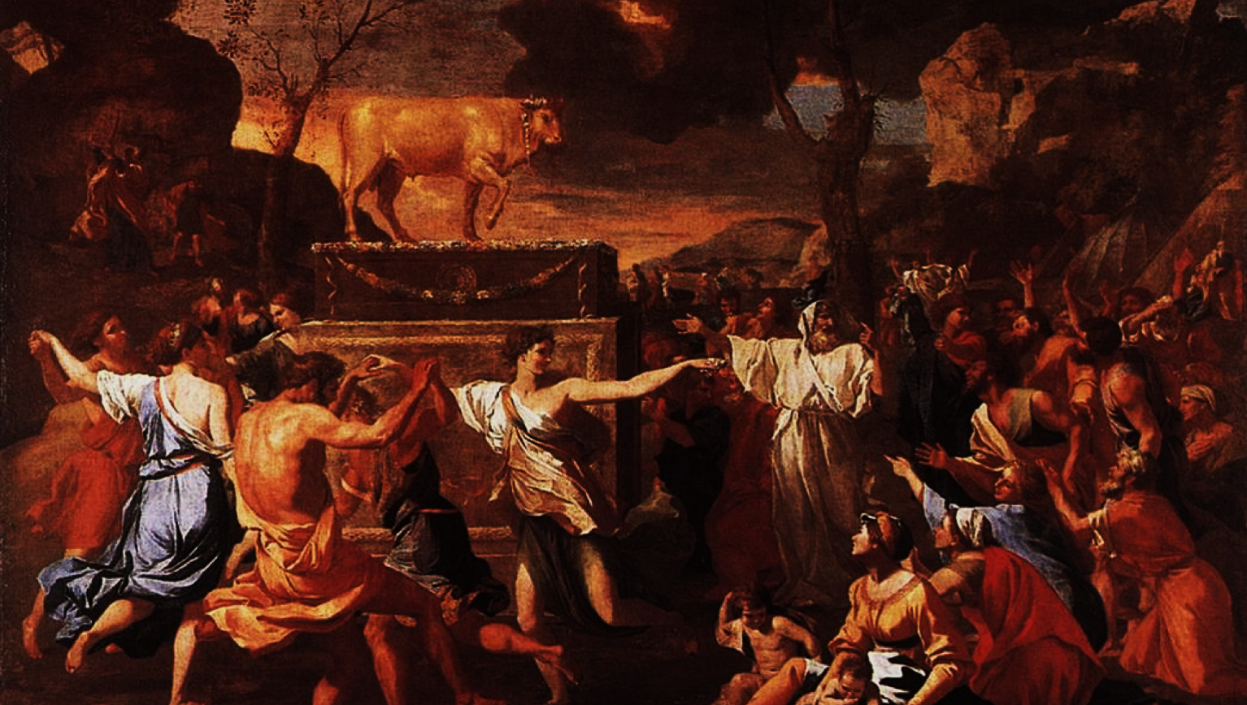
Many times throughout their history the ancient Israelites worshipped false gods and broke their covenant promises with God.

Slide 8
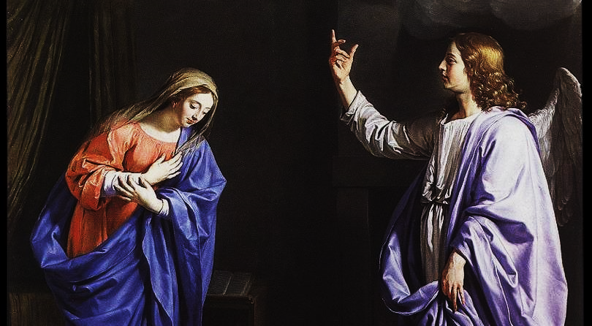
THE ANNUNCIATION
Be it done
Unto me
According to
Thy word.
Luke 1:38

Slide 9
Why does Mary have so many titles?
^{https://youtu.be/bKiO288PZmU}

Slide 10
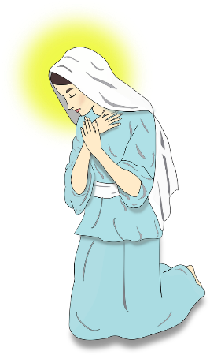
Mary Has Many Titles…
Let’s read the Bible!
Queen of Heaven
Mother of God
Mary, Star of the Sea
Mother of Perpetual Help
Spouse of the Holy Spirit
Help of Christians
Mother of Mercy
Cause of Our Joy
In addition to these titles, there are more included in the
Litany of the Blessed Virgin Mary that you were given.
Read through the titles and choose which one is your favorite.
Then discuss why you like that title the most.

Slide 11
FAMILY MISSION
1. Introduce Mission Activity
2. Explain Activity:
Since we are still in the Easter Season, be prepared to share about how your Living-the-Easter-Season Family Plan is going. Which activities are your favorite so far and why?
Together as a family watch the videos about Mary, the Ark of the Covenant.
Place a Mary statue or your Annunciation Prayer Craft and a candle on your home altar. Then together pray the Litany of the Blessed Virgin Mary.
Complete the Families Forming Disciples Family Survey

Slide 12
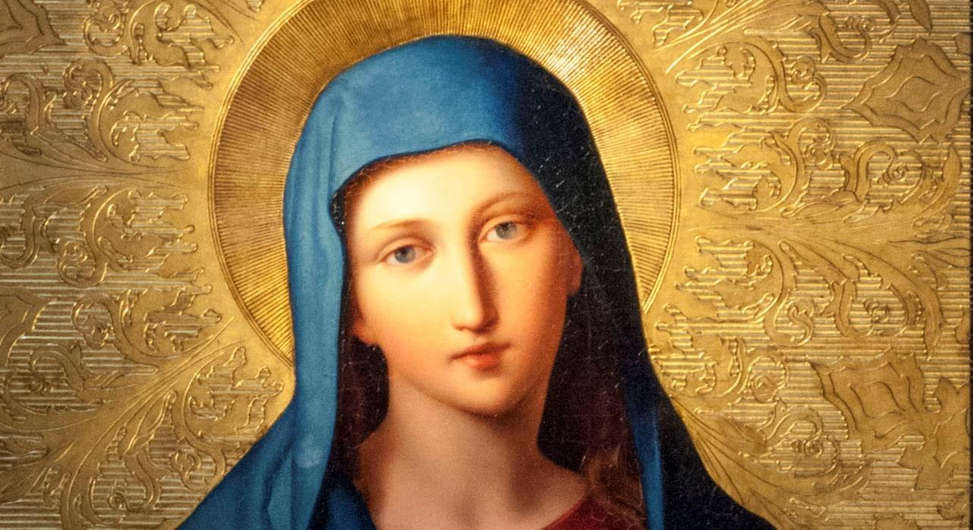
Together pray
the
Litany of the
Blessed Virgin Mary
(Litany of Loreto)

